Slide 1
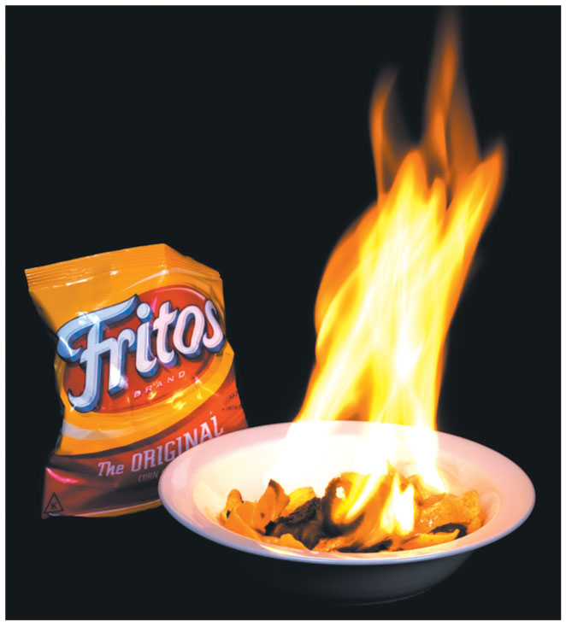
Chapter 11

Slide 2
Conical Pendulum
A 1 m massless string has a 10 kg ball at the end and swings in a circle at an angle $θ=$30 degrees from the vertical as seen on TV.
What is the net torque on the ball about the other end of the string?
What is the speed of the ball?
$$θ$$

Slide 3
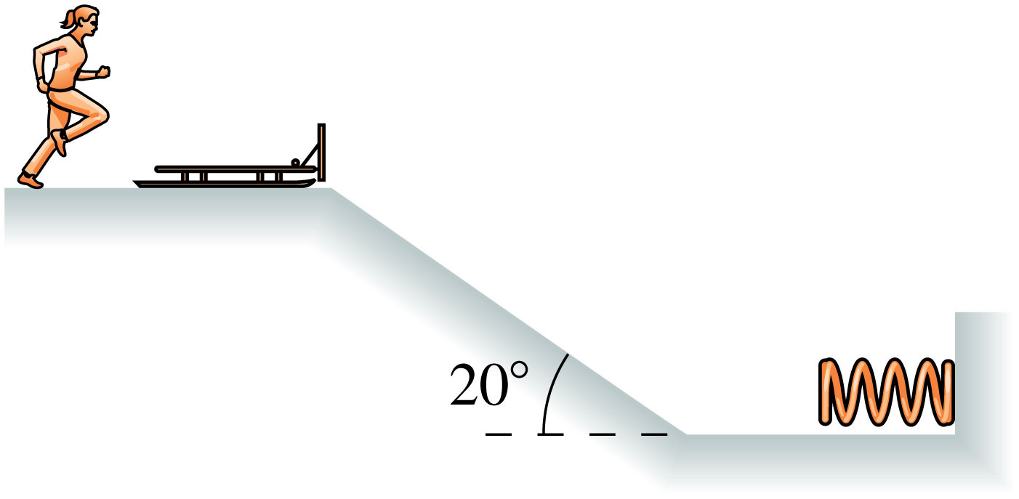
A 70 kg girl going 5 m/s jumps on a 20 kg sled at rest and then slides down a ramp with friction $μ_{k}=.1$ that is 5 m long. How far in does she compress the 1000 N/m spring at the bottom?
$$\frac{1}{2}mv_{i}^{2}+mgh_{i}+\frac{1}{2}kx_{i}^{2}=\frac{1}{2}mv_{f}^{2}+mgh_{f}+\frac{1}{2}kx_{f}^{2}+F_{f}d$$
$$\frac{1}{2}mv_{i}^{2}+mgh_{i}=\frac{1}{2}kx_{f}^{2}+F_{f}d$$
frictionless
Notes:
FIGURE P10.68

Slide 4
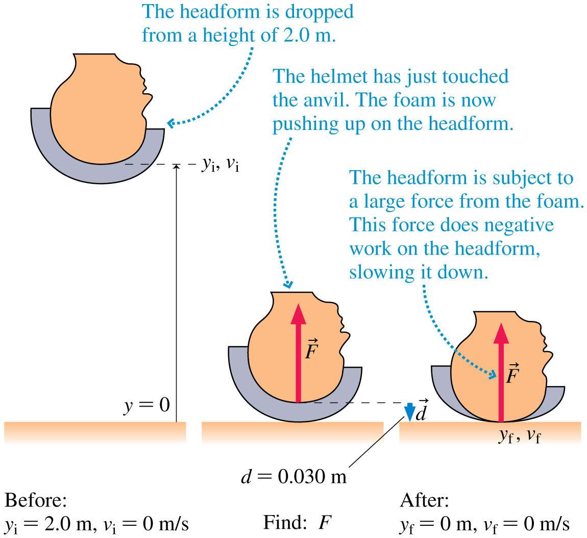
Quiz question 0
Notes:
FIGURE 10.30

Slide 5
Types of Kinetic Energies
Notes:
Chapter Summary 2

Slide 6
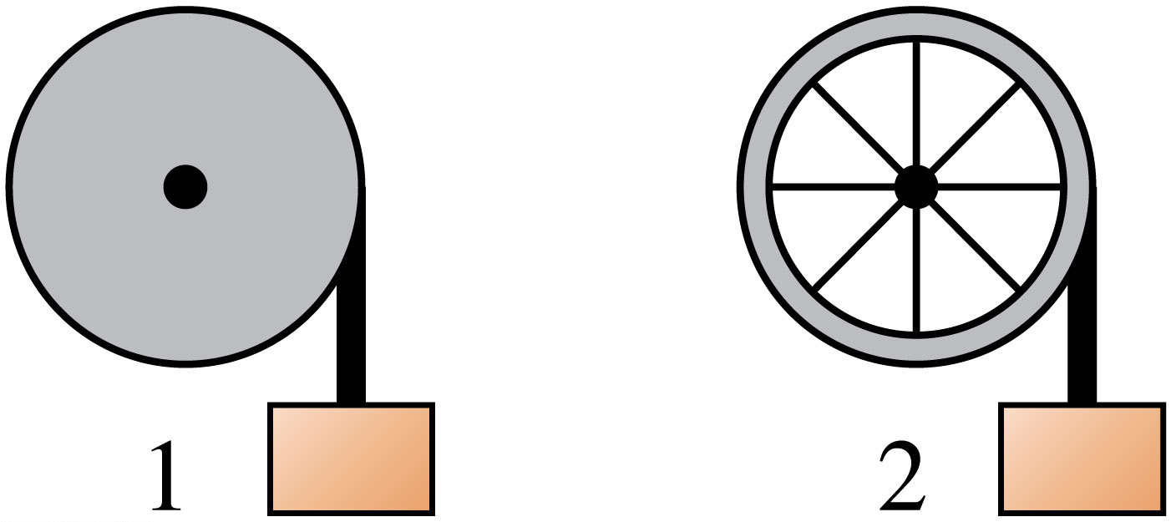
Quiz question 1
Which block will reach the ground first?
Notes:
FIGURE Q10.20

Slide 7
Power is energy per time
Watts - $\frac{\text{J}}{\text{s}}$ 1 H.P. = 760 watts
What about kW hrs ??
Notes:
Chapter Summary 5

Slide 8
Energy transformation
$$∆E_{\text{th}}=W−∆U$$
$$=100\text{J}−\text{75}\text{J}$$
$$=\text{25}\text{J}$$
Notes:
FIGURE 11.1

Slide 9
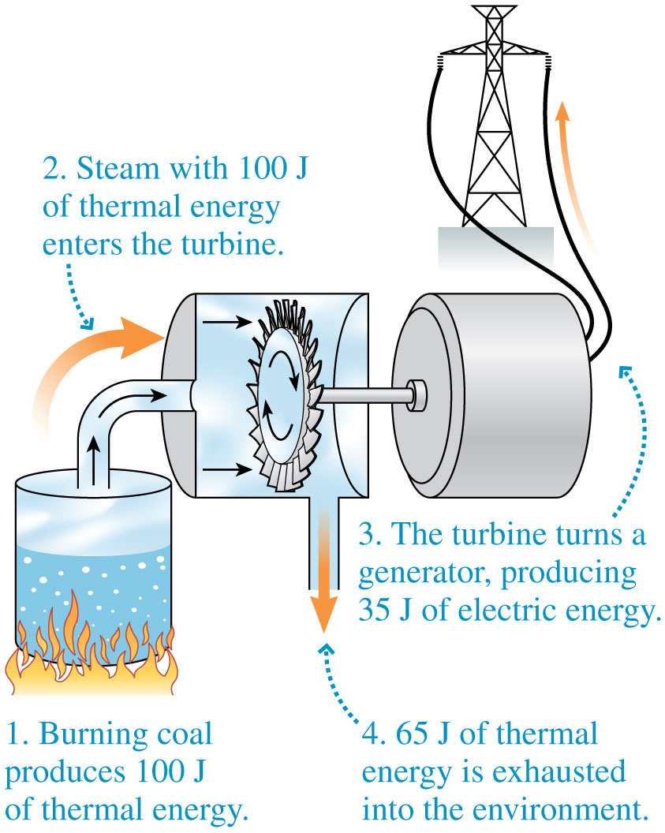
Limits to efficiency
$$e=\frac{\text{what} \text{you} \text{get}}{\text{what} \text{you} \text{had} \text{to} \text{pay}}$$
$$e=\frac{\text{35}\text{J}}{\text{100}\text{J}}$$
Notes:
FIGURE 11.1

Slide 10
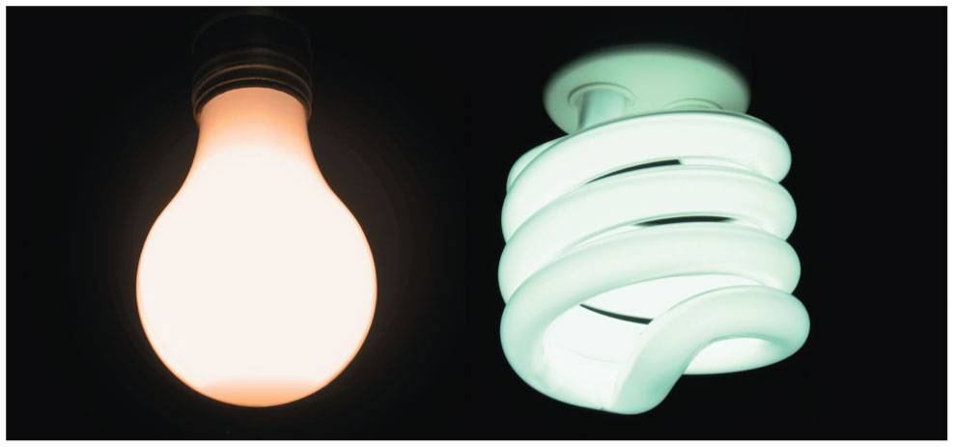
Let’s clean house
$$e=\frac{3\text{J}}{75\text{J}}$$
$$e=\frac{3\text{J}}{15\text{J}}$$
How exactly is it more efficient?
Notes:
FIGURE 11.3

Slide 11
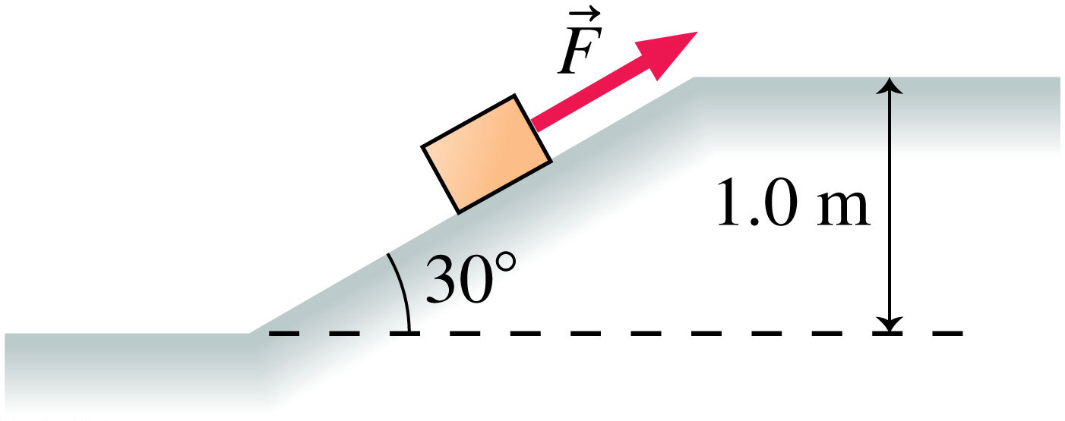
Quiz question 2
How far did you have to push this box to get it up the hill?
Notes:
FIGURE P10.59

Slide 12
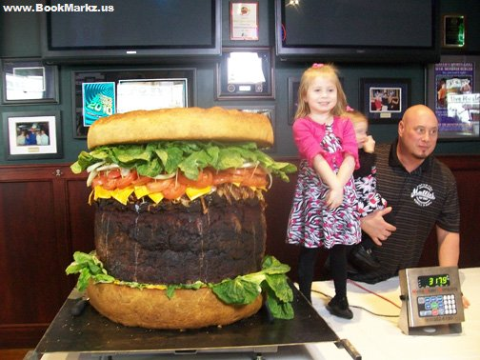
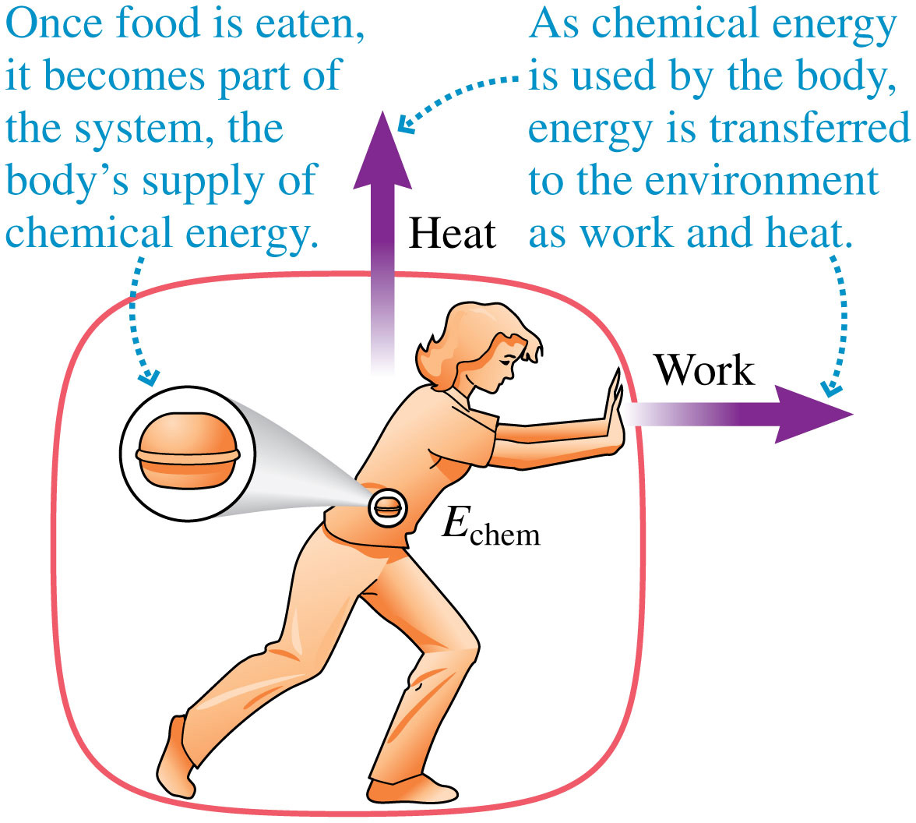
Affluent nation yes
Notes:
FIGURE 11.4

Slide 13
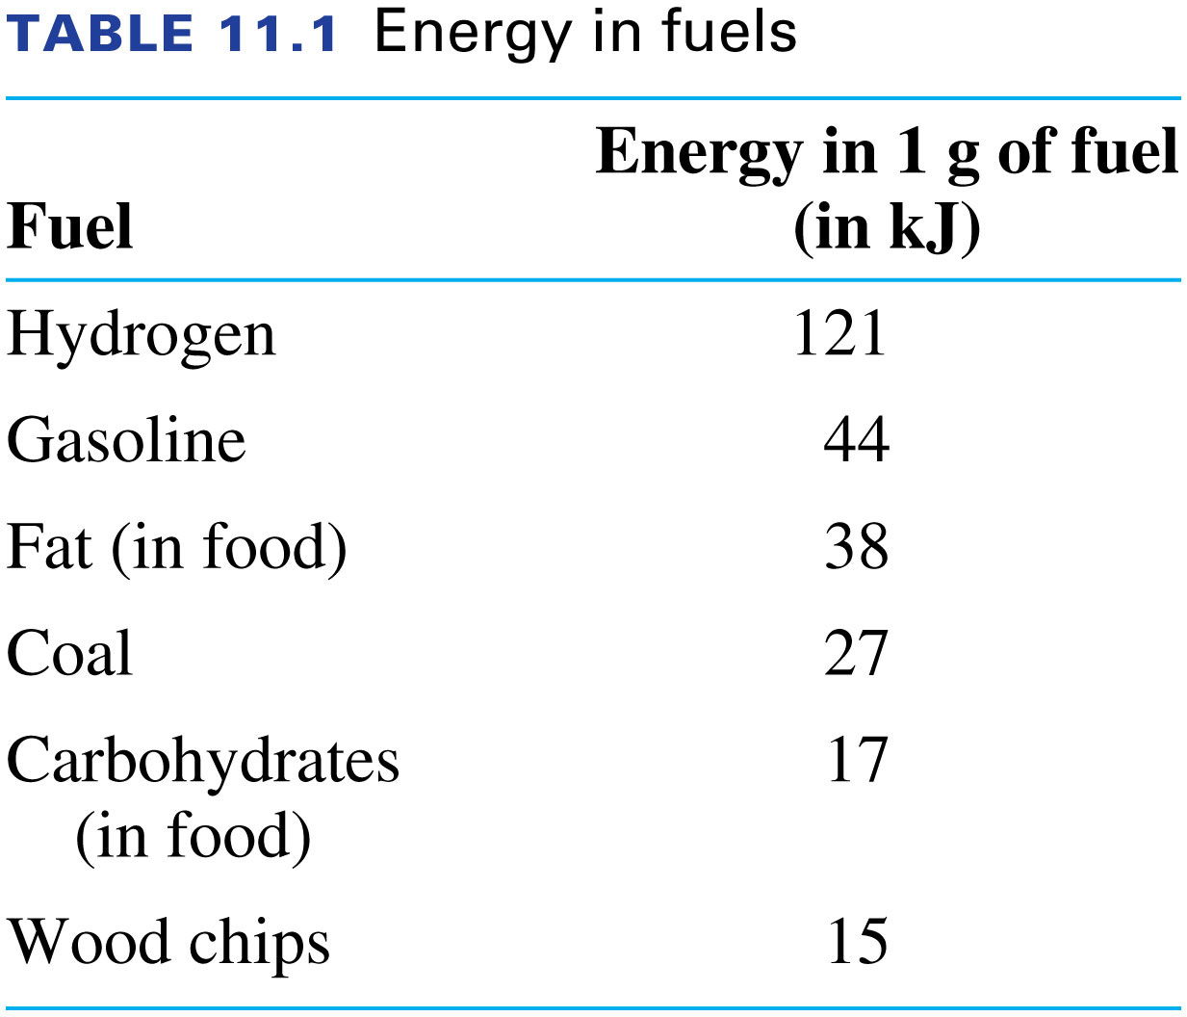
C
Notes:
TABLE 11.1

Slide 14
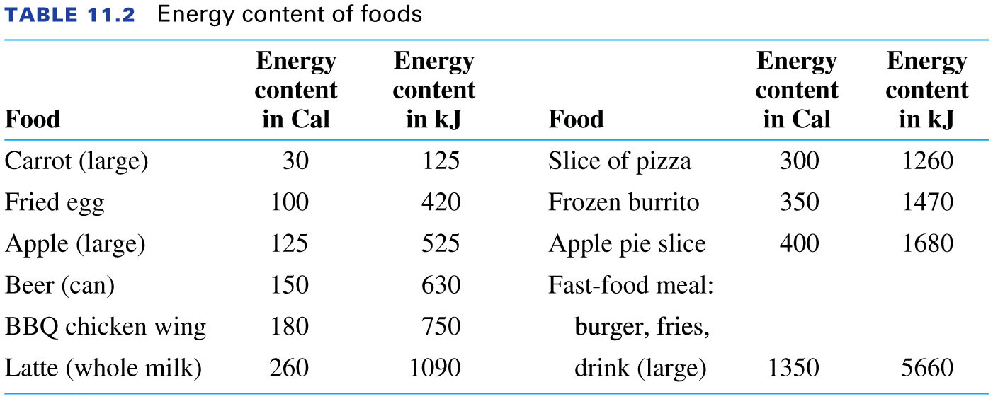
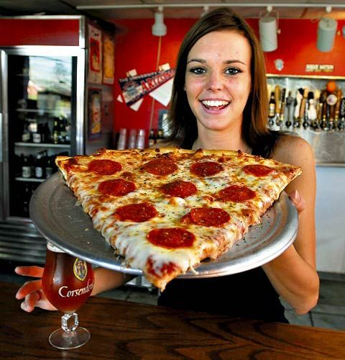
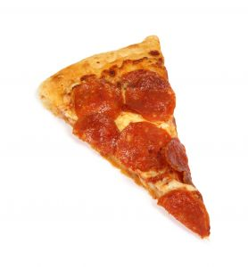
Where’s the FDA in the Mom n’ Pop joints?!?
Notes:
TABLE 11.2

Slide 15
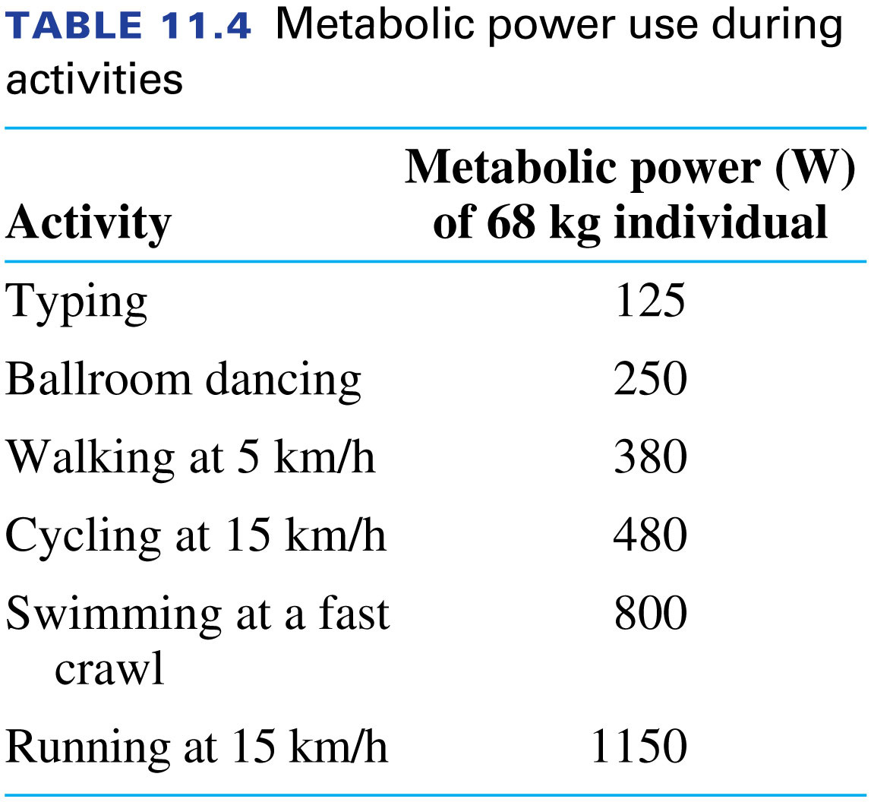
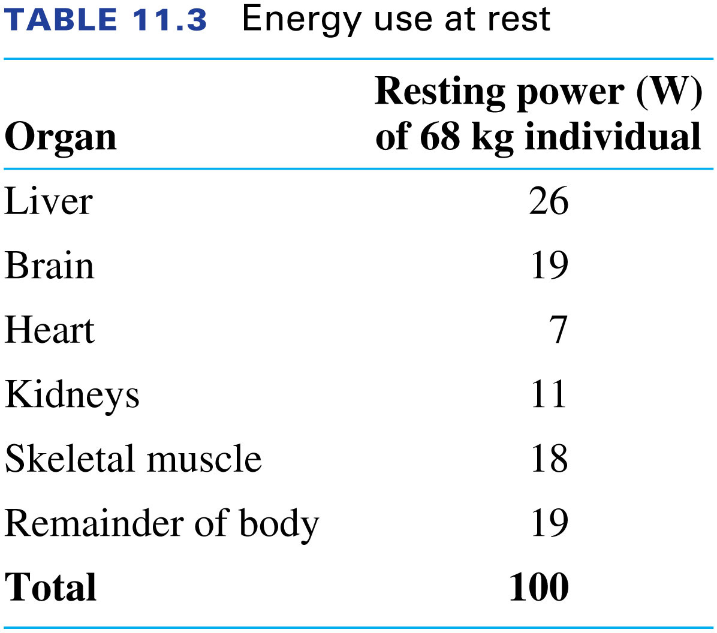
Quiz question 3
How many frozen burritos do you need for 2 hours of typing while swimming, followed by a 200 min. nap ?
Notes:
TABLE 11.3

Slide 16
$$PV=nRT$$
Good enough for now
Close but no cigar
Notes:
FIGURE 11.8

Slide 17
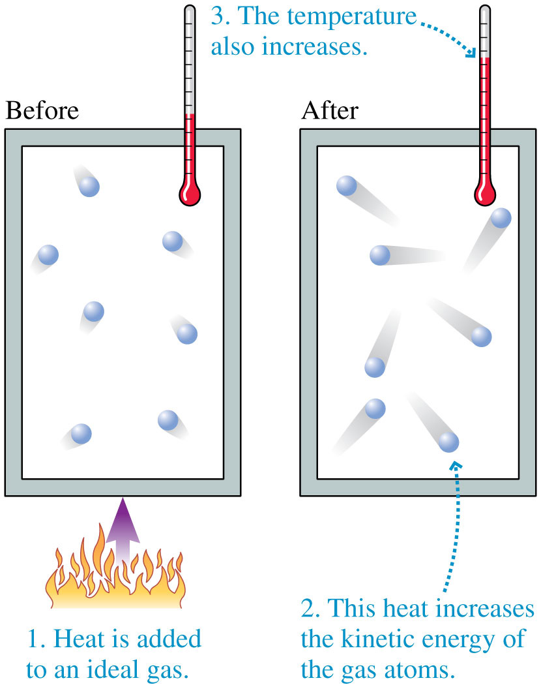
Difference between heat and temperature
Notes:
FIGURE 11.9

Slide 18
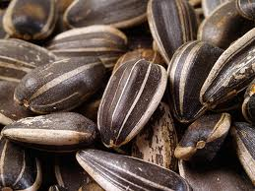
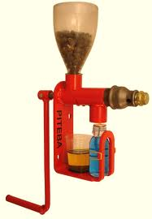
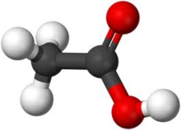
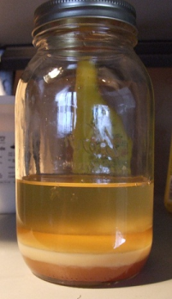
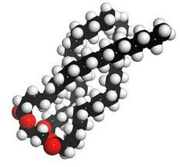
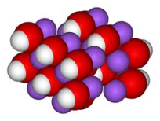
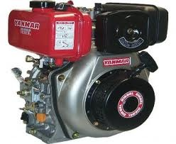
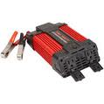
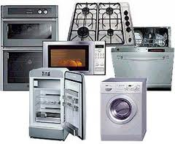
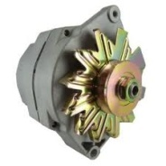
Combustion fuels – Hippie Methodologies
Add Heat, Chemical Potential Energy and Kinetic energy
Lose Heat and Chemical potential energy
Gain Transformed Chemical Potential energy
Add Chemical potential energy and Kinetic energy
Lose Heat
Gain Transformed Chemical Potential energy
Add Kinetic Energy
Lose Heat
Gain Electromagnetic Energy
Add Chemical potential energy and small Kinetic energy
Lose Heat and Chemical Potential energy
Gain Kinetic Energy
Add Electromagnetic Energy
Lose Heat
Gain An operating appliance of your choice

Slide 19
Look for alternatives, bottlenecks, synergies, etc…

Slide 20
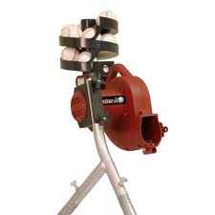
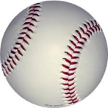
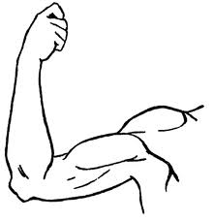
Example: Practical application

Slide 21
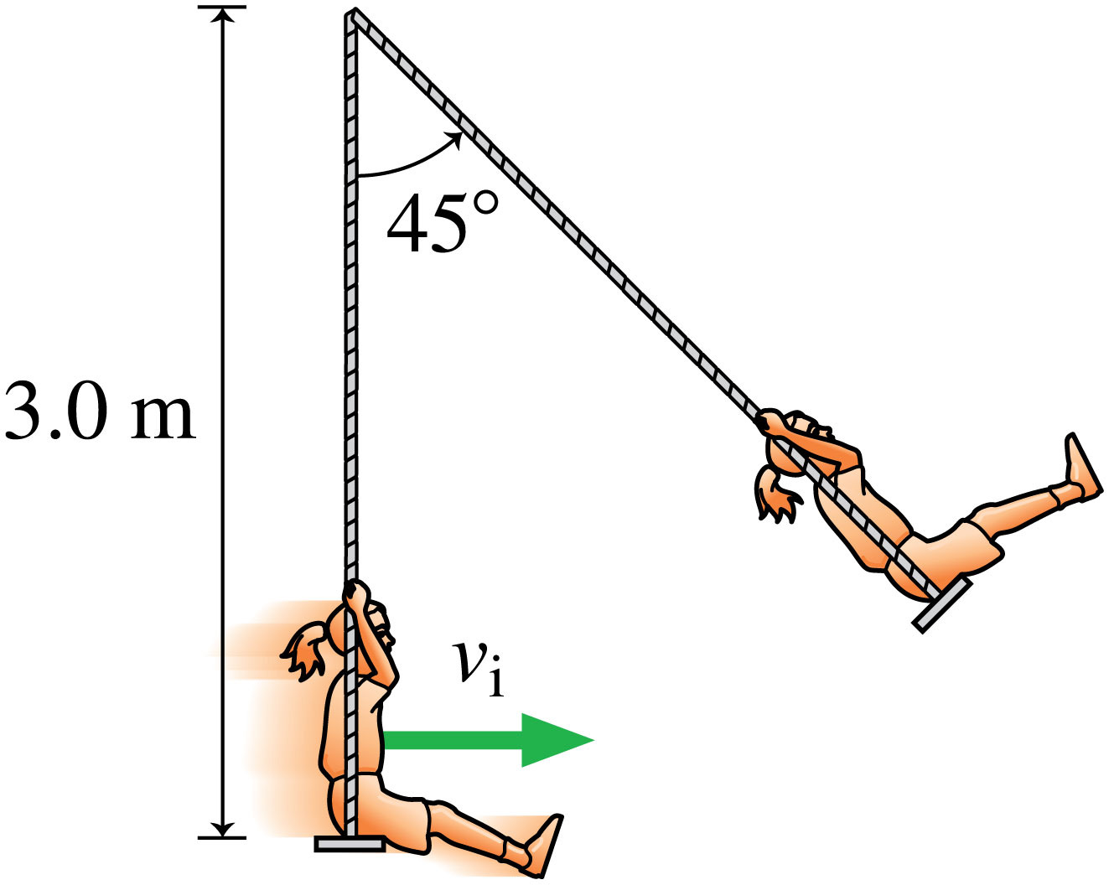
Quiz question 4
What is this girl’s change in height?
Notes:
FIGURE P10.58

Slide 22
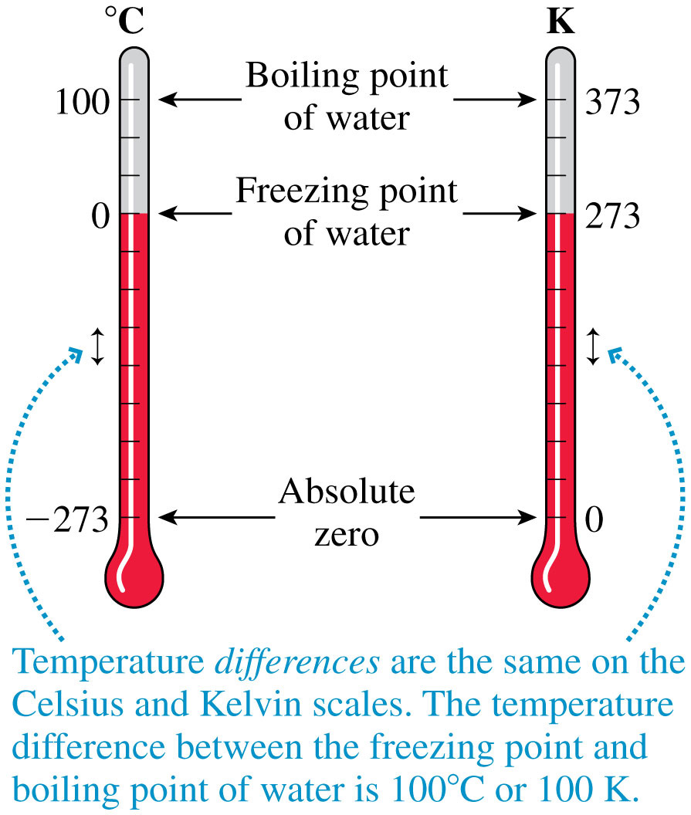
Celsius and Kelvin
Notes:
FIGURE 11.10

Slide 23
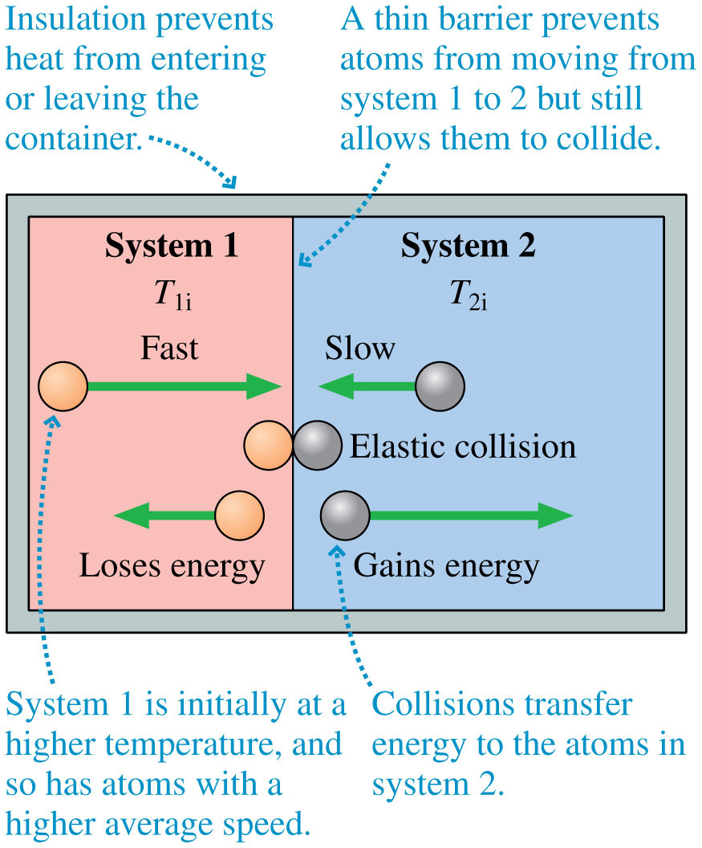
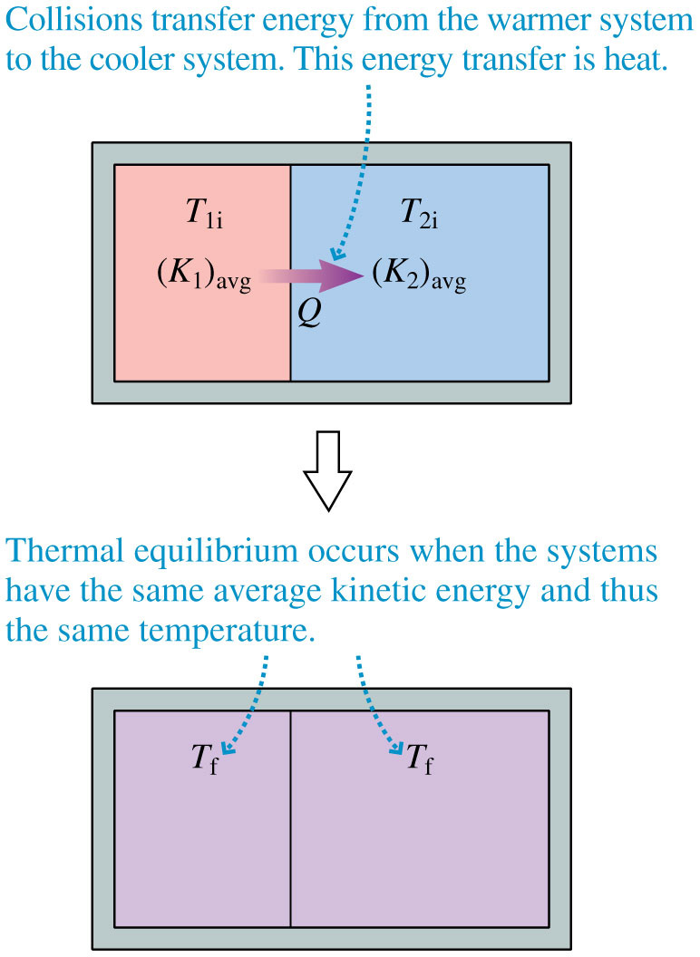
Heat Death!
Time $>{10}^{{10}^{56}}\text{years}$
Notes:
FIGURE 11.13

Slide 24
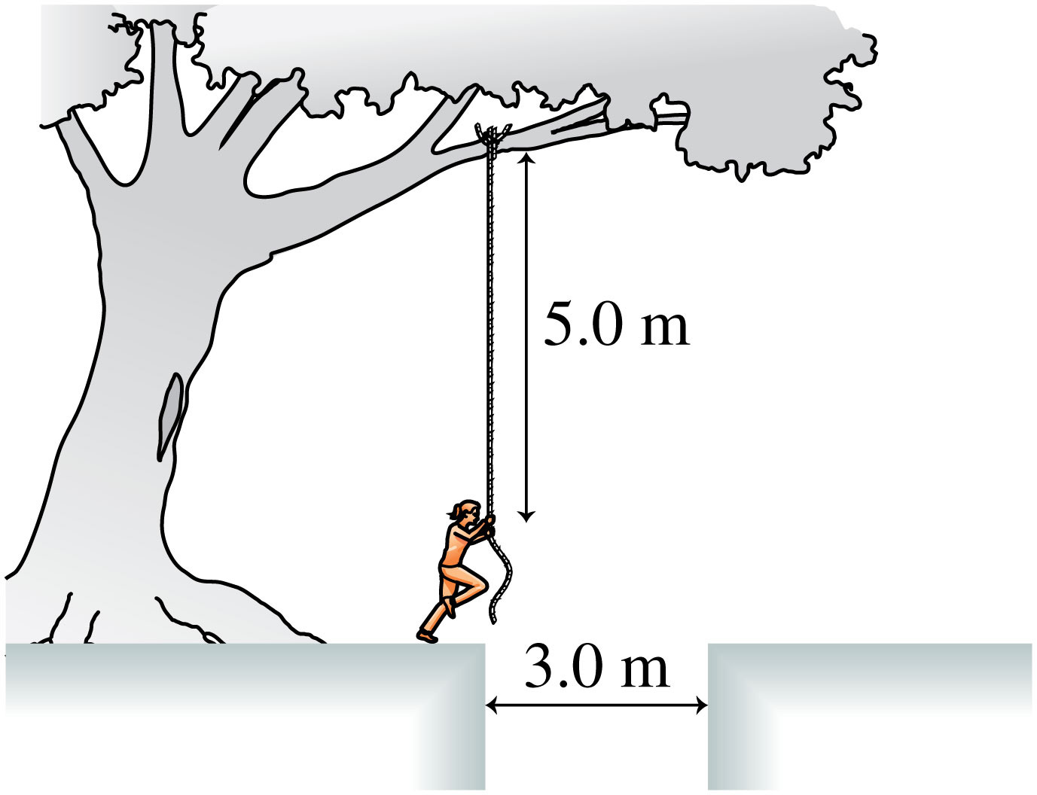
Quiz question 5
How fast will this girl have to run to be able to make it across(she can only drop from the rope)?
Notes:
FIGURE P10.66

Slide 25
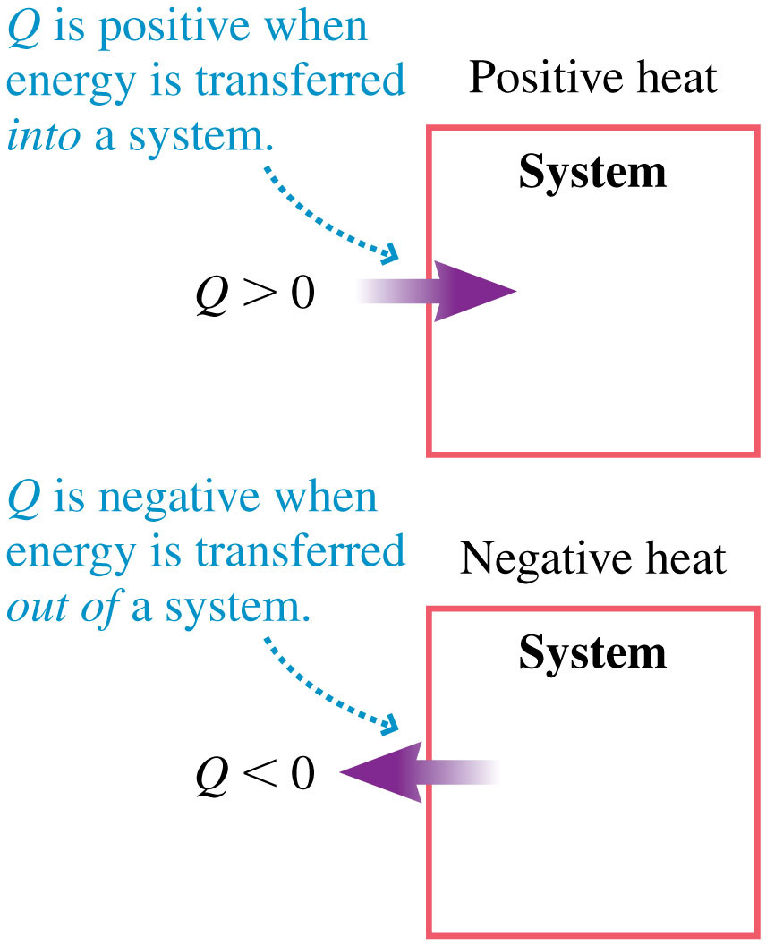
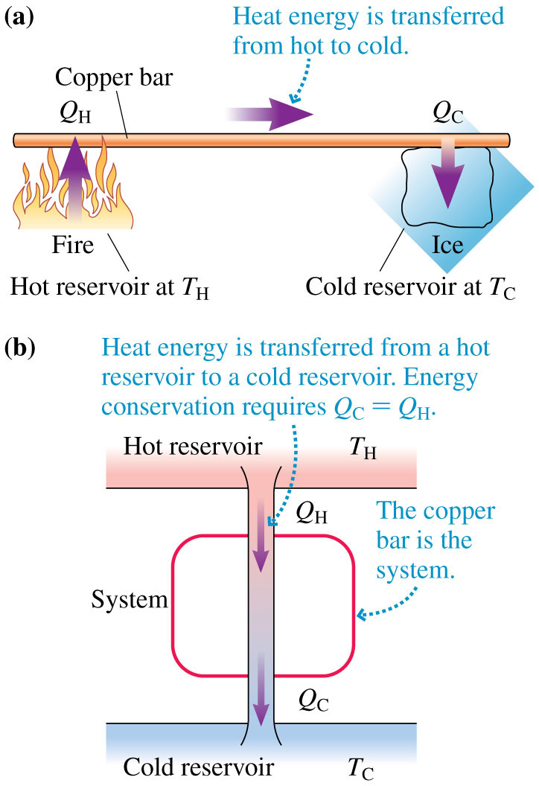
The sign of energy transfer
Notes:
FIGURE 11.14

Slide 26
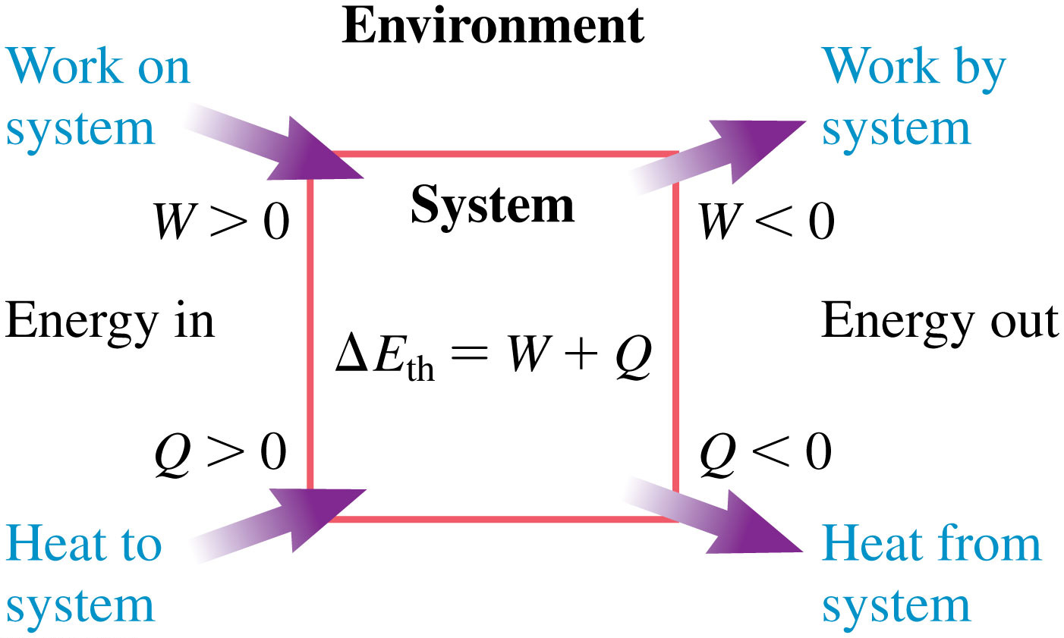
First law of thermodynamics
For a system in which only the thermal energy changes, the change in thermal energy is equal to the energy transferred into or out of the system as work W, heat Q, or both.
Notes:
FIGURE 11.15

Slide 27
Quiz question 6
A 60 kg girl going 0 m/s jumps on a 10 kg sled at rest and then slides down a ramp with friction $μ_{k}=.0$ that is 8 m long. How far in does she compress the 1200 N/m spring at the bottom?
frictionless
Notes:
FIGURE P10.68

Slide 28
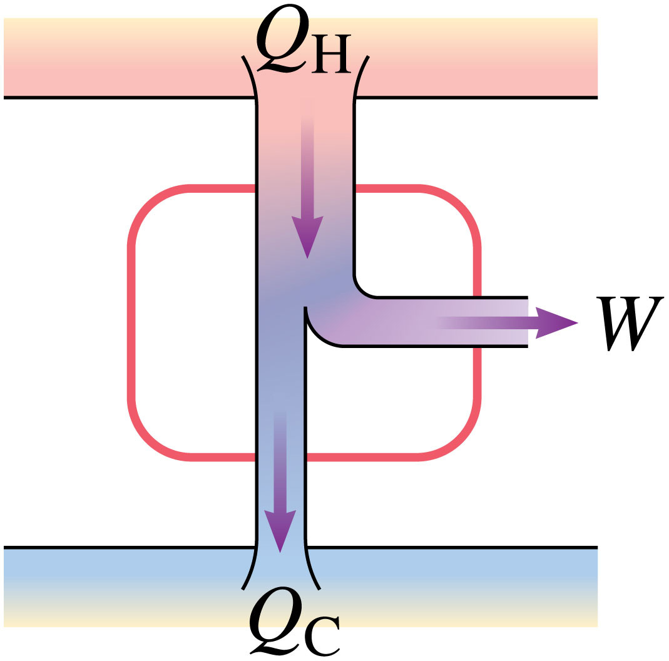
The heat engine
Hot reservoir
Extracted work
Cold reservoir
Notes:
Chapter 11 Part II Summary 6

Slide 29
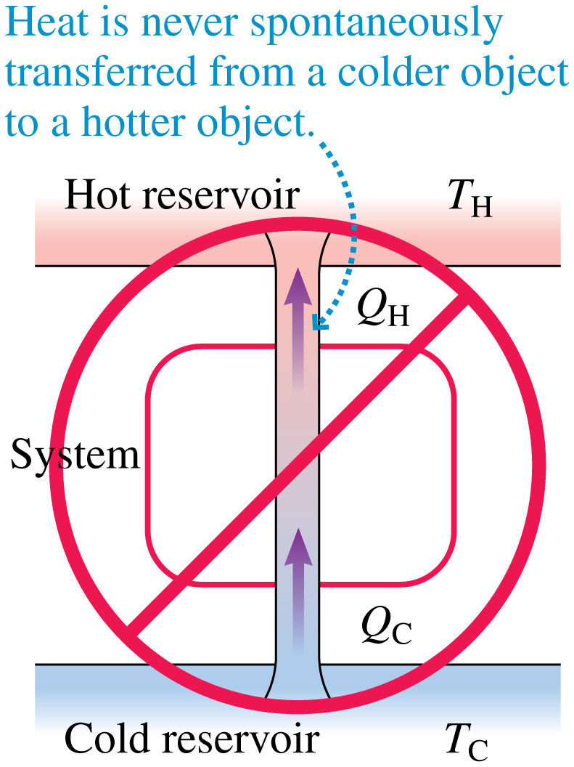
Which way does heat flow?
Notes:
FIGURE 11.17

Slide 30
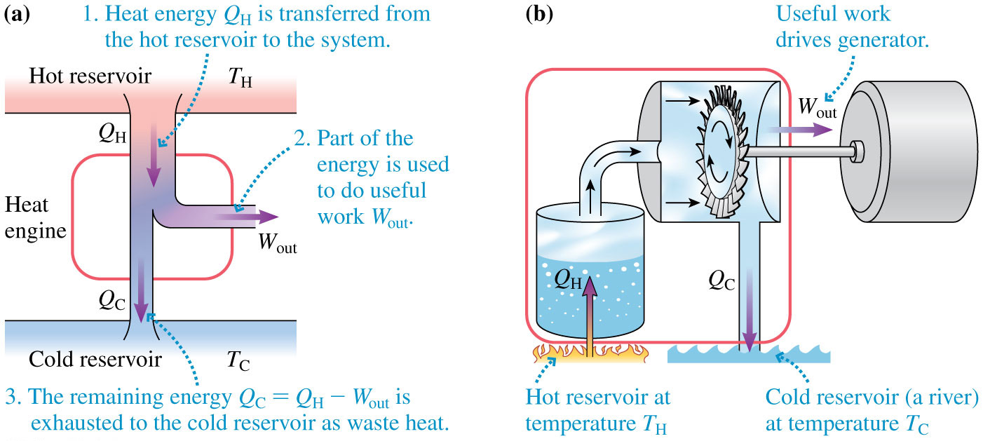
Heat engine operations
Notes:
FIGURE 11.18

Slide 31
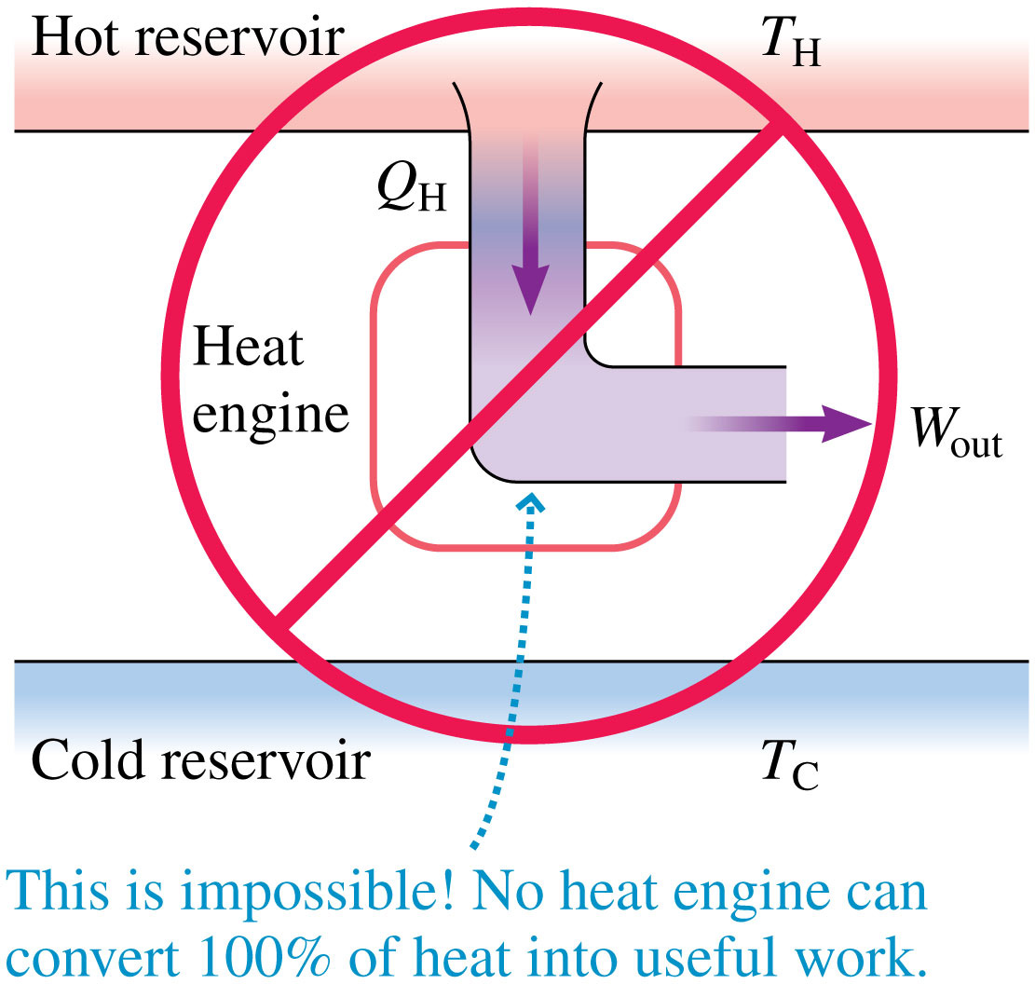
Too good to be true?
$$e_{\text{max}}=1−\frac{T_{\text{C}}}{T_{\text{H}}}$$
What kind of temperatures would be need for 100% efficiency of an ideal heat engine????!?
Notes:
FIGURE 11.19

Slide 32
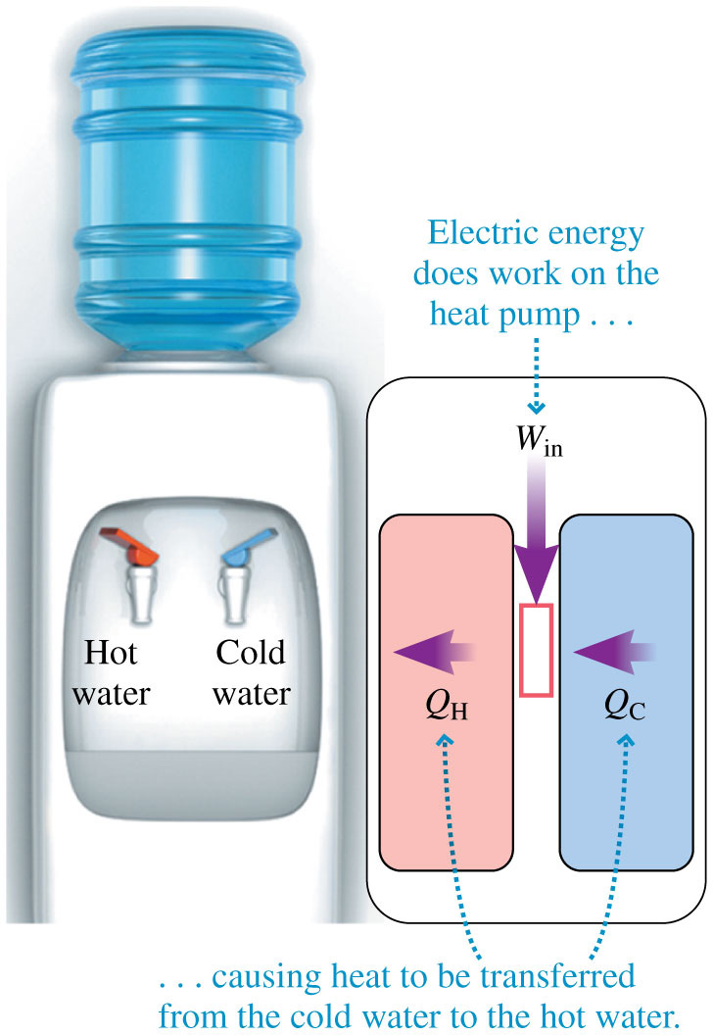
Heat pump to cool water?
Notes:
FIGURE 11.20

Slide 33
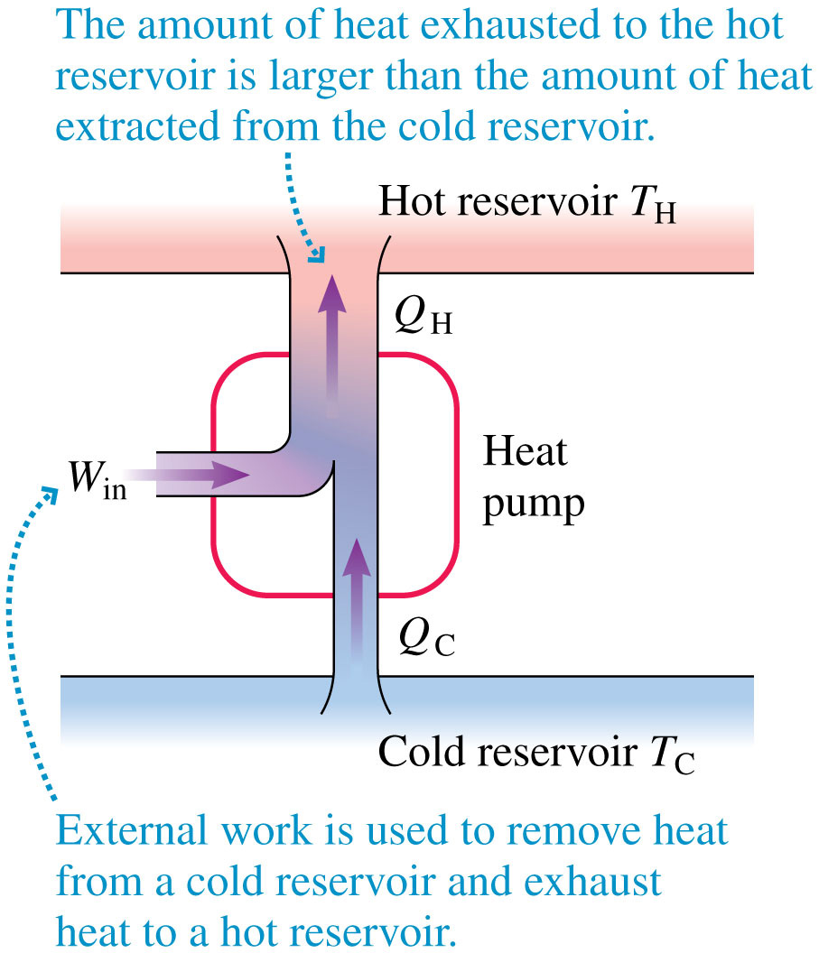
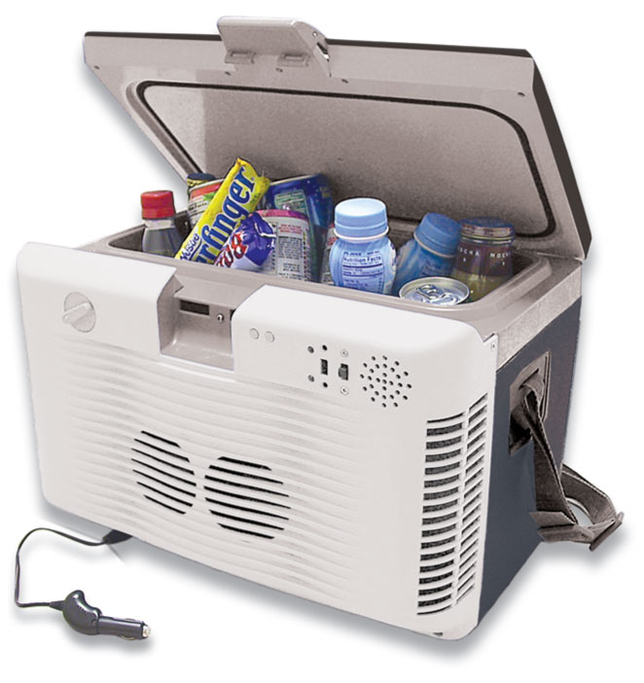
Heat pumps r in the opposite direction
Notes:
FIGURE 11.21

Slide 34
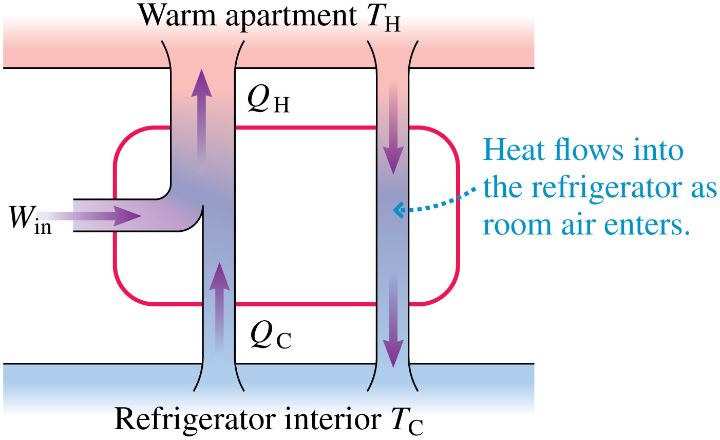
Quiz question 7
Your roommate wants to open the fridge to cool off the kitchen on a hot day. Will this help? Why or why not?
Notes:
FIGURE 11.22

Slide 35
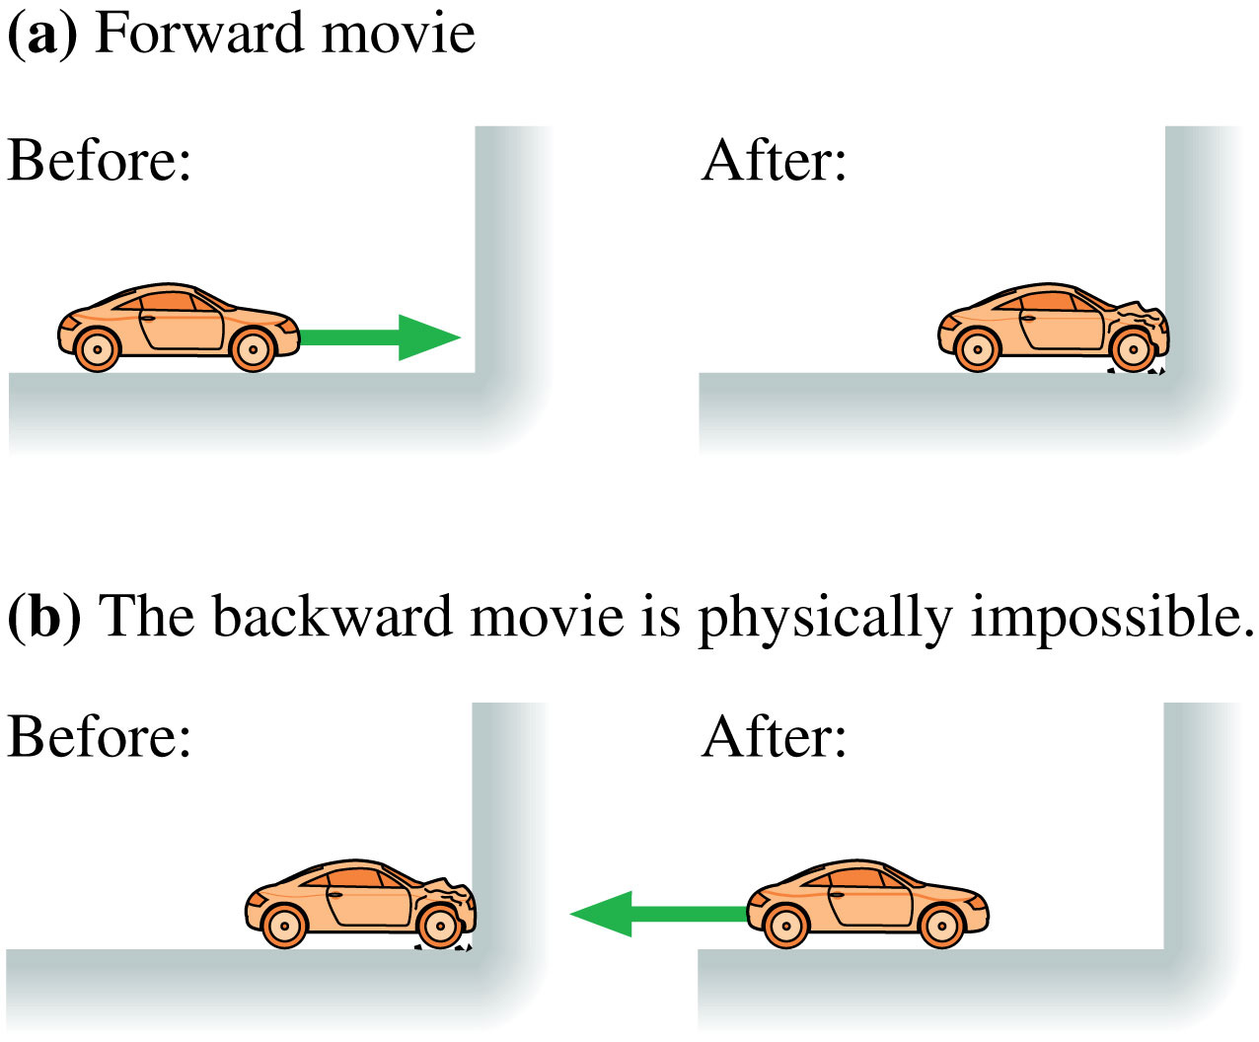
Reversible processes
improbable
Notes:
FIGURE 11.24

Slide 36
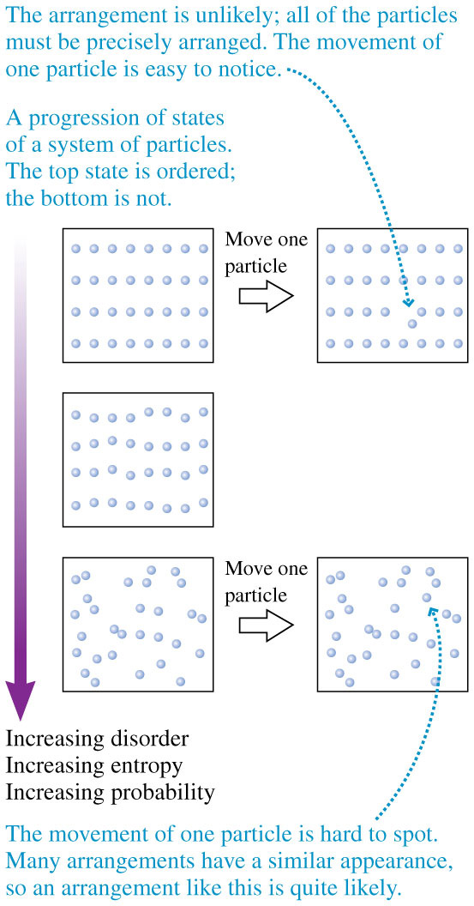
2nd law of thermo
The entropy of an isolated system never decreases. The entropy either increases until the system reaches equilibrium, or, if the system began in equilibrium, stays the same.
What is entropy?
How many ways(microstates) are there have a clean room(macrostate)?
How many ways(microstates) are there have a dirty room(macrostate) ?
Entropy is proportional to the number of microstates in a macrostate.
Notes:
FIGURE 11.26

Slide 37
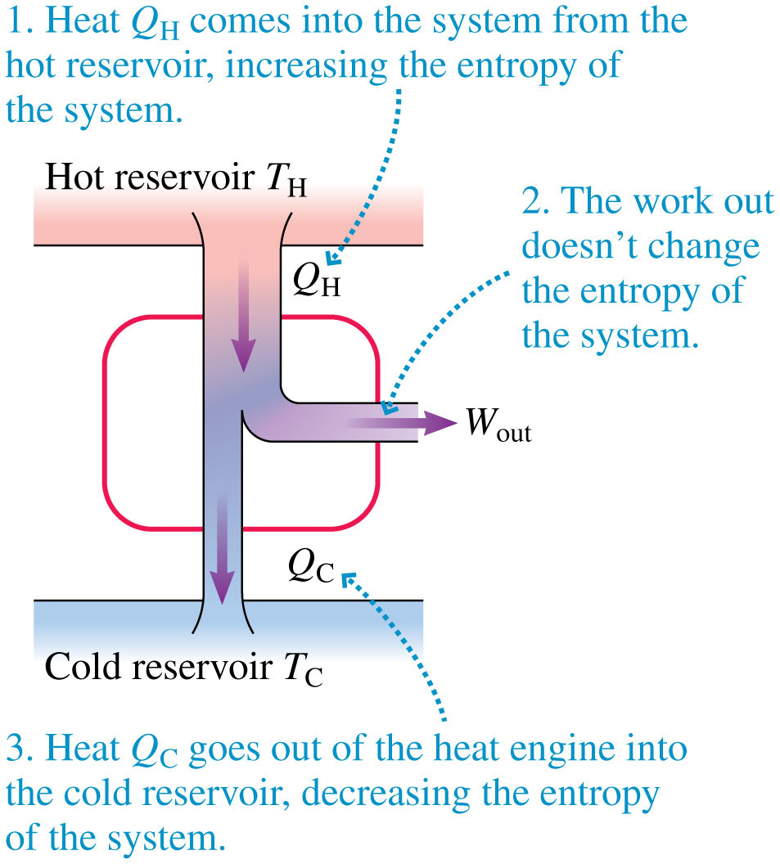
Note the entropy changes
Notes:
FIGURE 11.28

Slide 38
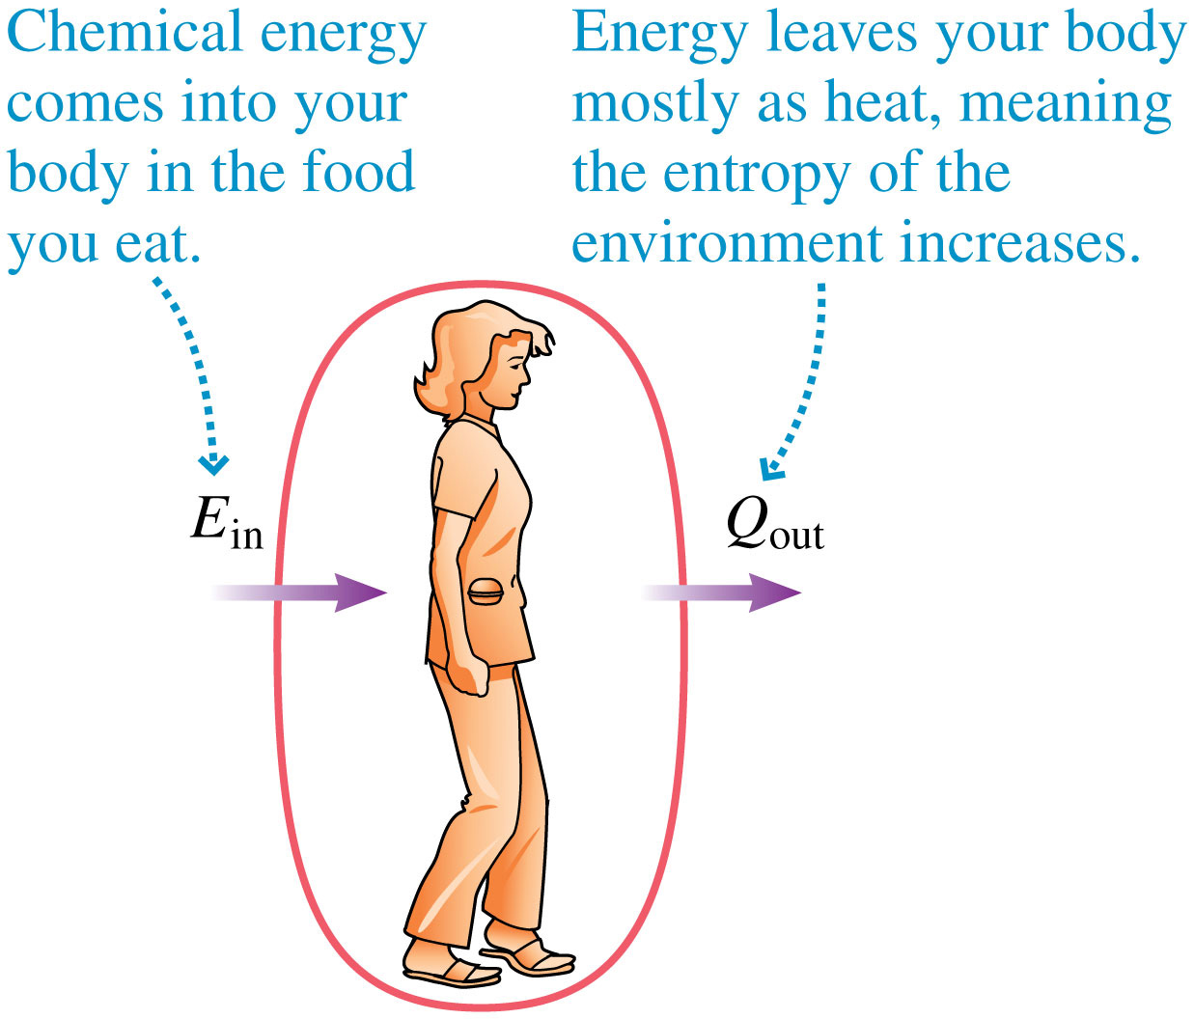
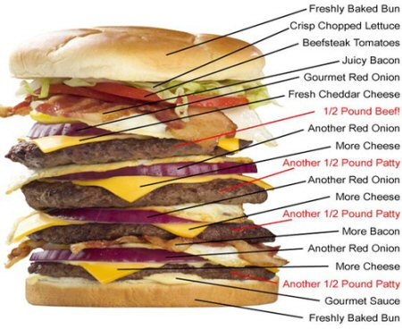
You done messed up son
Notes:
FIGURE 11.29

Slide 39
Quiz question 8
What’s the difference between heat and temperature?
Notes:
FIGURE P10.68

Slide 40
How efficient are you?
Notes:
Chapter Summary 1

Slide 41
Which one is messiest?
Which one is hottest?
nature
Notes:
Chapter Summary 2

Slide 42
How many years till the heat death?
Notes:
Chapter Summary 3

Slide 43
efficiency standards
Heat engine
Heat pump
Notes:
Chapter Summary 7

Slide 44
Which, if any, of the heat engines violate the first law of thermodynamics? The second law?
Notes:
FIGURE P11.35

Slide 45
Energy use vs. Mass is not linear
The more massive you are, the less energy you need per kilogram of body weight to operate
$$E$$
$$m$$
Notes:
UNNUMBERED FIGURE P11.51

Slide 46
Quiz question 9
Which, if any, of the heat engines violate the first law of thermodynamics? The second law?
Notes:
FIGURE P10.68

Slide 47
Do you even freaking care bro?
Notes:
FIGURE P11.68

Slide 48
Quiz question 10
While this 300 watt blender ran for 45 seconds, it lost 600 joules of heat to the surroundings, how much heat was added to the frozen vegetables?
Notes:
FIGURE P10.68

