Slide 1
Chapter 8: Conservation Laws
Did you read chapter 8
before coming to class?
Yes
No

Slide 2
Conservation of Nonsense

Slide 3
Conservation Laws
What does it mean to conserve something?
A conserved quantity:
_______ can neither be created or destroyed, but can be changed from one form to another or transferred from one object to another.

Slide 4
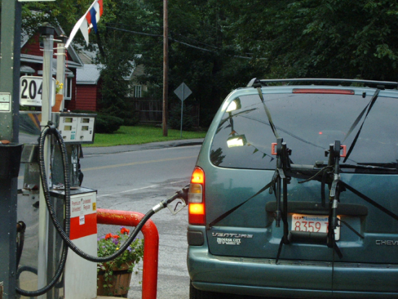
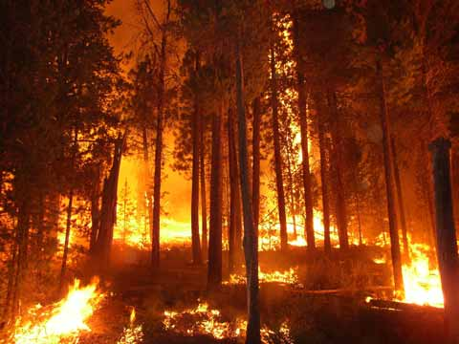
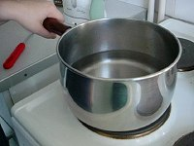
Conservation of Mass
Mass is neither created nor destroyed. Mass may change from one form to another, but the total mass after the transformation is always the same as that before. Examples
gasoline in car
forest fire
boiling water

Slide 5
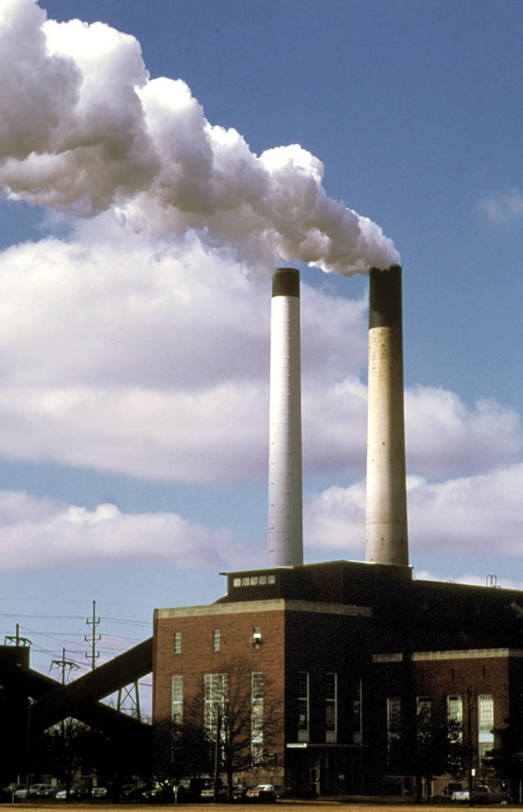
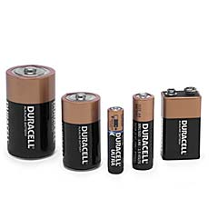
Conservation of total Electric Charge
The difference between the total amount of positive and negative charges does not change.
Examples
Cat fur and rubber rod
Batteries
Power plants

Slide 6
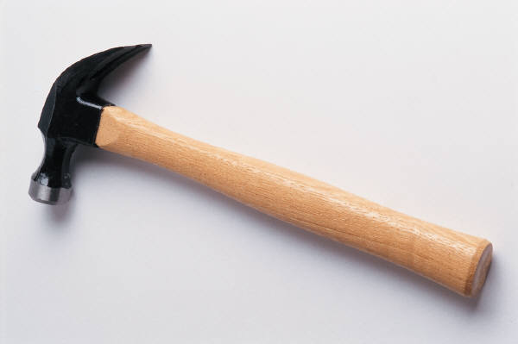
At this point, we’ve reached the limit of what you can see with light.
We can use other methods to “see” finer details
Mostly, we just use hammers to break the particles apart and try to detect the pieces.

Slide 7
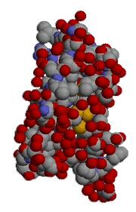
Molecules
Size ~ 10⁻⁹ – 10⁻⁸ meters
Held together by the electromagnetic force via sharing electrons.

Slide 8
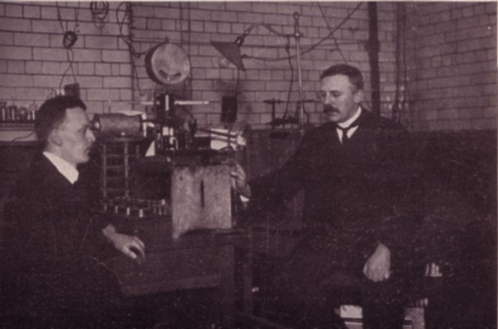
Atoms
Size ~ 10⁻¹⁰ meters. An atom is mostly empty space!
The only relevant force is the electromagnetic one which holds the electrons to the nucleus.
Hans Geiger and Ernest Rutherford

Slide 9
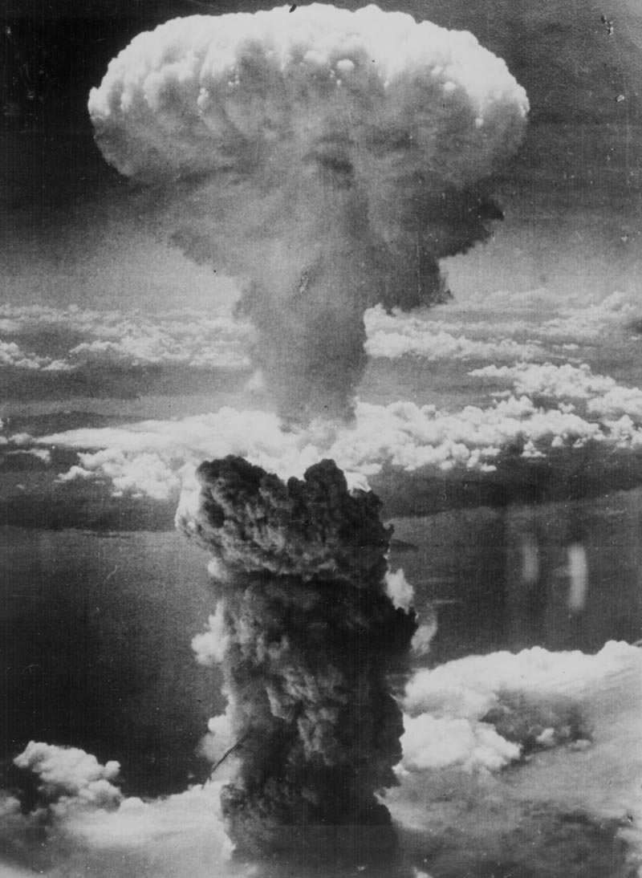
Electrons seem fundamental (we can’t break them into pieces), but the nucleus comes apart.

Slide 10
Nucleons have parts (but we never see them separately)
Size ~ 10 ⁻¹⁵ meters
Only 2 nucleons
Protons: charge = +1
Neutrons: no charge
Their masses are essentially the same
They are thought to be composed of simpler entities called quarks. (Nobel Prize in 1990)

Slide 11
So what are we really made of?
Electrons
Quarks
Mass and charge conservation both relate to the conservation of these fundamental particles.
There are other fundamental particles too, and in all the processes you experience, fundamental particles are conserved.

Slide 13
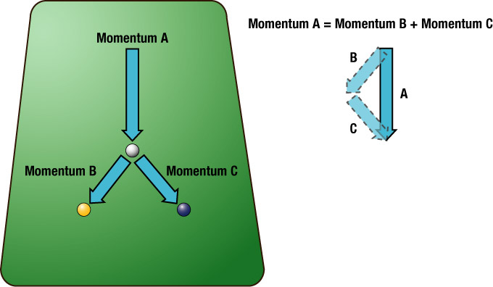
Macroscopic properties conserved in motion: Linear Momentum
Momentum is (mass) x (velocity)
Conserved in the absence of external net force
For a system with constant mass, this is just of restatement of Newton’s First Law
Examples
Collisions
Cannon

Slide 14
Momentum transfer
mv = mv
velocity of bullets
velocity of gun
v
v
m
m
http://www.youtube.com/watch?v=4CfREbZ1V5o

Slide 16
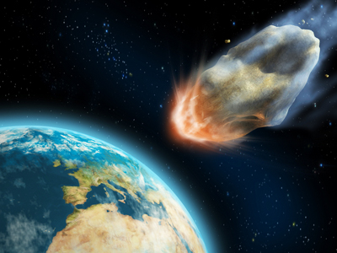
Momentum is conserved even when the various parts of the system split due to internal forces
Initial
Final
Energy and Momentum
are conserved during
elastic collisions
At rest
At rest
Only momentum
is conserved during
inelastic collisions
At rest

Slide 17
Conservation of angular momentum
Angular momentum is mass x speed x radius
Examples:
Diver
Ice skater
Riding a bike
Iw = Iw
Equal masses but different shapes
50*2 = 4*25
It speeds up!

Slide 19
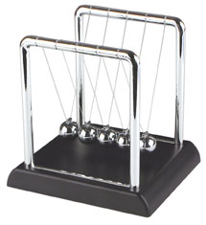
Newton’s Cradle
To explain this behavior we need something else to be conserved. This will turn out to be Energy

