Slide 1
Chapter 9 Energy
Did you read chapter 9
before coming to class?
Yes
No

Slide 2
Sometimes it is hard to describe all of the motion in a system, and we want something simpler

Slide 3
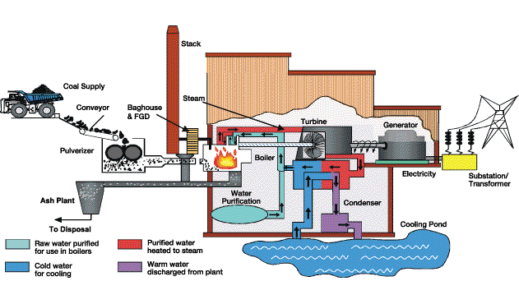
Sometimes it is hard to describe all of the motion in a system, and we want something simpler
A more complicated example: Power plant

Slide 4
Energy
A more complicated example: Power plant
E_{in}
E_{stack}
E_{friction}
E_{friction}
E_{electricity}
boiler
turbine
generator

Slide 5
Energy
Energy is
the capacity “to do something”
Ability to exert a force on an object while moving it through a distance
Energy can either be associated with an objects position (potential) or its motion (kinetic)
Total energy is conserved: Energy can be neither created nor destroyed. The total amount of energy in the universe never changes. However, energy can change from one form to another, or be transferred from one object to another.

Slide 6
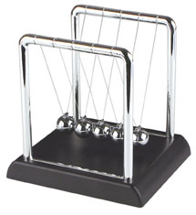
Kinetic Energy
Kinetic energy is the energy of motion.
Kinetic Energy = ½ mv²
½ mv² = ½ mv²
mv = mv
What about a ball rolling up a hill?

Slide 7
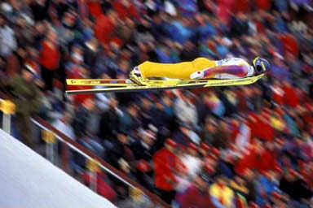
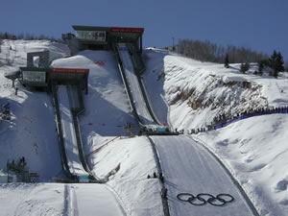
Gravitational Potential Energy
energy associated with the height of an object
gravitational potential energy = (weight) x (height)
Examples
Balls rolling on tracks (energy transfers from potential to kinetic)
Pendulum
Ski Jump
Bouncing ball
http://www.youtube.com/watch?v=bHBN7Cds07I&feature=related

Slide 8
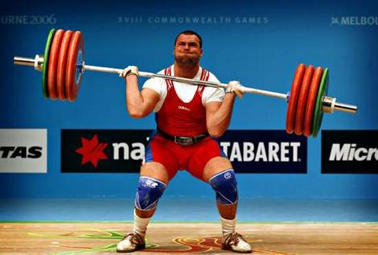
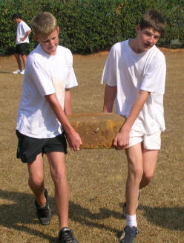
In physics, the word “work” has precise meaning that is somewhat different than you may be used to.
Work = (force) x (distance parallel to force)
For work to be done in the physics sense, a force must be applied and the object must have some motion parallel to the force
Work is a method of transferring energy, it is not a form of energy itself.

Slide 9
Internal Energy
Internal energy is energy “hidden” inside materials. It is associated with the temperature of the materials (thermal energy) and the chemical potential energy of materials
Examples
Mass on a spring, decaying motion results in?
Dolorimeters apply steady pressure, heat, or electrical stimulation to some area, or move a joint or other body part and determine what level of heat or pressure or electric current or amount of movement produces a sensation of pain. Sometimes the pressure is applied using a blunt object, or by locally increasing the air pressure on some area of the body, and sometimes by pressing a sharp instrument against the body.

Slide 10
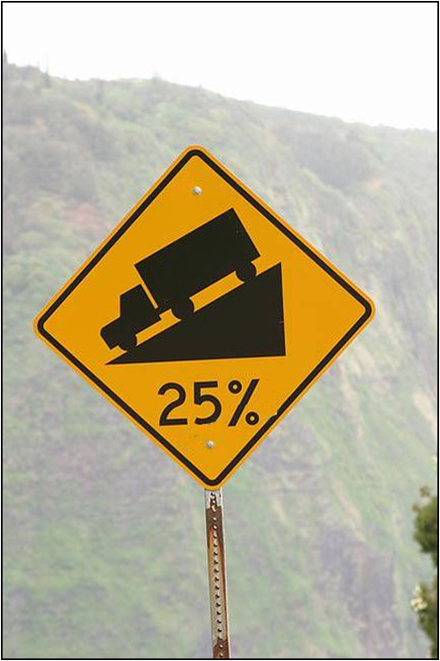
Thermal Energy
Internal energy associated with kinetic energy of individual particles.
Related to temperature (average KE of atoms and molecules)
A warm object has more internal energy than when it is cold
Two objects at the same temperature may have different amounts of thermal energy, why?
water 1 cal/gºC
gold .03 cal/gºC

Slide 11
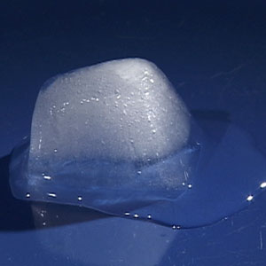
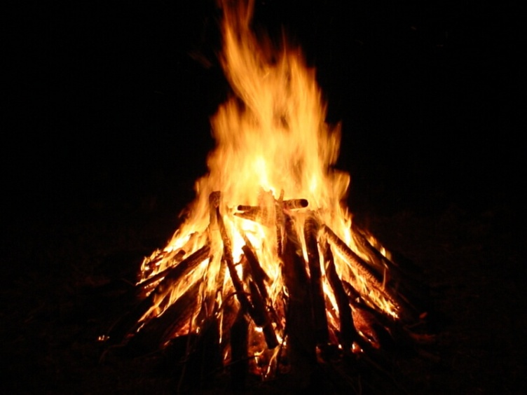
Chemical Potential Energy
Internal electrical potential energy of atoms in a material
Examples
change of state (rearrangement of atoms)
chemical bonds
burning gasoline, natural gas, or wood
exploding firecracker

Slide 12
Elastic Potential Energy
Energy stored in a material by deforming it in such a way that its molecules are displaced from their equilibrium positions.
A form of internal electrical potential energy
Examples:
deformation (springs, balls)
Rubber band
Trampoline

Slide 13
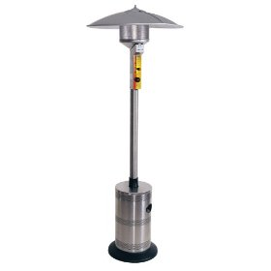
Radiant Energy

Slide 14
Summary: Forms of energy
Kinetic Energy
Gravitational Potential Energy
Electrical Potential Energy
Internal Energy
Thermal (internal kinetic)
Elastic potential (internal electrical)
Chemical Potential (internal electrical)
Radiant Energy

Slide 15
Energy Transfer and Transformation
Radiation: energy is transmitted by visible light, infrared radiation, ultraviolet radiation, X-rays, or radio waves. (sun, space heater)
Conduction (Heat Flow ): a process in which internal energy is transferred because of a difference in temperature. (electric stove, soldering iron)
Convection: internal energy is transferred because matter moves from one place to another. (hot air furnace)
Work: energy is transferred or transformed by forces acting on an object. (friction, muscles, electric motor)
Combustion: chemical potential energy is transformed into another form (gasoline engine, dynamite, light stick)

Slide 16
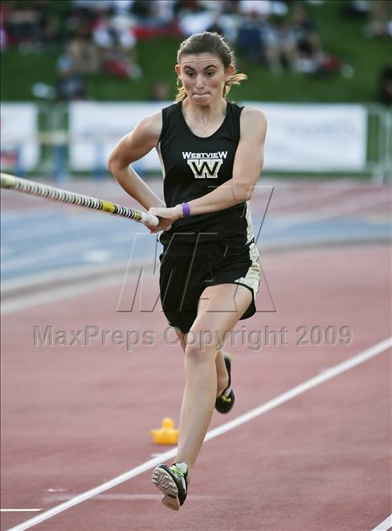
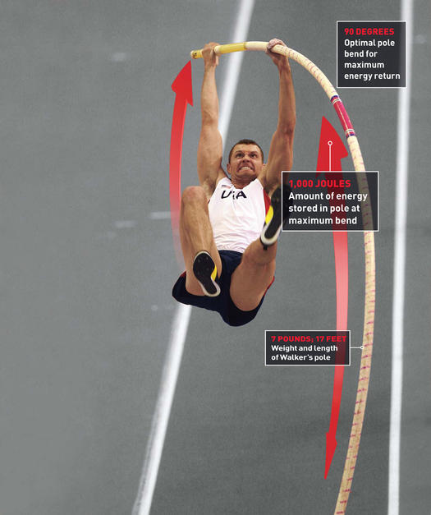
Kinetic
Elastic
Potential
6.15m
7:25
Sergei Bubka
http://www.youtube.com/watch?v=IWGyzPNXI_U

Slide 17
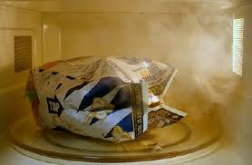
The method of heat transfer used to cook microwave popcorn is
radiation
conduction
convection

Slide 18
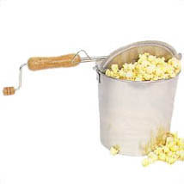
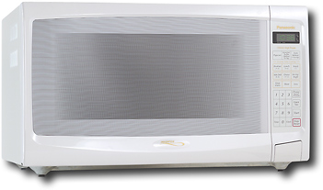
Popcorn
Three methods for popping popcorn
Microwave --
Hot air --
Stove top --
Identify the method of heat transfer for each.
Radiation
Convection
Conduction

Slide 19
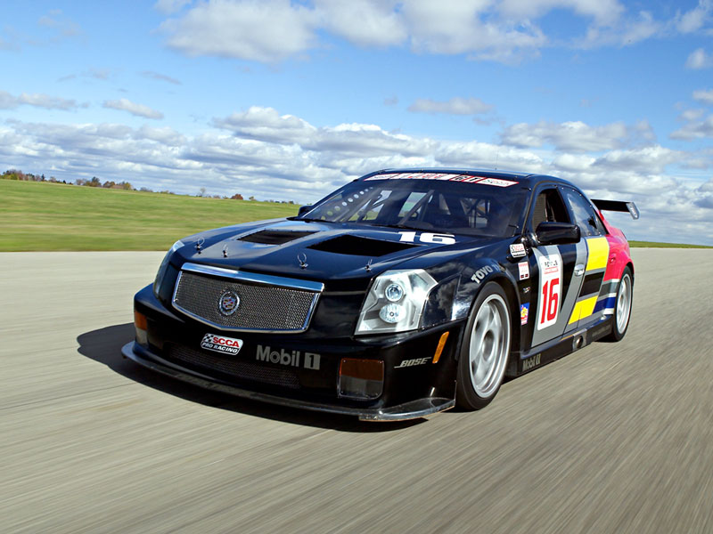
Kinetic energy from Chemical Potential
The engine is running, doing work on the car.
There is a lot of energy in the fuel but we can only get so much work out of it.
We are in a power crisis not an energy crisis

Slide 20
Conservation of Mass-Energy
Mass and energy are two manifestations of the same quantity
The total amount of mass-energy in an isolated system is constant
Mass and energy can be converted from one form to the other
E=mc²
Notes:
Resolution of problem with conservation of mass and conservation of energy.

