Slide 1
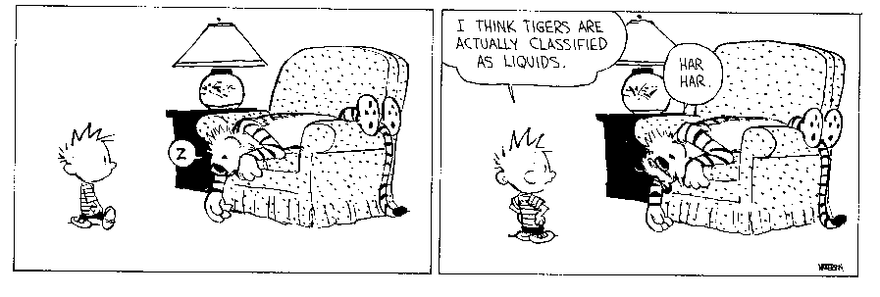
The Physical Properties of Matter
Did you read chapter 12
before coming to class?
  Yes
  No

Slide 2
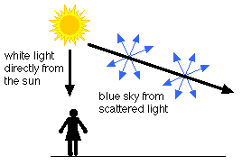
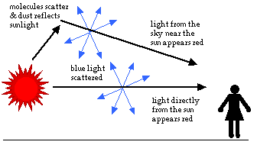
The Physical Properties of Matter
Misconception of the Week
Why is the sky blue?
Why is the sky red?

Slide 3
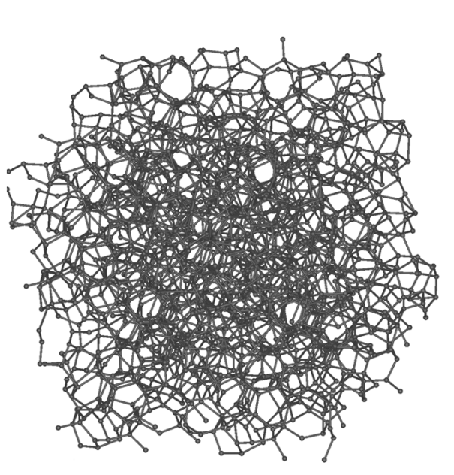

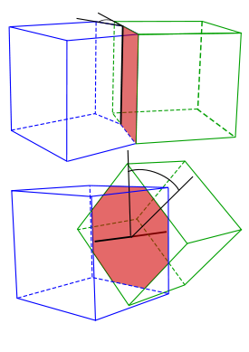
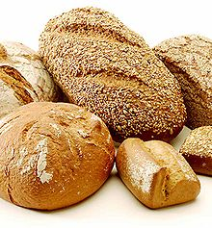
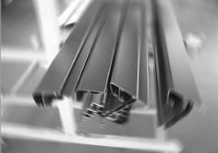
Mathematical Shape of the Week
Crystal Structures
Amorphous
Polycrystalline

Slide 4
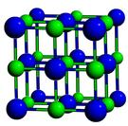
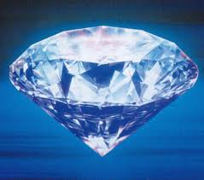
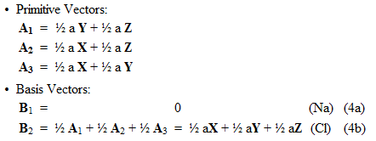
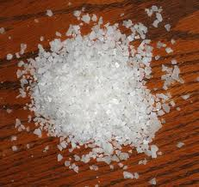
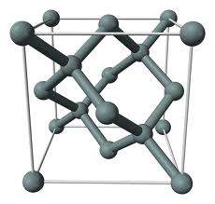
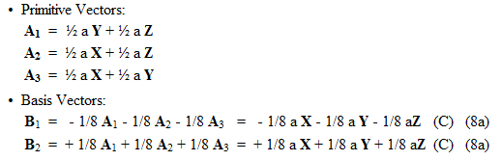
Mathematical Shape of the Week
Crystal Structures

Slide 5
Where we are in the course
Part I: Why do things move the way they do?
    Newtonian View - the laws of force and motion
    Conservation laws
    Symmetry Principles
    Relativistic view
Part II: What are things made of?

Slide 6
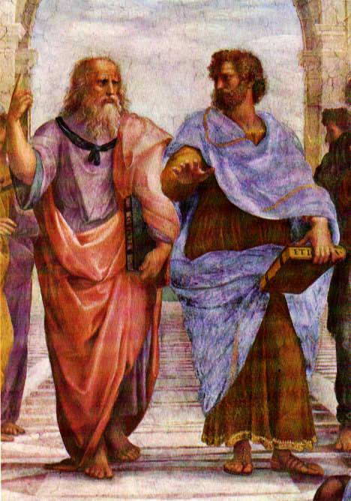
The First Model of Matter (Aristotle)
4 elements—
  Earth
  Water
  Air
  Fire
Everything is made of a combination of these four things
Not a great model, but it gets us started in the right direction: Classification

Slide 7
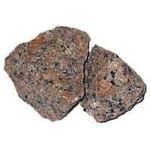
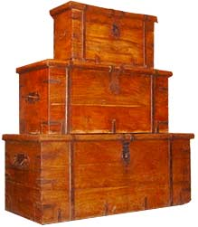
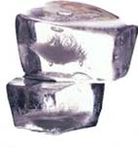
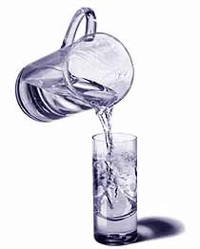
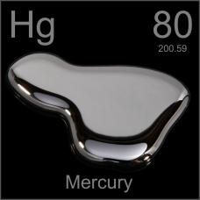
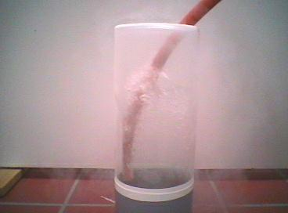
States of matter
Solid: resists changes in size or shape, has a fixed volume
Liquid: assumes the shape of its container and resists changes in volume
Gas: expands to fill shape and size of container

Slide 8
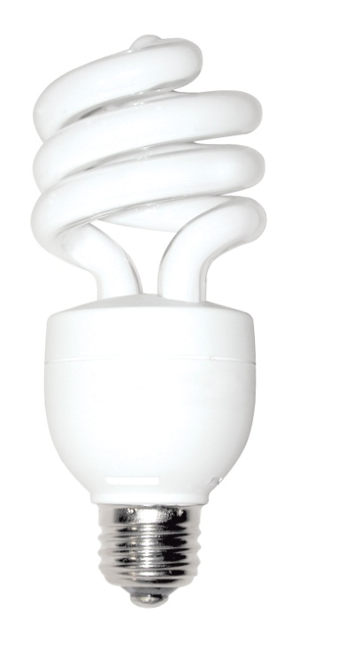
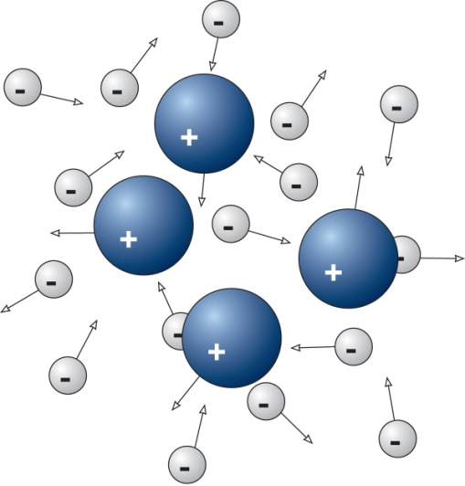
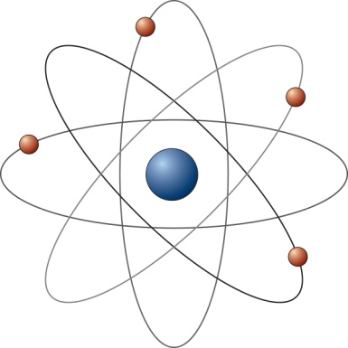
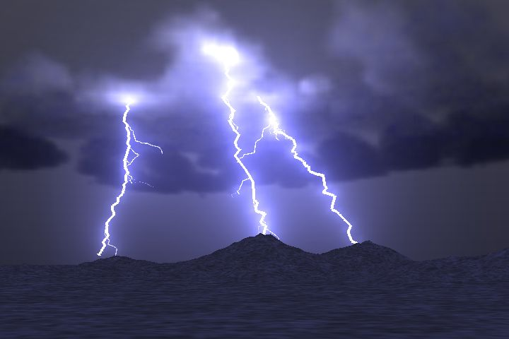
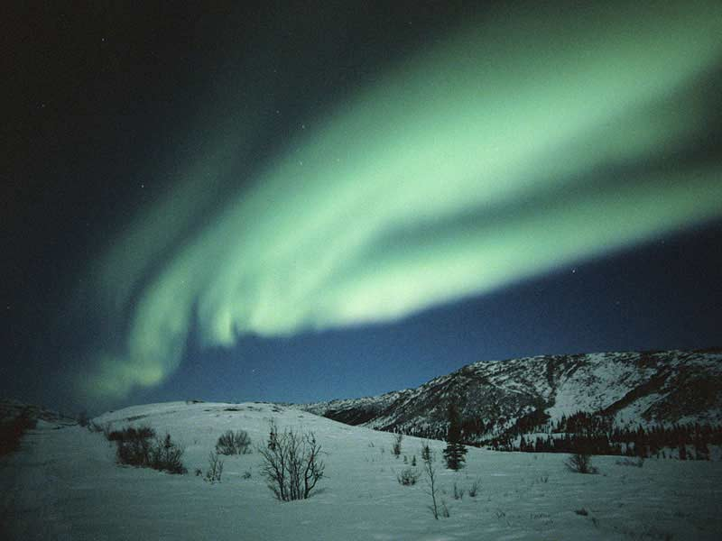
States of matter
Plasma: ionized gas; electrons become detached from atoms

Slide 9
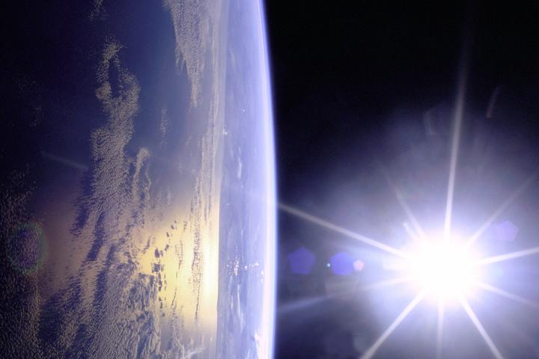
What is the most common state of matter in the visible universe?
Solid
Liquid
Gas
Plasma
Earth

Slide 10
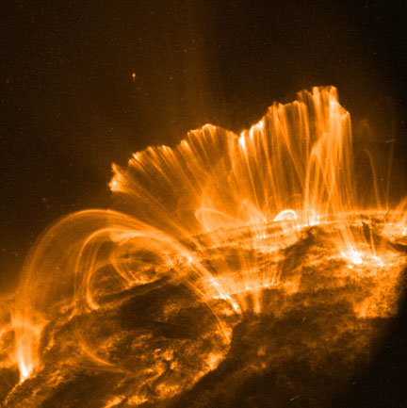
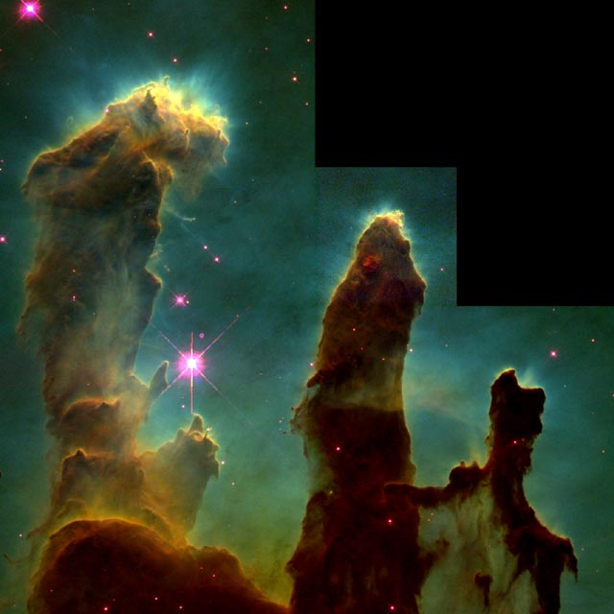
Over 99% of the visible universe is in the plasma state
Coronal Loops on the Sun (~250,000 miles long)
Eagle Nebula (Fingers are ~1 Light Year)
Notes:
Close-up images reveal an active surface with coronal loops emerging and disappearing all over the Sun's surface and can span a length of about 250,000 miles, or about 30 times the diameter of Earth.
Image is hubble view of eagle nebula, those tremendous pillars of gas and dust are more than a light year in length

Slide 11
An Interesting Parallel
Modern
Four states of matter
  Solid
  Liquid
  Gas
  Plasma
Ancient
Four elements of matter
  Earth
  Water
  Air
  Fire

Slide 12
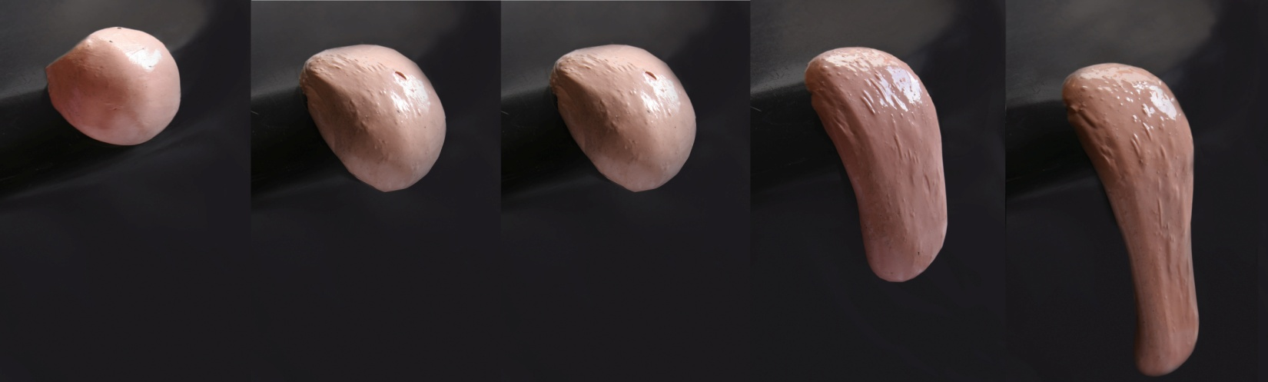
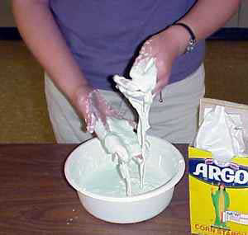
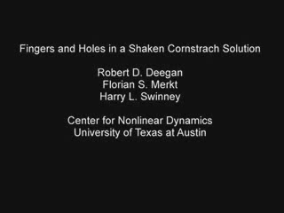
Some materials do not fit neatly into a state classification

Slide 13
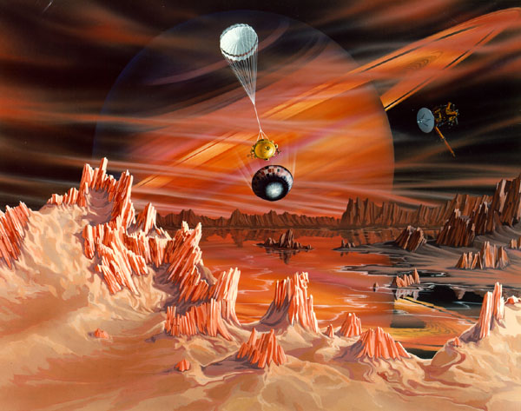
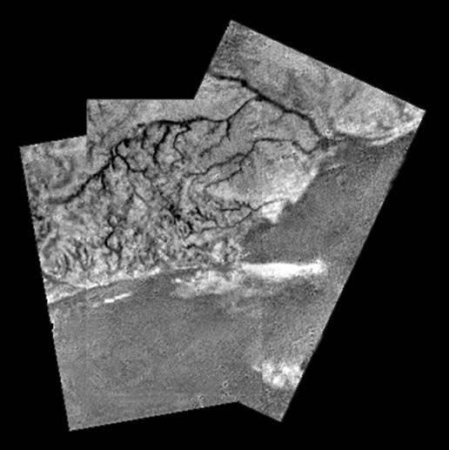
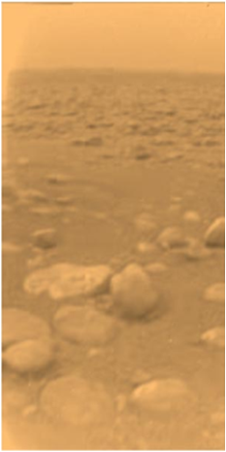
The state of matter depend on temperature and other factors
Example: Cassini-Huygens Titan Probe
  Ammonia: Melts at -78 °C, boils at -33.5 °C
Notes:
Ammonia Rivers and water rocks

Slide 14
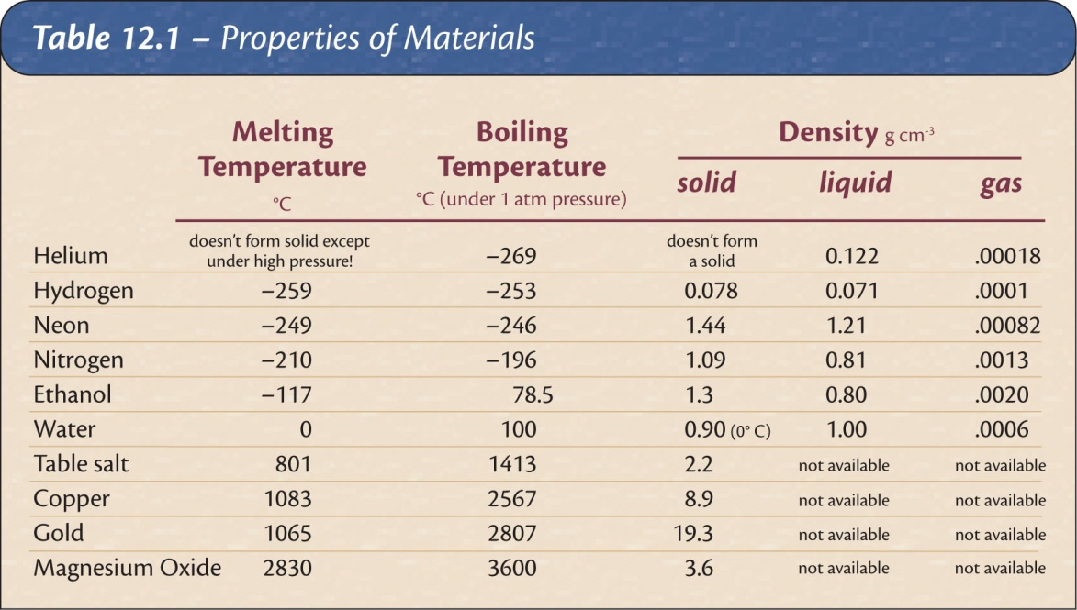
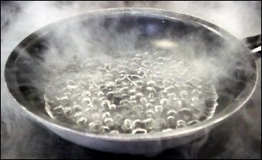
Changes of State
State is a function of temperature (and pressure).
Different materials change state at different temperatures.
Balloon in liquid Nitrogen: air phase change

Slide 15
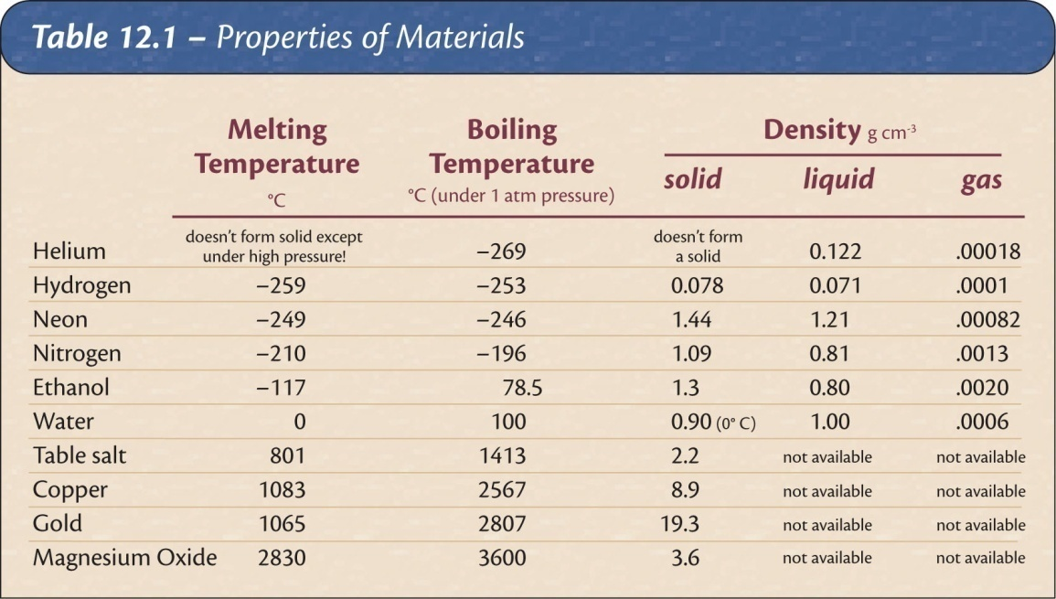
An unknown solid melts at -50 degrees. Which of the following would most likely be its boiling point?
-120 degrees
0 degrees
90 degrees
1,000 degrees
The temperatures at which substance transform from solid to liquid and liquid to gas give information about the strength of the bonds holding the material together.

Slide 16
Response to forces that deform
Compression
Tension
Shear
Which forces do
  Solids resist?
  Liquids resist?
  Gases resist?

Slide 17
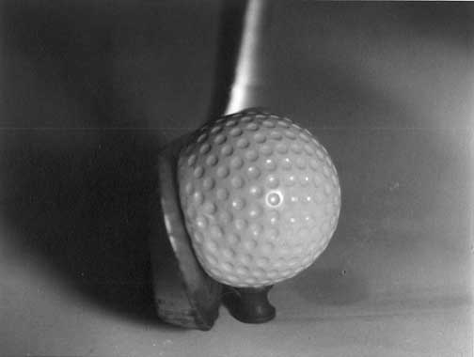
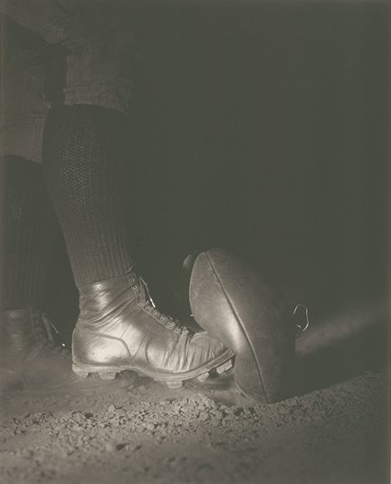
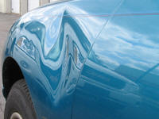
Deformation
Elastic deformation: object returns to its original shape after the deforming force is removed.
Plastic deformation: object retains its new shape when the force is removed.
Elastic limit: transition point between elastic and plastic deformation for a material.
elastic constant = force / deformation
Notes:
Which has the larger elastic constant, rubber band or table?

Slide 18
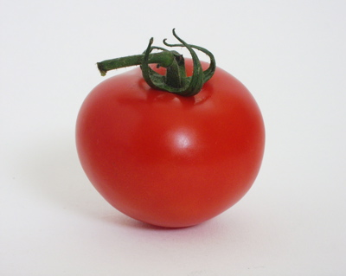
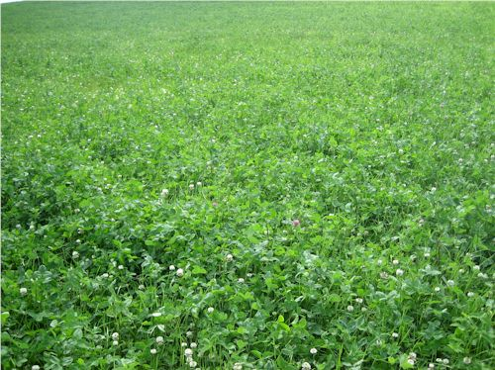
The color of an object gives information about its composition
The color of an object is determined by what wavelengths of light it reflects (or emits)
  Examples: Tomatoes reflect red light, and absorb other colors.
  Clover reflects green colors, absorbs others

Slide 19
The spectrum of light source is a measure of which wavelengths are present
continuous spectrum
discrete spectrum -- only a few specific colors
Discrete absorption spectrum – All colors but a few lines

Slide 20
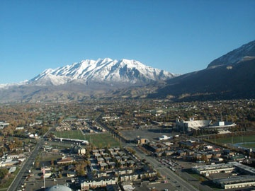
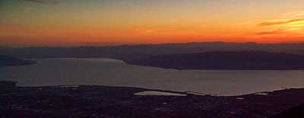
Why is the sky blue?
Sunlight contains a continuous spectrum of all visible colors
Blue light is more easily scattered to the side by air molecules than other colors.
The sun is red in the evening because the light travels through more atmosphere, and more of the blue light is scattered to the side before it gets to you.

Slide 21
Electrical Conductivity
Conductor - electric current flows easily
Nonconductor - resists flow of current (insulator)
Semiconductors - allow current under special conditions
Ionic materials - nonconductors that become conductors when liquid or dissolved in water
Nonionic - nonconductor when liquid or dissolved in water
Notes:
Metals: silver, copper, gold
Semiconductors: germanium, silicon
Insulators: glass, mica, polyethylene

Slide 22
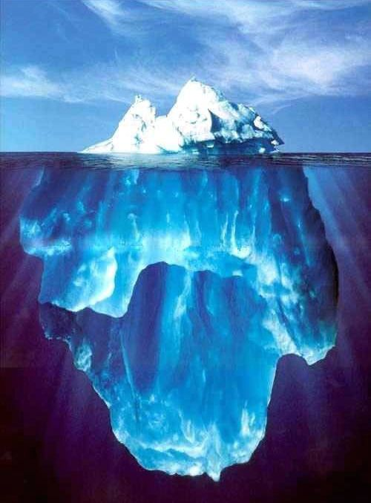
Density
steel
Styrofoam
Objects normally contract when cooled. What happens to the density? Why?
Water is an exception. It expands as it changes to a solid, so ice is less dense than liquid water
  This is good; Otherwise ice would sink and the planet would freeze over.

Slide 23
A ball bearing and a cannonball are made of the same material.
The cannonball will be more dense than the bearing
The two objects will have the same density
The bearing will be more dense than the cannonball

Slide 24
Summary
We classify matter according to
  State (solid, liquid, gas, plasma)
  Color
  Response to force (deformation)
  Density
  Conductivity
Over the next several lectures we will discuss various models that have been used to explain the origin of these properties.

