Slide 1
Chapter 15: Duality of Matter
Did you read chapter 15
before coming to class?
Yes
No

Slide 2
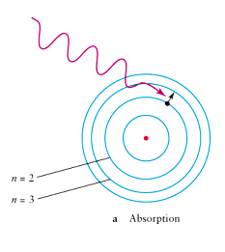
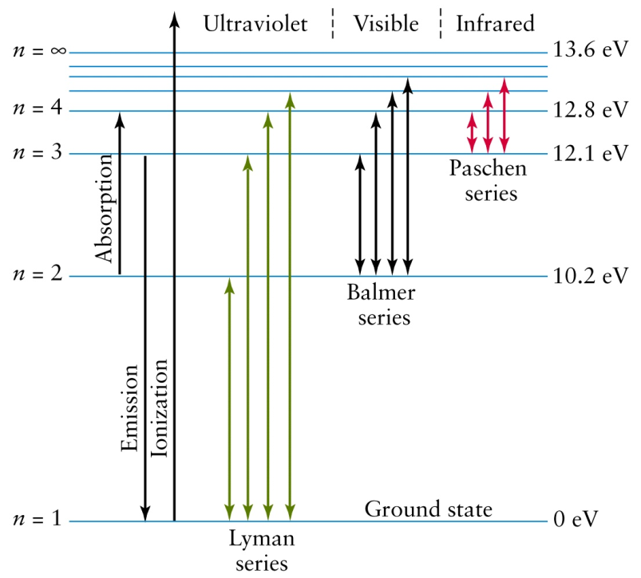
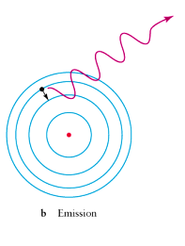
Review: How the Bohr model explains the Hydrogen Atom spectrum
Absorption
Emission
Energy Level Diagram

Slide 3
An atom has only the following possible energy levels. How many discrete colors can it emit?
2
4
5
6
7 or more
E₄
E₃
E₂
E₁

Slide 4
The “bullets” used by Rutherford to probe gold atoms were:
Electrons
Neutrons
Positively charged particles

Slide 5
Matter Models (continued…)
At least two puzzles remain at this point:
The wave-particle duality of light.
The physical basis for the Bohr model.

Slide 6
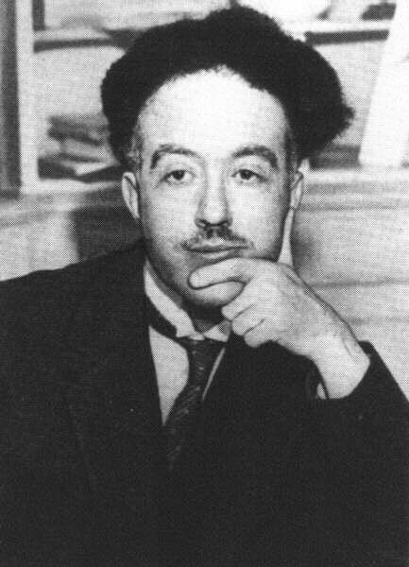
The de Broglie Hypothesis was originally hailed as the “French Comedy”…
In 1923 a graduate student named Louis de Broglie proposed a radical idea about matter: In addition to light, matter should also exhibit a wave-particle duality.
A particle of mass should have a wavelength defined by:
wavelength = h / (mass × speed)
where h = Plank’s constant = 6 x 10⁻³⁴

Slide 7
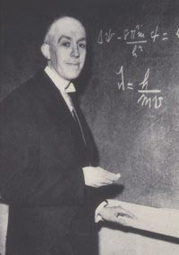
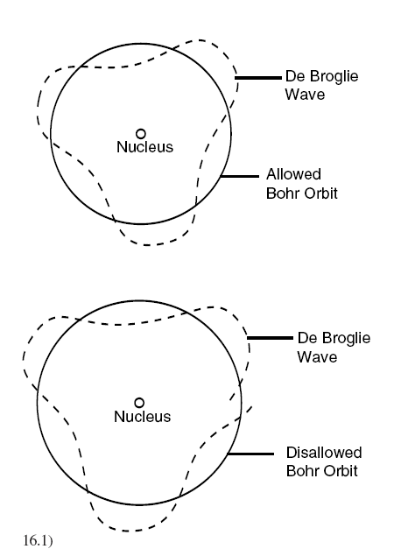
But it turned out to describe what we observe.
De Broglie’s idea explained the Bohr orbitals
The quantized orbits of the Bohr model are predicted perfectly by requiring electrons to exactly wrap 1, 2, 3, etc waves around the nucleus.
Nobel Prize, 1929

Slide 8
Examples
wavelength = h / (mass×speed)
where h = Plank’s constant = 6 x 10⁻³⁴
Wavelength = 10⁻³⁸ m
(nonsense?)
Wavelength = 10⁻³⁴ m
(again nonsense?)
Wavelength = 10⁻¹⁰ m
Diameter of an atom…
60 mph
100 mph
-
2,000 mph

Slide 9
Why don’t we observe the wave nature of matter?
To observe wave effects, your “slits” need to be similar to the wavelength
wavelength = h / (mass×speed)
h = 6 x 10⁻³⁴
Example: It would take 10²⁷ years for a student to “diffract” through a doorway.
For all material objects except the very least massive (such as electrons and protons), the wavelength is so immeasurably small that it can be completely ignored.

Slide 10
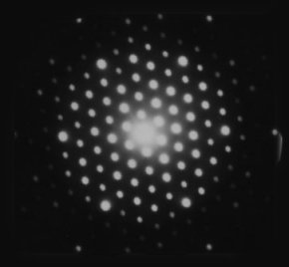
But are electrons really waves?
Let’s see if they diffract. We need slits about the size of the electron wavelength (~10⁻¹⁰ m) to witness it.
How do you make a slit that small? You can’t manufacture one, but nature provides something we can use: the space between atoms in a crystal.
Fire an electron beam at a crystal and we DO get diffraction and interference patterns! Electrons ARE waves!

Slide 12
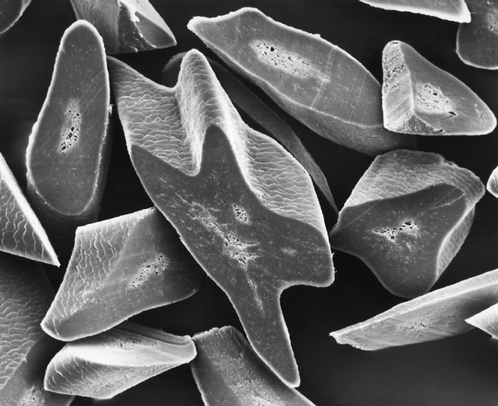
Small electron wavelength is useful in electron microscopes
Diffraction limits how small you can see with an optical microscope
When objects are about the size of the wavelength of light, light diffracts around the object so you can’t get a clear image.
Electron wavelengths can be 1/1000th the size of optical wavelengths. So using electron beams we can “see” things 1000 times smaller with the same clarity.

Slide 13
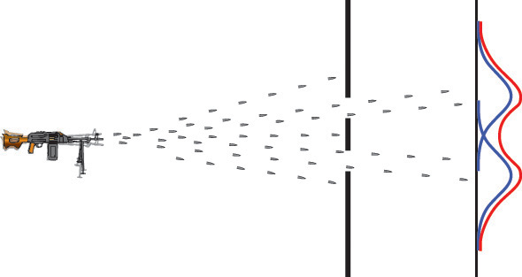
The concept of a probability distribution

Slide 14
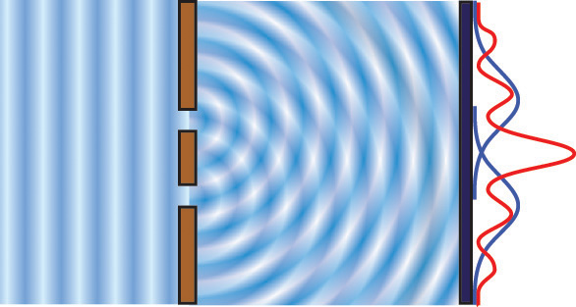
For waves, we can use the amplitude as a measure of where the wave “is”

Slide 15
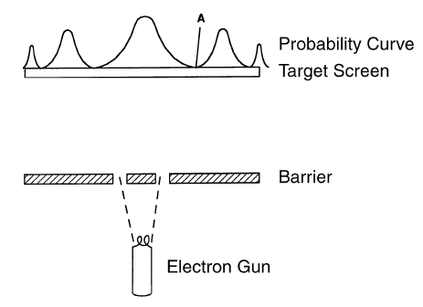
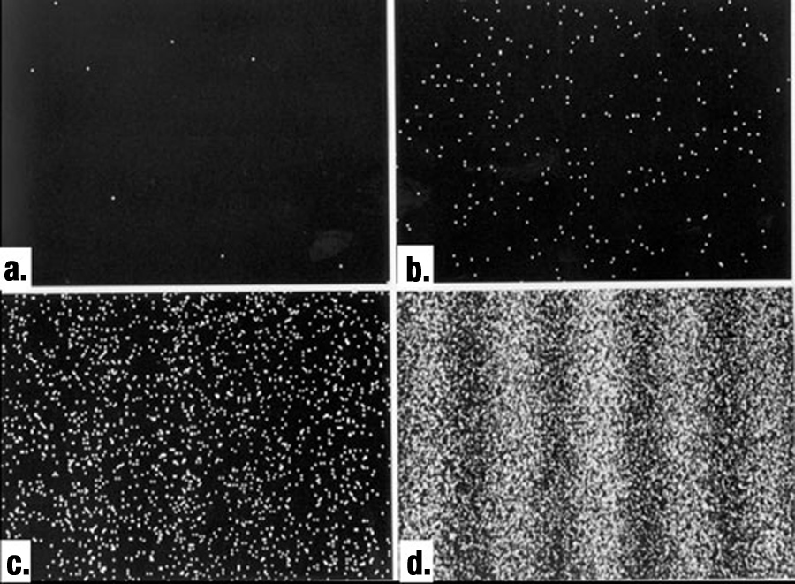
Experimental double slit experiment using electrons
Electrons are detected like particles, but the places that they are detected show interference patterns.
This is essentially the same behavior we observed with photons!

Slide 16
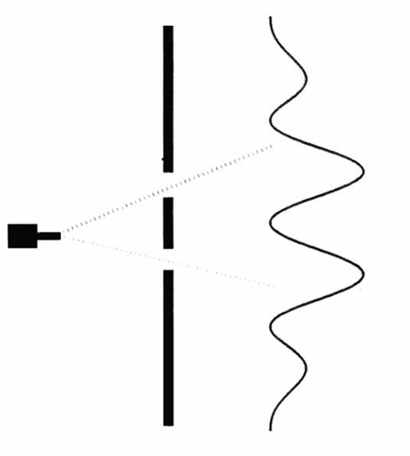
So, which slit does the electron go through?
Electron Detector

Slide 17
The results depend on how and what we measure.
Don’t measure which hole the electron goes through → wave-like behavior.
Do measure which hole the electron goes through → particle-like behavior.
How the electron behaves depends on whether it is observed.
Deep thought: How does one study an unobserved electron.
We have found the truth; and the truth makes no sense. (G. K. Chesterton)

Slide 18
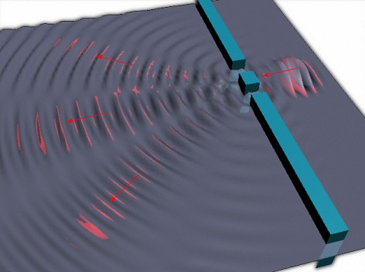
So what is waving?
The mass of the particle is not spread out and mechanically oscillating.
The “wave” is interpreted as being the probability of locating the particle.
High amplitude corresponds to high probability of detection.
It propagates like a pure wave with diffraction, interference, refraction, etc.
Somehow electrons “know” about the existence of both slits even when we cannot prove that they ever go through more than one slit at a time.
Clearly we need another model.

Slide 19
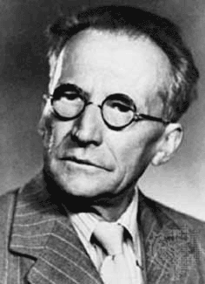
Schodinger’s wave mechanics
I don't like it and I'm sorry I ever had anything to do with it.

Slide 20
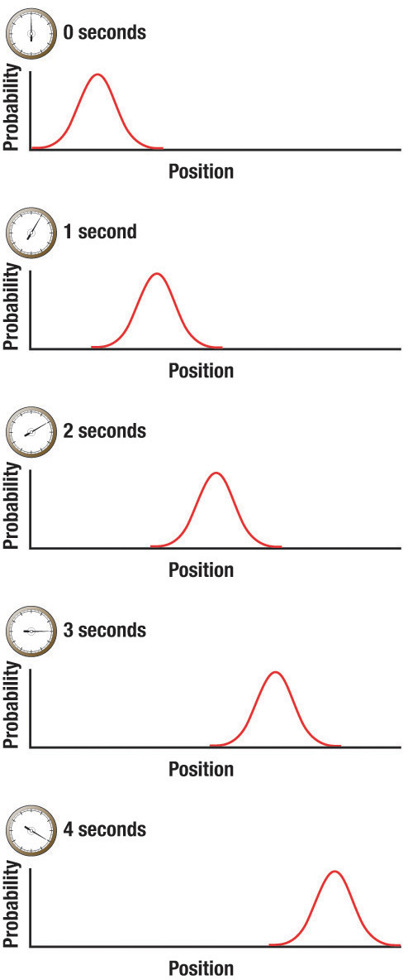
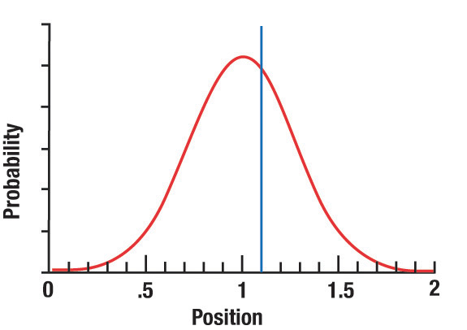
The electron position is described with a probability wave
When we measure the position, we find it at a certain position. We refer to this as the collapse of the wave function.

Slide 21
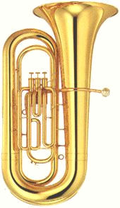
The Uncertainty Principle and waves
To find the trajectory of a particle we must know its position and velocity at the same time.
How do you locate the position of a wave/particle electron?
A well-defined momentum has a well-defined wavelength according to De Broglie.
wavelength = h / momentum
Pure sine wave → unclear position but clear wavelength (momentum).
Sharp pulse → clear position but unclear wavelength (momentum).

Slide 22
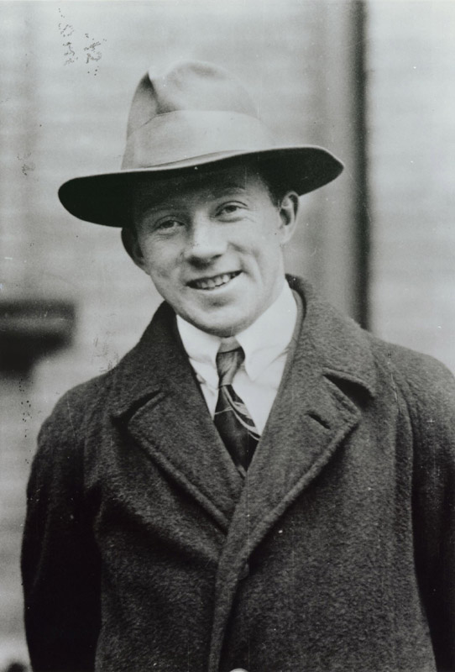
Heisenberg Uncertainty Principle
Electrons: fuzzy position and fuzzy wave properties.
The uncertainty in position times the uncertainty in momentum (mass x velocity) is greater than Planck’s constant. Or
∆x ∆(mv) > h

Slide 24
Consequences
If we try to find out where an electron is, we know less about where it is going.
Measuring position more accurately makes uncertainty in momentum larger.
This is an alternative explanation for electron diffraction.

Slide 25
Philosophical shift in wave mechanics
We could predict this interaction perfectly using Newton’s Laws of motion.
8
We cannot predict the results of this interaction perfectly in quantum mechanics. We can only give probabilities that certain outcomes will happen.
?
?
?
?

Slide 26
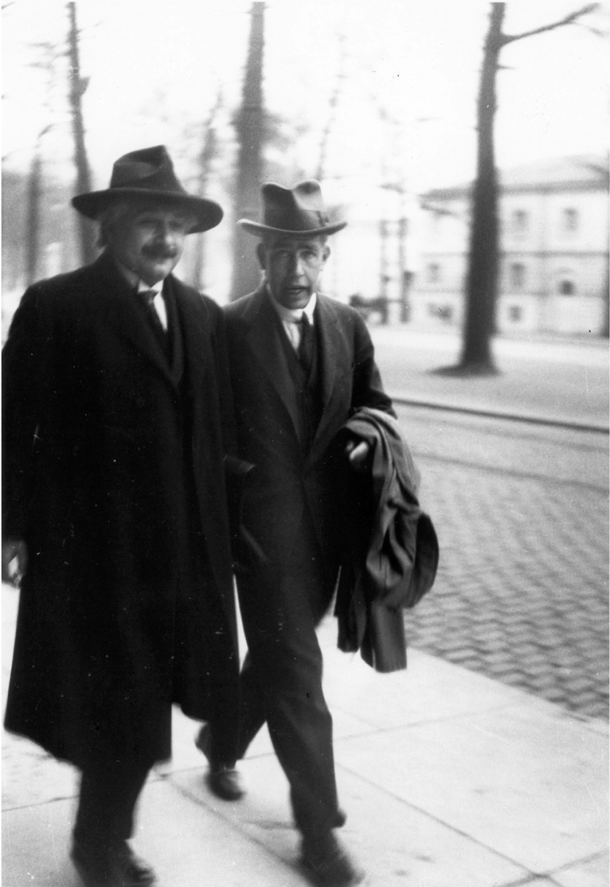
So does the electron “know” where it is and where it is going?
Quantum mechanics experiments demonstrate that there is fundamental uncertainty in nature.
It is not a matter of the experimentalist not being clever enough to measure both position and momentum at the same time. A particle simply cannot have an exact position and an exact momentum at the same time.

Slide 27
I hope this bothers you some…
I remember discussions with Bohr which went through many hours till very late at night and ended almost in despair; and when at the end of the discussion I went alone for a walk in the neighboring park I repeated to myself again and again the question: Can nature possibly be as absurd as it seemed to us in these atomic experiments?
~Werner Heisenberg

