Slide 1
Chapter 22: Bonding in Ionic Compounds
Did you read chapter 22
before coming to class?
Yes
No

Slide 2
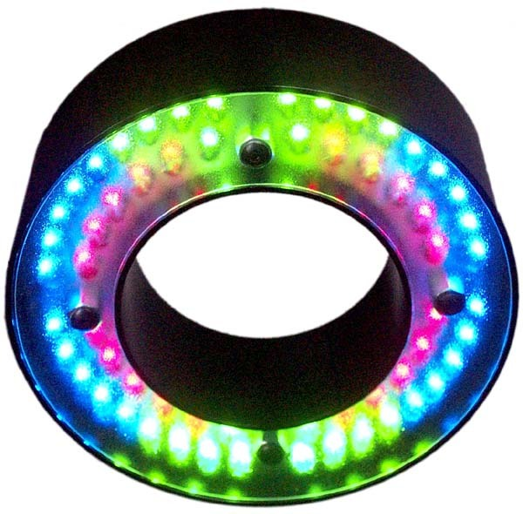
Review: Which color light emitting diode (LED) has the largest band gap?
Red
Yellow
Green
Blue
0

Slide 3
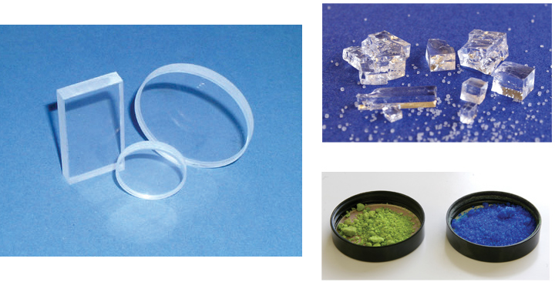
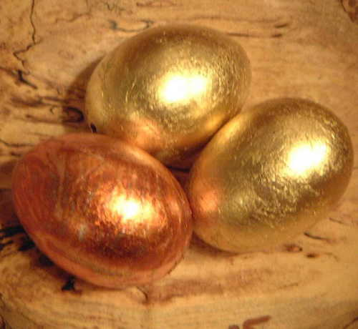
Compare and Contrast: Ionic Compounds vs Metals
Network Solids
High melting T’s
Brittle solids
Don’t conduct heat and electricity in solid
Often colorless and usually transparent in big chunks (White when powdered)
Network Solids
High melting T’s
Malleable
Good conductors of heat and electricity in solid
Opaque
Explanation: Many closely spaced energy levels with mobile electrons

Slide 4
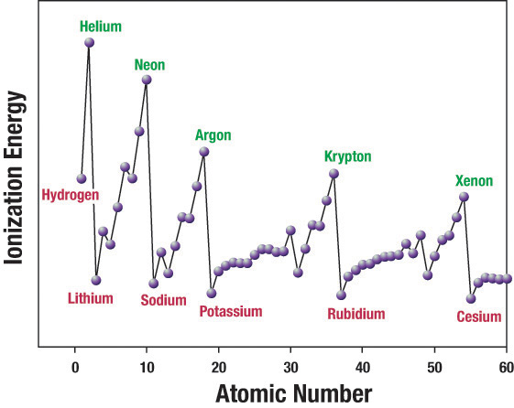
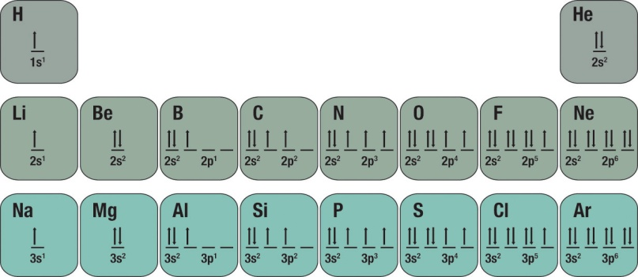
Metals vs Non-Metals
Metals
Large atoms
Few valence electrons
Low ionization energies
Non-metals
Small atoms
Many valence electrons
High ionization energies
Why do metals and non-metals react?
Principles of reactivity:
materials react to lower energy and increase entropy of universe

Slide 5
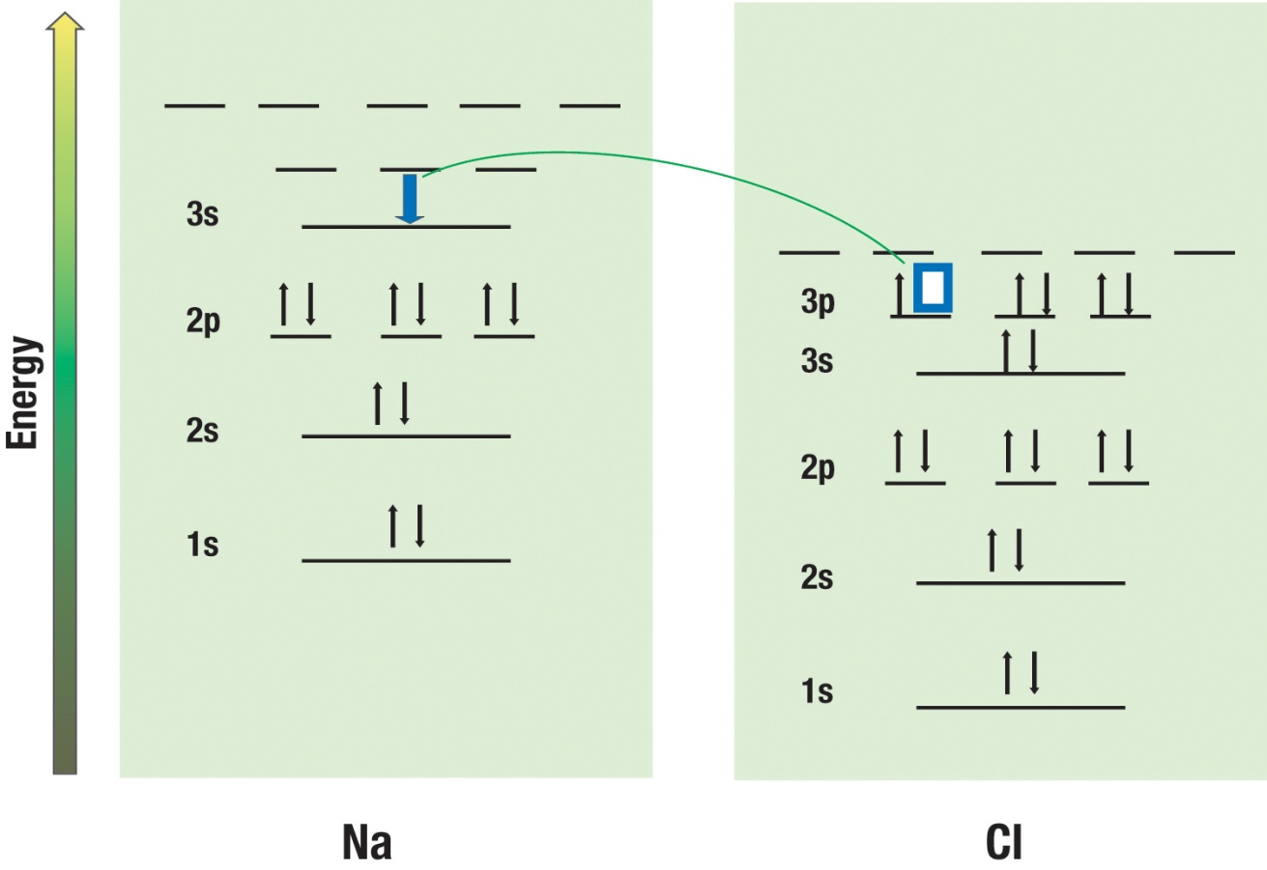
How can energy be lowered?
Metals lose valence electrons
Non-metals gain valence electrons
Process is downhill energetically

Slide 6
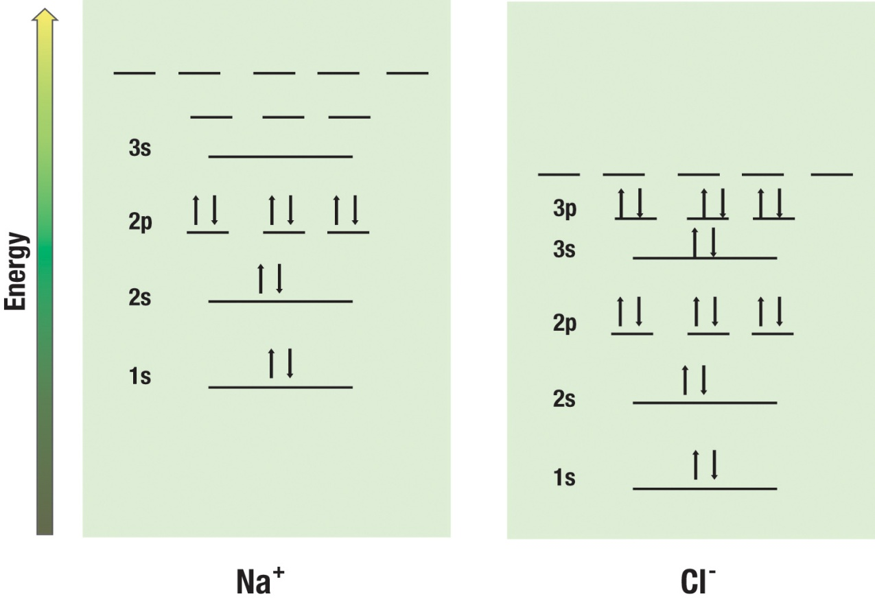
When electrons are moved from one atom to another, ions are produced
Positively charged
Sodium ions
(11 protons, 10 electrons)
Negatively charged
Chloride ions
35 protons, 36 electrons
Electrons “belong” to individual ions; they are not shared among ions
as was the case in metals.
Notes:
Pure fluorine (F2) is a corrosive pale yellow or brown[1] gas that is a powerful oxidizing agent. It is the most reactive and most electronegative of all the elements (4.0), and readily forms compounds with most other elements. Fluorine even combines with the noble gases, krypton, xenon, and radon. Even in dark, cool conditions, fluorine reacts explosively with hydrogen. It is so reactive that glass, metals, and even water, as well as other substances, burn with a bright flame in a jet of fluorine gas. It is far too reactive to be found in elemental form and has such an affinity for most elements, including silicon, that it can neither be prepared nor be kept in ordinary glass vessels. Instead, it must be kept in specialized quartz tubes lined with a very thin layer of fluorocarbons. In moist air it reacts with water to form also-dangerous hydrofluoric acid.
In aqueous solution, fluorine commonly occurs as the fluoride ion F−, although HF is such a weak acid that substantial amounts of it are present in any water solution of fluoride at near neutral pH. Other forms are fluoro-complexes, such as [FeF4]−, or H2F+.
Fluorides are compounds that combine fluorine with some positively charged counterpart. They often consist of crystalline ionic salts. Fluorine compounds with metals are among the most stable of salts.
Fluoride compounds, usually calcium fluoride, are naturally found in low concentration in drinking water and some foods, such as tea. Water with underground sources are more likely to have higher levels of fluoride, while the total concentration in seawater has an average concentration of 1.3 parts per million (ppm).[1] Fresh water supplies generally contain between 0.01-0.3 ppm, while the ocean contains between 1.2 and 1.5 ppm

Slide 7
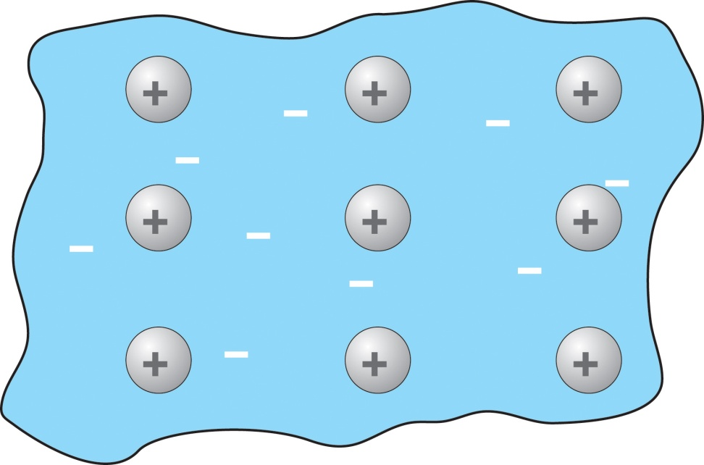
Electron location and mobility is much lower in an ionic substance than in a metal
Ionic Crystal
Metal
+
+
+
+
+
+
+
+
+
Electrons – fixed;
localized on individual
nucleus
Sea of Electrons – mobile;
electron density is spread out
over many nuclei

Slide 8
Energy levels in an ionic crystal have relatively large spacing (rather than the nearly continuous spacing in metals)
IONIC COMPOUND ENERGY LEVELS
few levels, spaced very far apart
many closely spaced levels
spread out over many nuclei

Slide 9
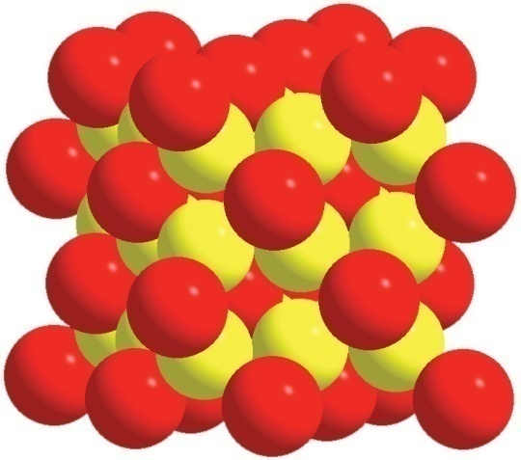
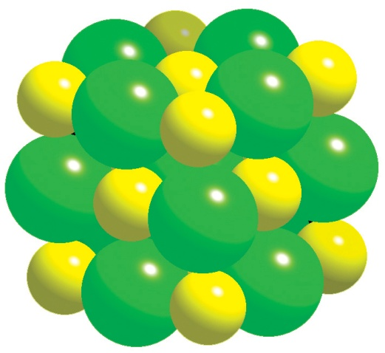
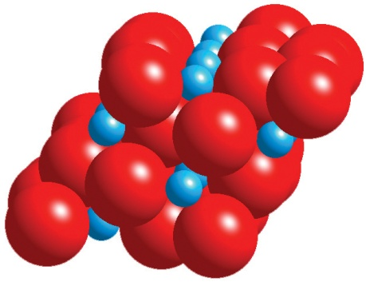
Examples of Ionic Compounds
Na₂O
NaCl
Al₂O₃
Ions: different
charges and sizes
Ions: similar sizes,
but different charges
Ions: same charges
and similar sizes
Describe the structure of each compound: Do ions of one type cluster together?
What type of ion immediately surrounds a given ion?
How do the answers to these two questions relate to the electric force law?
What prediction could you make about the arrangement of ions in any ionic compound?

Slide 10
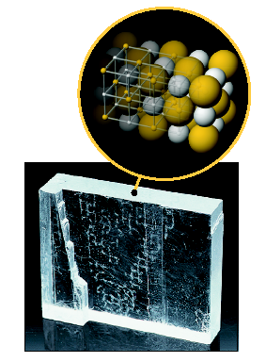
Formation of a salt crystal
2Na + Cl₂ = 2NaCl
What about entropy change?

Slide 11
What about entropy change?
2Na + Cl₂ = 2NaCl + lots of heat and light
Heat and light – cause an increase in entropy of the surroundings

Slide 12
How does the model explain properties of salts (ionic compounds) ?
High melting and boiling temperatures?
Strong attractions between + and – ions
Attractive forces act over fairly large atomic distances
Brittleness?
Strong repulsions when ions with like charge come together; material shatters to relieve the stress.

Slide 13
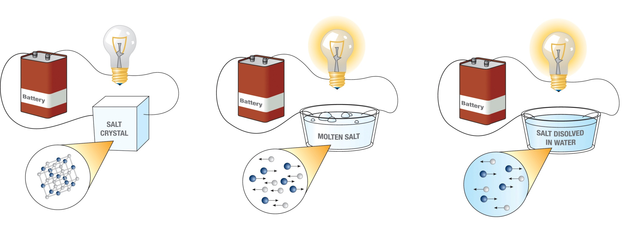
Conductivity
Don’t conduct as a solid. Why?
Do conduct when molten or dissolved. Why?

Slide 14
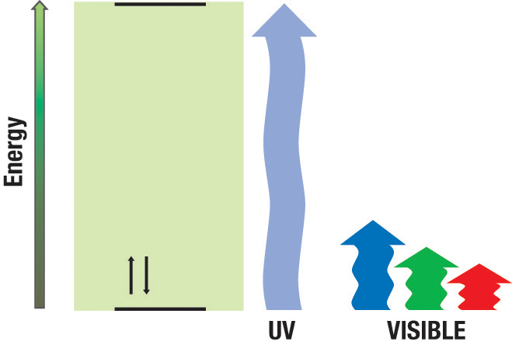
Salts are generally transparent to light
Why are they transparent?
Electron orbitals are localized around individual ions with FEW energy levels

Slide 15
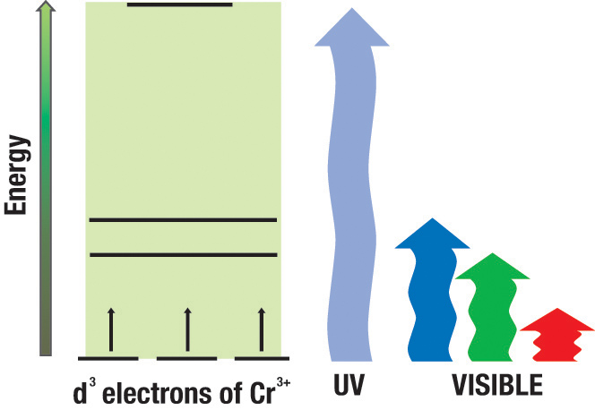
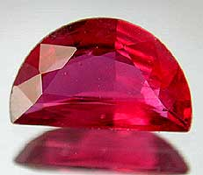
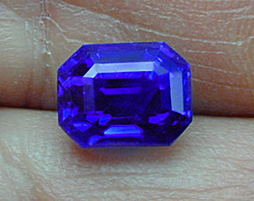
Why are some ionic materials colored?
Because they contain “transition” metals with more energy levels for electrons
Sapphire is a crystalline form of Ol₂O₃
Chromium substitutions in the lattice allow blue and green light to be absorbed, resulting in a Ruby.
Titanium and Iron substitutions allow green and red light absorption, and give the blue color to what we normally think of as Sapphire

Slide 16
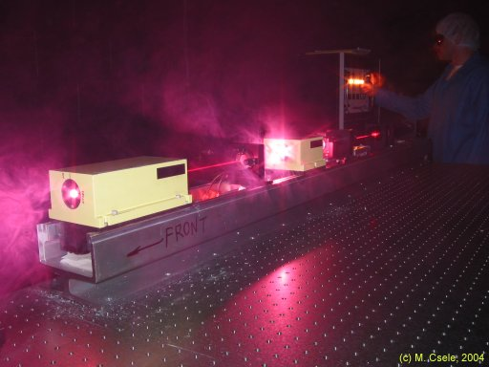
Making a laser
A ruby laser is possible because of the energy level structure

Slide 17
We can use the periodic table to make predictions of what ions usually form.
Unreactive
noble gases
don’t form
ions.
Metals lose their
valence electrons.
Non-metals gain enough valence electrons
to become “noble”.

Slide 18
The octet rule
Atoms will most likely form an ion that has the ns²np⁶ configuration of the closest noble gas atom.
Metals take on this configuration by losing electrons
Non-metals take on this configuration by gaining electrons

Slide 19
Families
Chlorine and Fluorine will form the same types of compounds since their valence electrons are the same number and same orbital type.
3d
3p
3s
3d
3p
3s
2p
2p
₉F
2s
₁₇Cl
2s
1s
1s

Slide 20
Beryllium (Be) will most likely form an ion with what charge?
-1
-2
+1
+2

Slide 21
What would the chemical formula for magnesium fluoride (a salt of Mg and F) be?
MgF
Mg₂F
MgF₂
MgF₃

Slide 22
Ionic compounds are neutral (no net charge). What are the ionic charges in the following compounds?
NaCl
KBr
MgF₂
Al₂O₃
Na⁺¹ and Cl⁻¹
K⁺¹ and Br⁻¹
Mg⁺² and F⁻¹
Al⁺³ and O⁻²

Slide 23
Naming convention for salts
The metal comes first with its name unchanged
The nonmetal comes second, with the suffix “ide” appended

Slide 24
Predicting Formulas for Salts
Find the number of electrons lost by the metals and gained by the non-metals.
If they are equal, the atoms combine one to one.
If they are NOT equal, use the number lost/gained for the other atom’s subscript.
Examples
Mg and O
P and Ca
N and Li
Mg ²⁺ & O ²⁻⁻ → MgO
P ³⁻ & Ca ²⁺ → Ca₃P₂
N ³⁻ & Li ⁺ → Li₃N

Slide 25
When Potassium (K) and Chlorine (Cl) combine the resulting formula is
KCl
K₂Cl
KCl₂
K₂Cl₃
K₃Cl₂

Slide 26
When Aluminum (Al) and Chlorine (Cl) combine the resulting formula is
AlCl
Al₂Cl
AlCl₂
AlCl₃
Al₃Cl₂

Slide 27
When Magnesium (Mg) and Sulfur (S) combine the resulting formula is
MgS
Mg₂S
MgS₂
Mg₂S₃
Mg₃S₂

Slide 28
When Calcium (Ca) and Phosphor (P) combine the resulting formula is
CaP
Ca₂P
CaP₂
Ca₂P₃
Ca₃P₂

Slide 29
How about carbon?
Would carbon like to gain or lose electrons?
It turns out that it likes to share electrons in covalent bonds, which we’ll talk about on Monday.

