Slide 1
Chapter 25: Radioactivity, Nuclear Processes, and Applications
The discovery of nuclear chain reactions need not bring about the destruction of mankind any more than did the discovery of matches. We only must do everything in our power to safeguard against its abuse.
~ Albert Einstein
Did you read chapter 25 before coming to class?
Yes
No

Slide 2
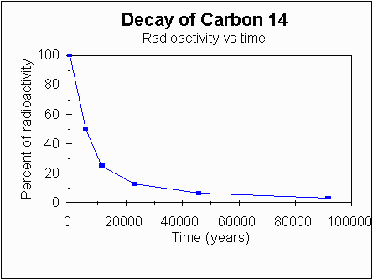
I done messed up big time, not cool
Considering Carbon Dating
Carbon-14 does not decay into Carbon-12
Carbon-14 decays into Nitrogen-14 and an electron
However! The ratio of C-14 to C-12 approaches that of the atmosphere
Can Carbon-14 can decay into Carbon-12?
C-14
e
+
e
p
p

Slide 3
I remain standing corrected
Considering Trans Fats
When margarine was first introduced to the marketplace, it was loaded with trans fats.
In recent years, food manufacturers and the general public began to realize the negative health effects of trans fats. As a result, manufacturers have created non-hydrogenated margarine, which is now widely available. Non-hydrogenated margarine contains no trans fat, and it's softer than the first-generation margarine stick.
Typical soft tub margarine contains 0.2 to 0.3% trans-fatty acids. Butterfat contains 2-3% trans-fatty acids.[
A type of trans fat occurs naturally in the milk and body fat of ruminants (such as cattle and sheep) at a level of 2–5% of total fat.
Foods containing artificial trans fats formed by partially hydrogenating plant fats may contain up to 45% trans fat compared to their total fat.^{[29]} Baking shortenings, in general, contain 30% trans fats compared to their total fats, whereas animal fats from ruminants such as butter contain up to 4%. Margarines not reformulated to reduce trans fats may contain up to 15% trans fat by weight.

Slide 4
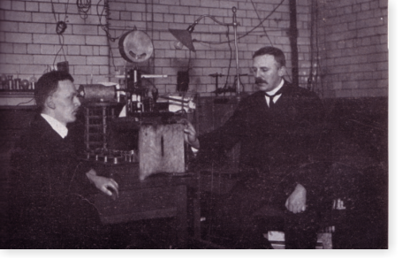
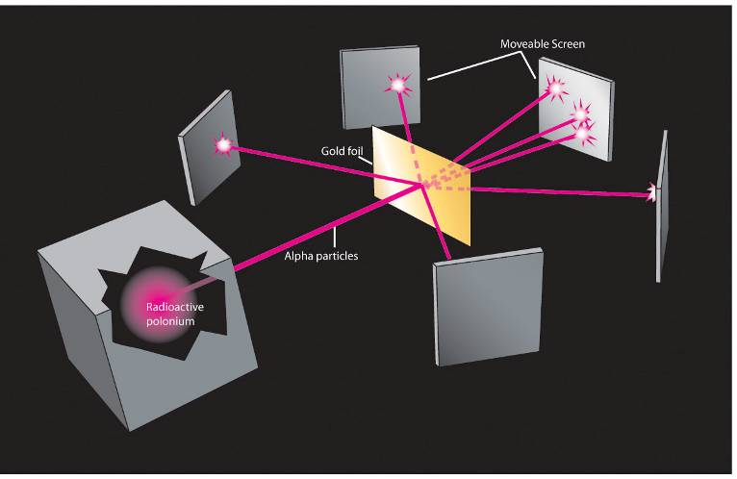
What do we know about the nucleus?
Rutherford discovered
Contains positively charged protons.
Held together by the Nuclear Strong Force.

Slide 5
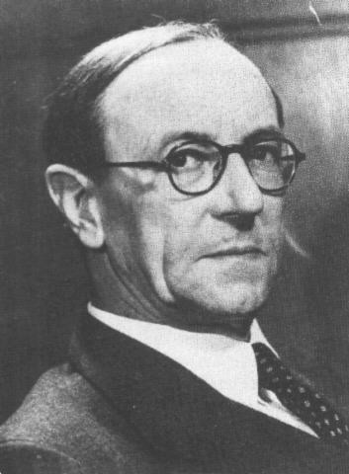
James Chadwick and the discovery of the neutron
Scientists in the early 1900’s knew that there was too much mass in the nucleus for it to be composed only of protons.
In 1930, bombardment of beryllium with alpha particles from a radioactive source produced neutral radiation which was penetrating but non-ionizing. They presumed it was gamma rays, but Curie and Joliot showed that when you bombarded a paraffin target with this radiation, it ejected protons with energy about 5.3 MeV. This proved to be inconsistent with gamma rays, as can be shown from momentum and energy analysis
Notes:
For four years, James Chadwick was a prisoner of war in Germany. When World War I ended, he returned to his native England to rejoin the mentor of his undergraduate days, Ernest Rutherford. Now head of Cambridge University's nuclear physics lab, Rutherford oversaw Chadwick's PhD in 1921 and then made him assistant director of the lab.
Chadwick kept the problem in the back of his mind while working on other things. Experiments in Europe caught his eye, especially those of Frederic and Irene Joliot-Curie. They used a different method for tracking particle radiation. Chadwick repeated their experiments but with the goal of looking for a neutral particle -- one with the same mass as a proton, but with zero charge. His experiments were successful. He was able to determine that the neutron did exist and that its mass was about 0.1 percent more than the proton's. He published his findings with characteristic modesty in a first paper entitled "Possible Existence of Neutron." In 1935 he received the Nobel Prize for his discovery.
When James Chadwick reported to Lord Rutherford on the Joliot-Curies’ results, Lord Rutherford exclaimed, "I do not believe it!" Chadwick immediately repeated the experiments at the Cavendish Laboratory in Cambridge, England. He not only bombarded the hydrogen atoms in paraffin with the beryllium emissions [neutrons], but also used helium, nitrogen, and other elements as targets. By comparing the energies of recoiling charged particles from different targets, he proved that the beryllium emissions contained a neutral component with a mass approximately equal to that of the proton. He called it the neutron in a paper published in the February 17, 1932, issue of Nature. In 1935, Sir James Chadwick received the Nobel Prize in physics for this work. It is interesting to note that the Joliot-Curies’ misinterpretation of their results cost them the Nobel Prize. (Not to worry; in 1935, they received the Nobel Prize in chemistry for their discovery of artificial radioactivity.)

Slide 6
So what is the equation for the nuclear strong force?
We don’t know.
Here is what we do know:
It is much stronger than the electric force at small separations.
It is much weaker than the electrical force at large separations.
The nucleons are in specific energy levels and obey the exclusion principle

Slide 7
Modeling the nucleus
All of the previously discovered rules still apply.
Electric force law – protons will repel each other.
Wave-particle duality – protons and neutrons will behave as waves of probability.
Pauli exclusion principle – only one proton (or neutron) can occupy each possible state.
Energy
n
p
n
p
p
n
p
p
n
p
n
n
p
n
p
p
p
p
p
n
p
n
p
p
n
p
p
n
n
p
n
n
p
p
p
n
n
p
p
n
n
p
p
p
p
n
n
n
p
n
p
p
n
n
p
n
p
p
p
p
n
p
p
n
n
Electromagnetic force
n
n
p
p
p
n
n
n
p
n
p
p
n
p
p
p
p
n
n
n
p
p
p
n
n
Strong force
n
n
Distance between nucleons

Slide 8
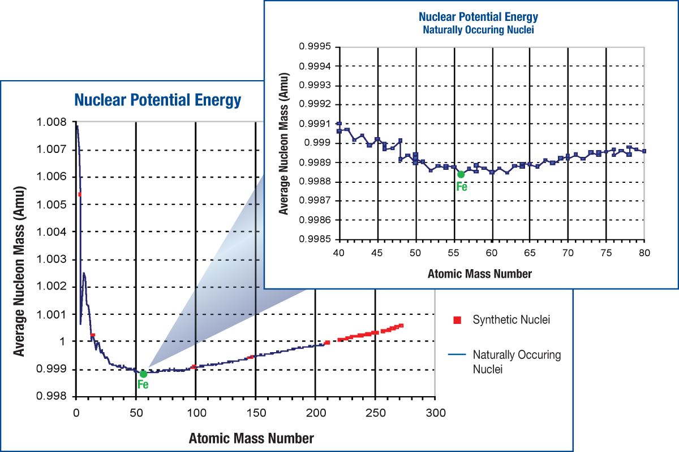
Where does the mass go? Why does the graph go down so steeply at low atomic mass?
E = mc²

Slide 9
Why would the graph increase at large atomic mass?
E = mc²

Slide 10
The graph abruptly ends. What does this tell us about the range of the nuclear strong force?
E = mc²

Slide 11
Nuclear energy. Explain the following:
How does the mass of a proton in a hydrogen atom compare to the mass of a proton in a helium atom?
How do the nuclear potential energies compare?
How do nuclear forces explain this?

Slide 12
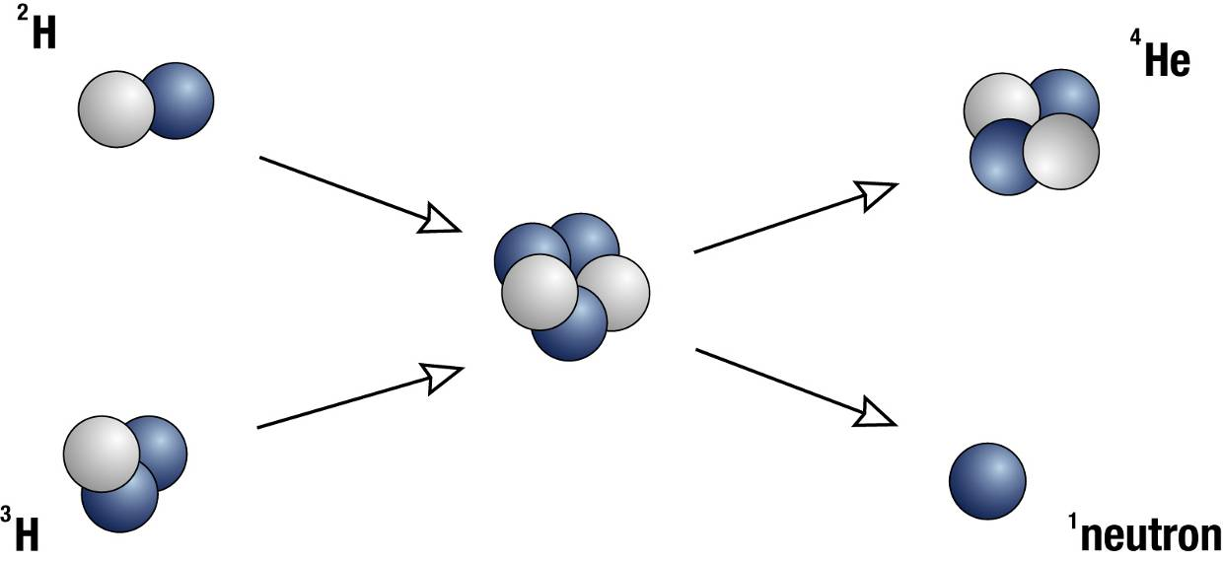
Fusion
Combining two small nuclei to make a larger one gives off energy.
Abundant fuel (in sea water) and large energy gain make this a very exciting possibility.
The catch: Because nuclei are positively charged, you need either extremely hot reactants or large confining forces.
What forces do you have available for confinement?

Slide 13
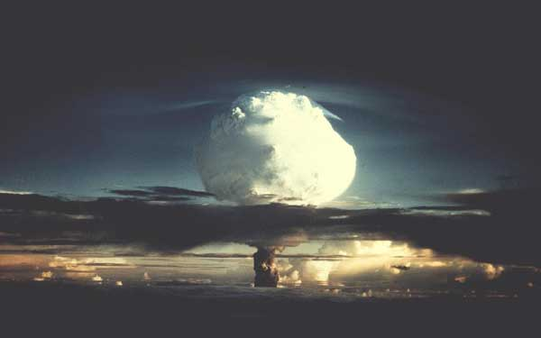
No confinement

Slide 14
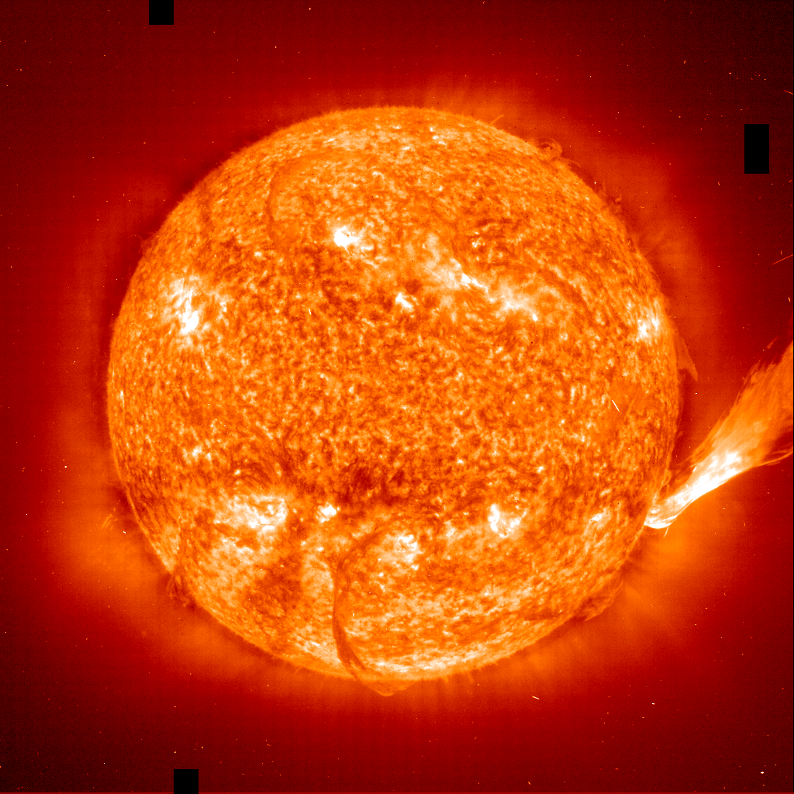
Gravitational confinement

Slide 15
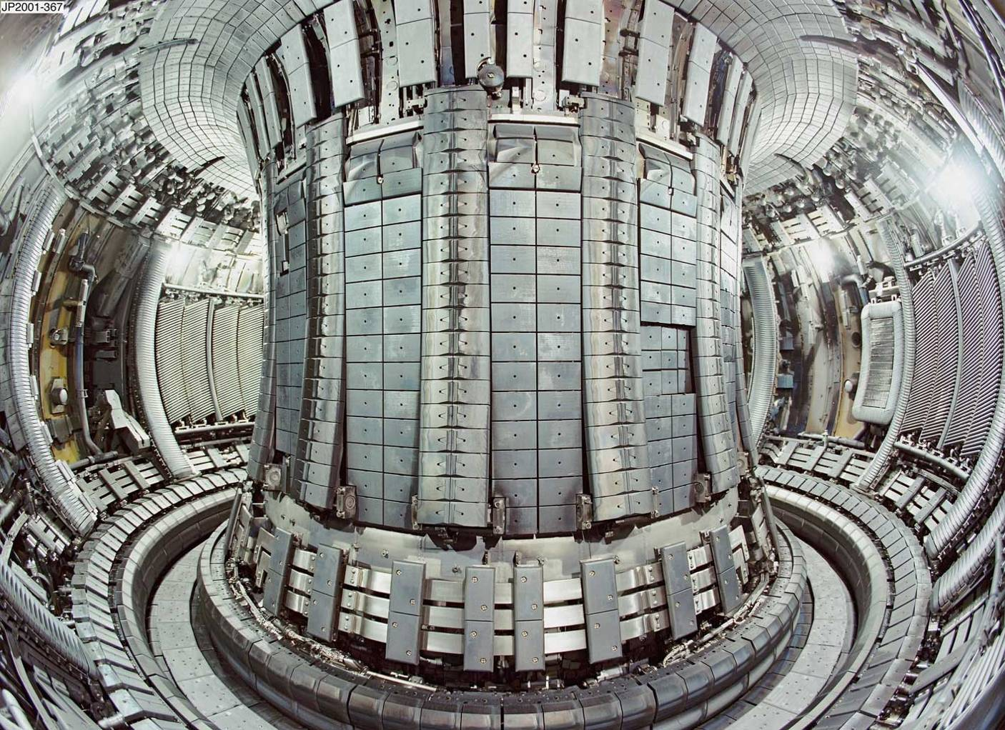
Confinement using magnetic fields: Tocamak

Slide 16
Another way to do nuclear energy
How does the mass of a proton in a uranium atom compare to the mass of a proton in an iron atom?
How do the nuclear potential energies compare?
How do nuclear forces explain this?

Slide 17
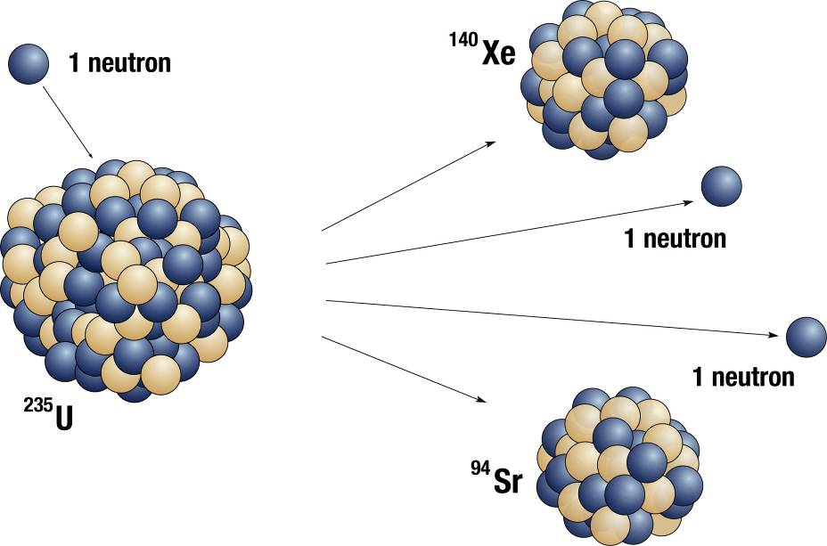
Fission
Breaking one extremely large nucleus into two smaller ones gives off energy.
Free neutrons from one fission can trigger another fission, creating a chain reaction.
This reaction is easy to control simply by changing the number of neutrons that are absorbed by inert atoms.
This reaction produces isotopes not normally found in nature.

Slide 18
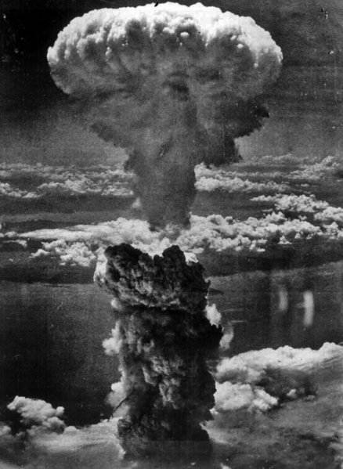
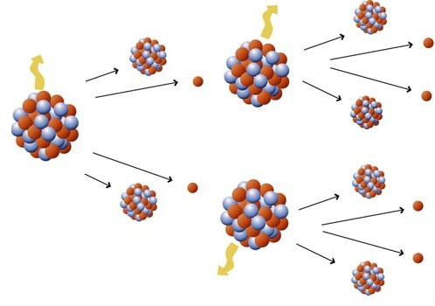
Fission Process
Notes:
mass of fragments vary, but usually 2 fragments and 2-4 neutrons come out. The extra neutrons can trigger other reactions. This process is much more probable with slow neutrons (they spend more time near the nucleus and have more time to react).

Slide 19
A chain reaction

Slide 20
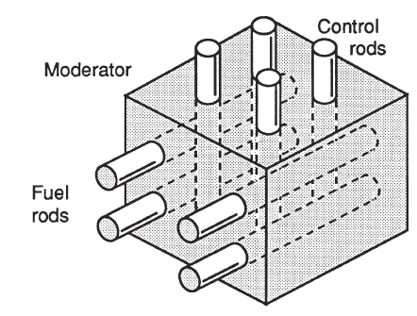
Fission Reactor
Fissile material (fuel rods)
²³⁵U, ²³⁹Pu
Moderator
Slow neutrons down
Control rods
Absorb extra neutrons
Problems
radioactive waste
fuel is rare
fuel can be misappropriated for weapons
mistakes are costly
Notes:
²³⁹Pu can be produced in a breeder reaction
fuel rods, ²³⁵U and ²³⁹Pu
good control rod: cadmium
good moderator: graphite, water
wastes have a long half life. Yucca Mountain--repository in Nevada: a place to put this (Nevada residents do not want to be the nuclear dumping ground of the nation). Nearby states (including Utah) don’t want fuel going through their state on the way there.

Slide 21
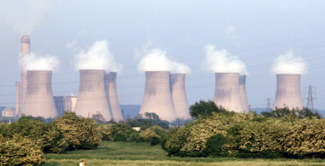
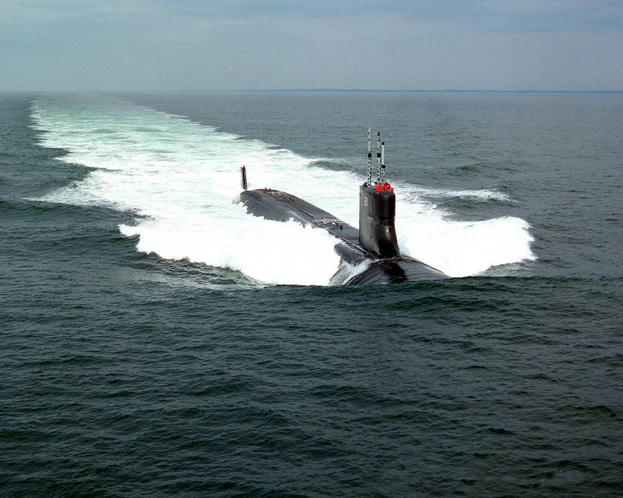
Current applications for fission reactors

Slide 22
When you look in more detail, what do you see? Why don’t all possible isotopes occur naturally?
Two or three different nuclei at the same mass number

Slide 23
Missing isotopes
We don’t see something we would expect to see … not all combinations of protons and neutrons occur. We don’t even find byproducts of naturally occurring fission. Why not?
Nature favors the state with the most disorder.
The missing isotopes must change into atoms with less nuclear potential energy (mass).
The energy will be released as heat.

Slide 24
Radioactive decay
Important laws
Conservation of mass-energy … The total mass-energy before is the same as the total mass-energy after the decay. Things decay into atoms with less mass so that energy can be released.
Conservation of Charge … the total number of positive - negative charges before and after the reaction must be the same.

Slide 25
Radioactive decay
Alpha decay – A nucleus emits 2 protons and 2 neutrons (a helium nucleus).
Beta decay – A proton changes into a neutron or vice versa
Gamma decay – Protons or neutrons shift energy levels and emit a high-energy photon.

Slide 26
Ionizing Radiation
The particles released in decay carry a lot of energy
often a million times typical molecular binding energies
danger to living cells
damage RNA or DNA causing death of cells or mutations
disrupt metabolic processes
cells with high activity seem more prone to damage than others (cancer therapy)
Notes:
damage could be direct (damage RNA directly) or disrupt other molecules that then damage DNA or RNA
cal also be used to control cancer

Slide 27
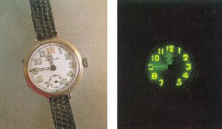
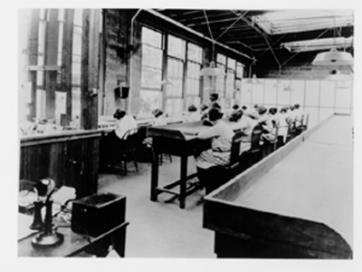
Radium watches
Notes:
During World War I and after, young women at the U. S. Radium Corporation in Orange were employed painting luminous dial watches with a radium material. Apparently, the women were directed to point up their brushes with their tongues, imbibing radioactive paint. After the war, it was discovered that these women were dying of anemia and a disease called radium necrosis (radium poisoning) which ate away their jawbones. The initial investigation was made by Katherine Wiley of the Consumers League of New Jersey, who was called in by the family of one of the women in 1924. The League campaigned successfully to have radium necrosis recognized as an occupational disease by the State Workmen's Compensation Board in 1926, too late, however, to benefit women who had suffered from radium poisoning before the law was passed. The League aided them with their lawsuits until 1935, when all proceedings for damages against U. S. Radium were stopped. The universal horror caused by this case contributed to the passage in 1949 of a bill making all industrial diseases compensable and extending the time during which workers could discover illness.

Slide 28
Energy Released or Absorbed for nuclear process involving element “A”?
 | A<Fe | A>Fe
Fusion | Released | Absorbed
Fission | Absorbed | Released
Notes:
During World War I and after, young women at the U. S. Radium Corporation in Orange were employed painting luminous dial watches with a radium material. Apparently, the women were directed to point up their brushes with their tongues, imbibing radioactive paint. After the war, it was discovered that these women were dying of anemia and a disease called radium necrosis (radium poisoning) which ate away their jawbones. The initial investigation was made by Katherine Wiley of the Consumers League of New Jersey, who was called in by the family of one of the women in 1924. The League campaigned successfully to have radium necrosis recognized as an occupational disease by the State Workmen's Compensation Board in 1926, too late, however, to benefit women who had suffered from radium poisoning before the law was passed. The League aided them with their lawsuits until 1935, when all proceedings for damages against U. S. Radium were stopped. The universal horror caused by this case contributed to the passage in 1949 of a bill making all industrial diseases compensable and extending the time during which workers could discover illness.

Slide 29
Half Life
The half life is the time it takes half a sample of radioactive nuclei to decay
Importance examples
¹⁴C --> ¹⁴N + e + neutrino (half life of 5730 years)
⁴⁰K + e --> ⁴⁰Ar + neutrino (half life of 1.3 billion years)
Applicable only to matter which was once living and presumed to be in equilibrium with the atmosphere, taking in carbon dioxide from the air for photosynthesis.
Carbon-14 decays with a halflife of about 5730 years by the emission of an electron of energy 0.016 MeV. This changes the atomic number of the nucleus to 7, producing a nucleus of nitrogen-14. At equilibrium with the atmosphere, a gram of carbon shows an activity of about 15 decays per minute.

Slide 30
Half Life

Slide 31
Radioactive Dating
Each half-life, half of the remaining atoms are left undecayed.
One half-life--> ½
Two half-lives--> ½ x ½ = 1/4
Three half-lives--> ½ x ½ x ½ = 1/8
If the original number of atoms is known, the age of the sample can be determined by the fraction of atoms left.
This process is known as radioactive dating

Slide 32
A sample of radioactive gas is produced. After 20 minutes, only ¼ of the original gas remains. What is the half life of the gas?
5 minute
10 minutes
15 minutes
20 minutes

Slide 33
A sample of radioactive material with a half-life of 6 hours sits for a day (24 hrs). How much of the original material remains?
A half
A quarter
An eighth
A sixteenth

Slide 34
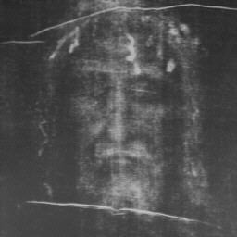
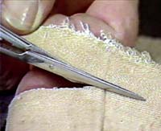
Extra Credit: Shroud of Turin
Result: AD 1260 - 1390
The Shroud of Turin, a linen cloth on which appear the imprints of the front and back of a crucified man, can be historically traced to ca. 1354 a.d. Many believe it to be a true relic of the Passion of Christ. Many others regard it as a fake. This paper suggests a third alternative, that it is an icon dating from the 11th century. If future scientific tests, of which radiocarbon dating will be the most important, support this theory, the Shroud of Turin may well be recognized as one of the masterpieces of Christian art.

