Slide 1
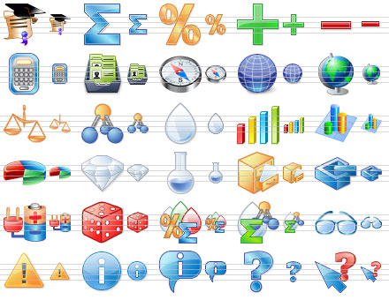
The Comprehensive Final Slide
PS1000 Fall 2010
UVU West NG106
Tu/Th 6-7:15

Slide 2
Occam’s Razor
When two ideas explain the same result and do not contradict, we favor the simpler one. i.e. Occam’s razor “slices away” the extraneous aspects leaving only the simple core.
William of Ockham 1288-1348
Notes:
Crop circle
From Wikipedia, the free encyclopedia
(Redirected from Crop circles)
Jump to: navigation, search
A crop circle pattern. See also: A crop circle on Google maps.
Crop circles are geometrical formations of flattened crops found in England and elsewhere. They have been found in wheat, barley, canola, rye, corn, linseed and soy.
The phenomenon itself was noticed in its current form after notable appearances in England in the late 1970s. Various explanations were offered for the phenomenon, which soon spread around the world. In 1991, two men, Doug Bower and Dave Chorley, revealed that they had been making crop circles in England since 1978 using planks, rope, hats and wire as their only tools[1][2]. Circlemakers.org[3] a UK-based arts collective founded by John Lundberg have been creating complex crop circles since the early 1990s. [4].
Despite the evidence that crop circles are of human origin various paranormal theories continue to enjoy some currency, although these violate Occam's Razor.[5]
History of crop circles
The phenomenon of crop circles became widely known in the late 1980s, after the media started to report crop circles (later found to have been created by Doug Bower and Dave Chorley) in Hampshire and Wiltshire. Subsequently crop circle enthusiasts have tried finding examples of the phenomenon before this. The earliest recorded crop circle is depicted in a 17th century woodcut called the Mowing-Devil. The image depicts a strange creature creating a circular design in a field of corn. The pamphlet the image appeared in states that the farmer, disgusted at the wage his mower was demanding for his work, insisted that he would rather have "the devil himself" perform the task.
A more recent historical report of crop circles was published in the journal Nature in 1880 (reproduced in 1991). An amateur scientist named Brandon Meland describes a field containing a number of crop circles, along with the suggestion that they might have been caused by "some cyclonic wind action".[1]
Although the pixie circles created by Elves in Scandinavian folklore were most likely caused by fungus colonies, there was also a rarer kind, consisting of circular patches where the grass had been flattened:
On lake shores, where the forest met the lake, you could find elf circles. They were round places where the grass had been flattened like a floor. Elves had danced there. By Lake Tisaren, I have seen one of those. It could be dangerous and one could become ill if one had trodden over such a place or if one destroyed anything there (an account given in 1926, Hellström 1990:36).
Not long after WWII, the aerial surveys that were being made over large areas of Britain revealed some unexpected phenomena, undetectable from the ground. When the surveys photographed ripening crops or drought-stressed terrain they revealed what were soon termed "crop marks", the differential ripening of the crop that revealed differences in the subsoil. These patterns were found to be caused by the buried remnants of ancient buildings. Archaeological investigations were soon instigated, but, though many previously unsuspected archaeological sites were found, no crop circles were ever recorded. Skeptics argue that this would have pointed to circles as a modern phenomenon, even if the initial pranksters had not revealed themselves; believers reply different agendas may simply be at work in the modern day.
Crop circles shot into prominence in the late 1970s as many circles began appearing throughout the English countryside. To date, thousands of circles have appeared at sites across the world, from disparate locations such as the former Soviet Union, the UK and Japan, as well as the U.S. and Canada. Some skeptics note a strong inverse correlation between crop circles and the presence of fencing and/or anti-trespassing legislation, as well as a great increase in the number of crop circles after media coverage.[citation needed]
[edit] Creators of crop circles
In 1991, more than a decade after the phenomenon began, two men from Southampton, England announced that the phenomenon of crop circles was an idea thought up one evening in a pub near Winchester, Hampshire in 1978. World War II veteran Doug Bower and his friend Dave Chorley revealed that they made their crop circles using planks, rope, hats and wire as their only tools. Bower and Chorley stated to reporters that a small group of people can stomp down a sizable area of crop in a single night using simple tools.
The pair became slightly frustrated that their work had not received as much publicity as they had hoped. In 1981 they created a crop circle in Matterley Bowl, a natural amphitheatre just outside Winchester, Hampshire - an area surrounded by roads from which a clear view of the field is available to drivers passing by.
Bower's wife had become increasingly suspicious of him due to noticing high levels of mileage in their car. Eventually, fearing that his wife suspected him of adultery, Bower confessed to her and subsequently informed a British national newspaper.
Bower revealed on TV the method he used. With a four-foot-long plank attached to a rope, circles of eight feet in diameter could be easily created. He stated that a 40-foot circle could be created by two men in a quarter of an hour. The designs were at first simple circles. When newspapers claimed that the circles could easily be explained by natural phenomena, Bower and Chorley chose more complex patterns. A simple wire with a loop, hanging down from a cap - the loop positioned over one eye - could be used to focus on a landmark to aid in the creation of straight lines. Later designs of crop circles became increasingly complex.
Dave Chorley died in 1996, and Doug Bower has made the occasional crop circle as recently as 2004. Bower has said that, had it not been for his wife's suspicions, he would have taken the secret to his deathbed, never revealing that it was a hoax.
Circlemakers.org, perhaps the best-known group of contemporary crop circle makers, was founded by John Lundberg. They have demonstrated that making what self-appointed cerealogist experts state are "unfakeable" crop circles is possible. One such cerealogist, Terence Meaden, was filmed claiming that a crop circle was genuine when the humans making the circle had been filmed the night before. On the night of July 11-12, 1992, a crop-circle making competition, for a prize of several thousand pounds (partly funded by the Arthur Koestler Foundation), was held in Berkshire. The winning entry was produced by three helicopter engineers, using rope, PVC pipe, a trestle and a ladder. Another competitor used a small garden roller, a plank and some rope. Minimal equipment and preparation sufficed to produce even the most complex crop circle designs.
Scientific American published an article by Matt Ridley[5], who started making crop circles in northern England in 1991. He wrote about how easy it is to develop techniques using simple tools that can easily fool later observers. He reported on "expert" sources such as the Wall Street Journal who had been easily fooled, and mused about why people want to believe supernatural explanations for phenomena that are not yet explained. Methods to create a crop circle are now well-documented on the Internet.[3]
The first people to be legally charged with creating a crop circle were Hungarian teenagers Gabor Takacs and Robert Dallos, both 17 and from the St. Stephen Agricultural Technicum, a high school in Hungary specializing in agriculture. On the night of June 8, 1992 they created a 36 meter diameter crop circle in a wheat field near Székesfehérvár, 43 miles southwest of Budapest. On September 3rd, they appeared on a Hungarian TV show and exposed the circle as a hoax showing photos of the field before and after the circle was made. As a result, Aranykalasz Co., the owners of the land, sued the youngsters for Fts.630,000 (approximately 6,000 UK pounds) in damages. The court eventually ruled that the boys were only responsible for the damage caused in the 36 meters diameter circle, amounting to about Fts.6,000 (47 UK pounds). They concluded that 99% of the damage to the crops was caused by the thousands of visitors that flocked to Szekesfehervar following the media's promotion of the circle. The fine was eventually paid for by the TV show, as were the boys' legal fees.
Paranormal enthusiasts, including Gerald Hawkins, argue that some designs have a degree of complexity that humans would not be able to easily recreate on paper, let alone in a field at night. They argue that the shapes of these formations are far too complex, and display a tremendously high level of precision which make it extremely difficult for a team of humans to create using just simple hand tools. Circle makers respond by noting that the only tool necessary for perfect symmetry is a measured length of rope rotated around a central pivot point[3], and more complex asymmetrical shapes are created by using marked ropes as straight edges to position elements.
Many popular arguments hinge on some part of the crop being left intact after the hoaxing. While something of this nature is difficult to ascertain, skilled crop circle creators are adept at using tractor tramlines and landscape features to avoid leaving other marks in the field. On the other hand, crop circles in Canada have been found in crop having no tramlines, as fertilization is done by aircraft.[6]
[edit] Investigators endorsing a non-human origin for some crop circles
Colin Andrews is held by some to be an investigator of the crop circle phenomenon, publishing two books including Crop Circles, Signs of Contact. His conclusion, which has gained support among some believers, is the 80/20% statement. "Based in our research, I concluded that approximately 80 percent of all the crop circles we investigated in England from 1999 through the year 2000 were manmade. This was one of the most important research findings to date because it cut to the core of what is truly important: the remaining 20 percent of the crop circles showed no sign of human hands."[3] This claim has been contested by the CSICOP, which notes that some of the alleged 20% 'genuine' crop circles have been documented as man-made and there is no reliable criterion for distinguishing between 'genuine' crop circles and those that are man-made. [2]
Another investigator, Freddy Silva, has published Secrets in the Fields.(2002)[7] He paraphrases Gerald Hawkin's summary "If crop circles are made by hoaxers, then they should stop doing it, because they are breaking the law and damaging the food supply. If they are made by UFO aliens, they shouldn't give us back the dates of our trips to Mars and the names of the men from the Titanic era - famous, clever, but now forgotten. If some are transcendental, the power behind it should realize that our culture is not now willing to accept transcendental happenings. But if they are indeed transcendental, then society will have to make a big adjustment in the years ahead."(p299)
[edit] Crop circle designs
Early examples of this phenomenon were usually simple circular patterns of various sizes, which led some people to speculate that it was a natural phenomenon. But after some years, more and more elaborate and complex geometric patterns have emerged. In general, the early formations (1970 - 2000) seemed to be based on the principles of sacred geometry. Later formations, those occurring after 2000, appear to be based on other principles, natural sciences and mathematics designs, including fractals. Many crop circles have fine intricate detail, regular symmetry and careful composition. Elements of three-dimensionality became more frequent, culminating in spectacular images of cube-shaped structures.
After the public admission of the original creators, crop circle activity skyrocketed. Each new design sought to be more complex than earlier designs. Today crop circle designs have increased in complexity to the point where they have become an art form in and of themselves.
Crop circle maker John Lundberg, in an interview with Mark Pilkington, spoke about this change in crop circle designs, "I am rather envious of circlemakers in other countries. Expectations about the size and complexity of formations that appear in the UK are now very high, whereas the rather shabby looking Russian formation made the national news. Even Vasily Belchenko, deputy secretary of the Russian Security Council, was on site gushing about its origin: "There is no doubt that it was not man-made... an unknown object definitely landed there. If the same formation appeared in the UK it would undoubtedly be virtually ignored by researchers and the media alike.".[3]
The Stonehenge Julia Set was first reported on 7 July, 1996. It measured 900 by 500 feet, with 151 circles. The Treble Julia Set, widely felt to be the pinnacle of the crop circle formations in that year, was found on Windmill Hill near Yatesbury, Wiltshire in July 1996.
[edit] Alternate origin theories
This article may require cleanup to meet Wikipedia's quality standards.
Please discuss this issue on the talk page or replace this tag with a more specific message.
This article has been tagged since July 2006.
Many alternate origin theories exist among enthusiasts, who contend that some crop circles are not created by people.
[edit] Unidentified flying objects
In this belief, crop circles are created by flying saucers landing in fields and forming patterns in crops.
[edit] Other causes
Often touted as evidence for the mystic origin of crop circles is the coincidence that many circles in the Avebury area of southern England occur near ancient sites such as earth barrows or mounds, white horses carved in the chalk hills, and stone circles. Other ideas on their formation have included tornadoes, freak wind patterns, ball lightning, and "plasma vortices".
A number of witnesses claim to have observed circles being created, saying that it takes a few seconds and the corn falls flat like a fan being opened[8] – though these accounts have never been supported by any evidence beyond the claimants' assertions.
There have been cases in which believers declared crop circles to be "the real thing", only to be confronted soon after with the people who created the circle and documented the fraud. [citation needed]
[edit] Similar phenomena
Lawn Cross of Eisenberg an der Raab
Unusual Ground Markings
In an unrelated phenomenon, fungal circles formed by a spreading mycelium. Older, larger fungal circles are not recognized when they have broken into arcs or patches. In Scandinavia and in Britain, the phenomenon of mushrooms or puffballs forming circles in a patch of meadow or pasture was referred to in folklore as älvringar, pixie circles or elf circles, and was attributed by countryfolk to mystical forces. This phenomenon is commonplace and is recognized [9] as the natural growth of fungus colonies.
[edit] In popular culture
In the TV show Monster Garage episode 45 featured a crew including abductee Travis Walton and crop circle maker John Lundberg turning an old tractor into a crop circle making machine.
In the TV show Pimp my Ride the first show of season 5 features a Chevrolet Malibu that is decorated inside and out with crop circle designs.
In the film Chicken Little (2005), crop circles are created by aliens as they chase the main characters in a corn field.
In the film Harold & Kumar Go to White Castle (2004), Harold and Kumar hang glide over a field with a crop circle pattern in the shape of male genitalia.
In the film Scary Movie 3 (2003), a spoof of Signs, Cindy has to investigate crop circles and prevent an alien invasion.
In the film A Place To Stay (2002), crop circles of Wiltshire are the background for a supernatural love story.
In the film Signs (2002), crop circles are attributed to the sinister motives of extraterrestrials.
In Fantastic Beasts and Where to Find Them, a book written by J. K. Rowling for the charity Comic Relief, a creature called a mooncalf occasionally performs strange dances flattening crops in fields "to the confusion of many muggles".
The film Mifune (1999) apparently featured the first appearance of a crop circle in a fiction film.
In Justice League Unlimited, Huntress is seen reading one of Question's theories about Girl Scouts being responsible for the phenomenon.
On the cover of Led Zeppelin Remasters.
In the Yu-Gi-Oh! Trading Card Game booster set, Power of the Duelist, there is a card called "Crop Circle" with the circle in the Egyptian Eye logo for Yu-Gi-Oh!.
[edit] Advertising
The UK based artists Circlemakers.org have been asked to create numerous crop circles since the mid 1990s for movies, TV shows, music videos, adverts and PR stunts. Clients to date have included Greenpeace, Microsoft, Nike, Shredded Wheat, AMD, Hello Kitty, Pepsi, Weetabix, BBC, The Sun, Mitsubishi, O2, Big Brother,National Geographic , NBC-TV, Orange Mobile, History Channel and the Discovery Channel.
New Age author Dan Joy in 1991 humorously suggested that crop circles are an advertising campaign displaying the logos of galaxy-wide corporations, preparing Earth for its forth coming admission to the Galactic Federation of planets.
[edit] Further reading
The Field Guide: The Art, History and Philosophy of Crop Circle Making by Rob Irving and John Lundberg, edited by Mark Pilkington (Strange Attractor 2006) ISBN 0-9548054-2-9
Round in Circles: Physicists, Poltergeists, Pranksters, and the Secret History of the Cropwatchers, by Jim Schnabel (Penguin 1993). ISBN 0-14-017952-6.
Circular Evidence: Bloomsbury, London by Colin Andrews and Pat Delgado, 1989, ISBN 0-7475-0635-3.
The Hypnotic Power of Crop Circles, by Bert Janssen, 2004. ISBN 1-931882-34-7
The Deepening Complexity of Crop Circles: Scientific Research and Urban Legends, by Eltjo H. Haselhoff, ISBN 0-285-63625-1.
Opening Minds by Dr. Simeon Hein, ISBN 0-9715863-0-6.
Hellström. 1990. En Krönika om Åsbro. ISBN 91-7194-726-4
Crop Circles by Lucy Pringle, 2004, Pitkin (an imprint of Jarrold Publishing) (largely in favour of the supernatural explanation of Crop Circles), ISBN 1-84165-138-9.
Carl Sagan, 1996. The Demon-Haunted world: Science as a Candle in the Dark; "Aliens" pp 73ff.
[edit] External links
Skeptical and scientific analysis:
http://news.nationalgeographic.com/news/2002/08/0801_020801_cropcircles.html This is an excellent introduction to crop circles, with a special emphasis on their value as art.
http://www.csicop.org/si/2002-09/crop-circles.html The Center for Scientific Investigation of Claims of the Paranormal looks at "crop circles" and is not impressed.
http://skepdic.com/cropcirc.html The Skeptic's Dictionary and CSICOP links to non-supernatural articles on crop circles.
Brief summary of scientific literature on causes of crop circles
Circle creators, and information on making your own crop circles:
http://www.circlemakers.org/ The most famous group of crop circle makers, founded by Doug Bower, Dave Chorley and John Lundberg.
http://www.amtsgym-sdbg.dk/as/crop/ufofake.HTM An entertaining report on how an elaborate crop circle made by astronomy students at Amtsgymnasiet in Sonderborg, Sweden fooled crop circle "researchers".
http://science.howstuffworks.com/crop-circle.htm How stuff Works explains how crop circles are made and how to make your own, with step by step pictures and complex circle patterns.
Pro paranormal explanation websites:
Discussion & pictures of crop circles
http://www.cropcircle-archive.com A complete crop circle database site with a search engine and flash animations of crop circle constructions using the "ruler and compass" rule.
http://www.cropcircleship.com/ A website attempting to put together a secret technology represented by the crop circles.
Photos, Documentaries and Geometry studies of Dutch researcher Bert Janssen
http://www.cropcircles.org
http://www.cropcircleresearch.com A page devoted to researching the phenomenon of Crop Circles - concentrating more on scientific research.
http://www.lucypringle.co.uk This site is the de facto standard for comprehensive aerial photographs of the UK's crop circles.
[edit] References
^ The Demon Haunted World, Carl Sagan (Random House, January 1996) pp. 73-77
^ Faking UFOs, Roel Van der Meulen (Self Published, 1994)
^ a b c d e http://www.circlemakers.org
^ The Field Guide: The Art, History and Philosophy of Crop Circle Making by Rob Irving and John Lundberg, edited by Mark Pilkington (Strange Attractor 2006) ISBN 0-9548054-2-9
^ a b Crop Circle Confession, How to get the wheat down in the dead of night by Matt Ridley, Scientific American, August 2002, p. 25
^ http://www.cccrn.ca/
^ Freddy Silva. Secrets in the Fields: The Science and Mysticism of Crop Circles. (2002) ISBN 1-57174-322-7
^ http://www.bltresearch.com/eyewitness2.html
^ http://plantclinic.cornell.edu/FactSheets/fairyring/fairyring.htm
Retrieved from "http://en.wikipedia.org/wiki/Crop_circle"

Slide 3
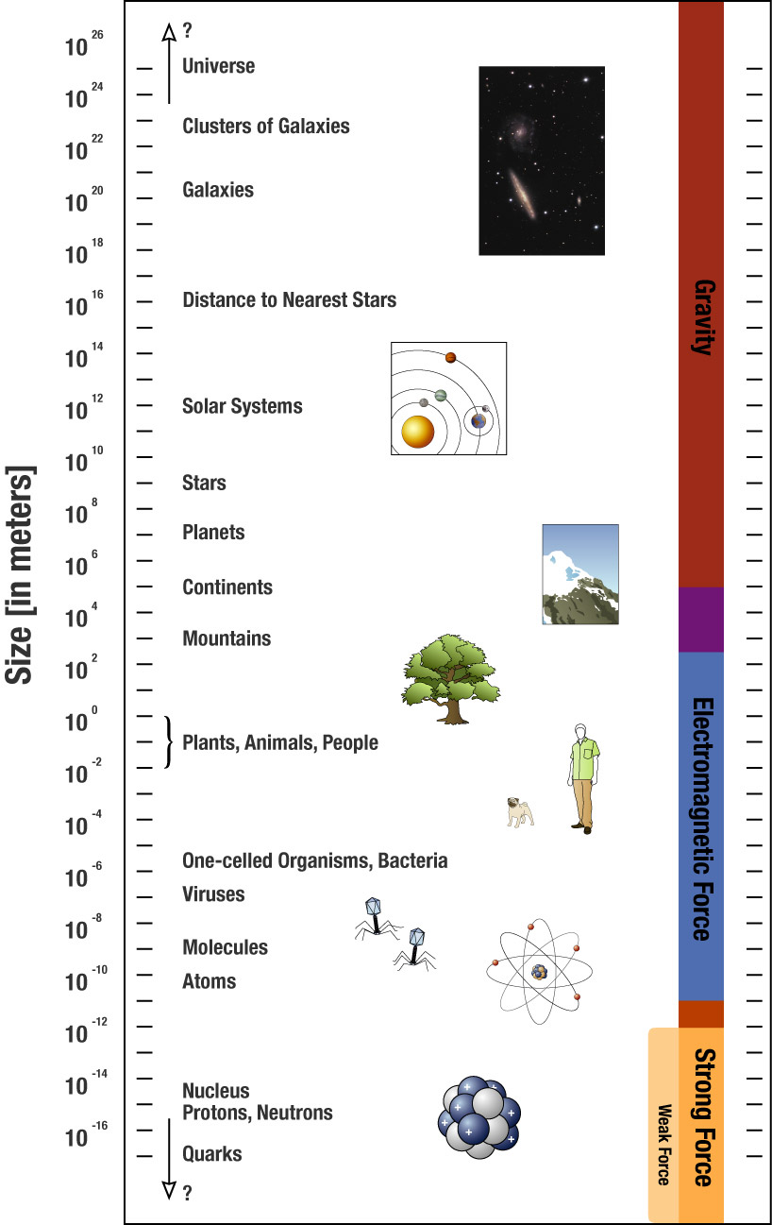
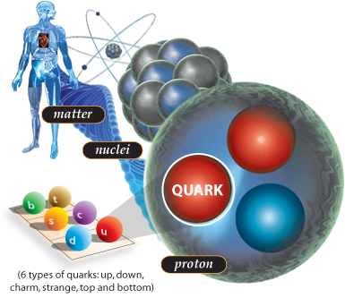
Interaction length scales of forces

Slide 4
Newton’s Laws
First Law
  Every object in a state of rest, or in a state of uniform motion in a straight line with unchanging speed, will stay in that state of rest or of uniform motion, until compelled to do otherwise by forces acting upon it.
Second Law
  Acceleration is proportional to force and inversely proportional to mass.
Third Law
  When interacting, each object exerting a force on the other. The two forces have the same strength, and act in exactly opposite directions.
Explain to your neighbor the difference between force, velocity, and acceleration

Slide 5
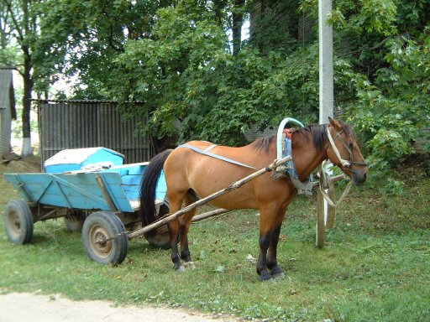
Something to think about: The reluctant horse
“My owner Sir Isaac said that every time I pull on the cart, it pulls back with equal force. If he’s right then I cannot pull the cart.”

Slide 6
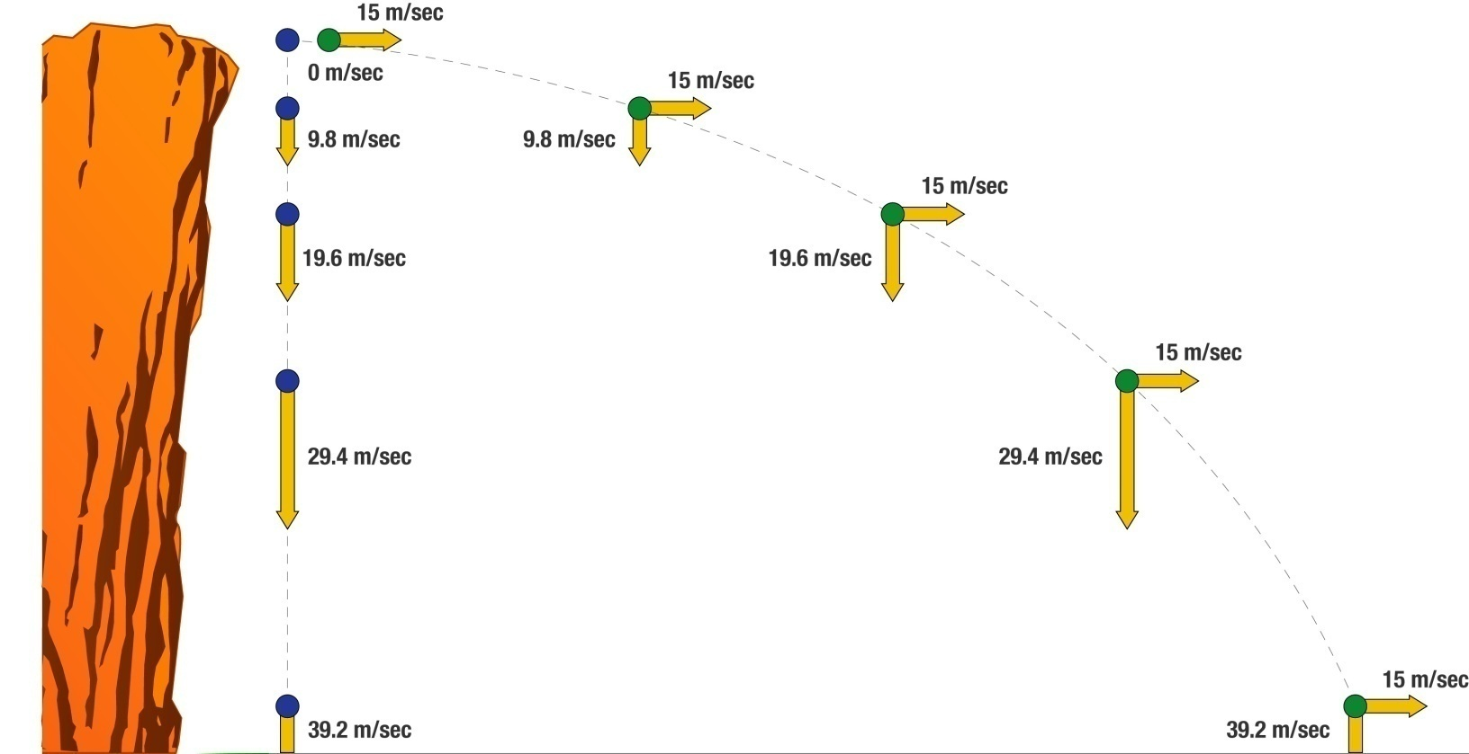
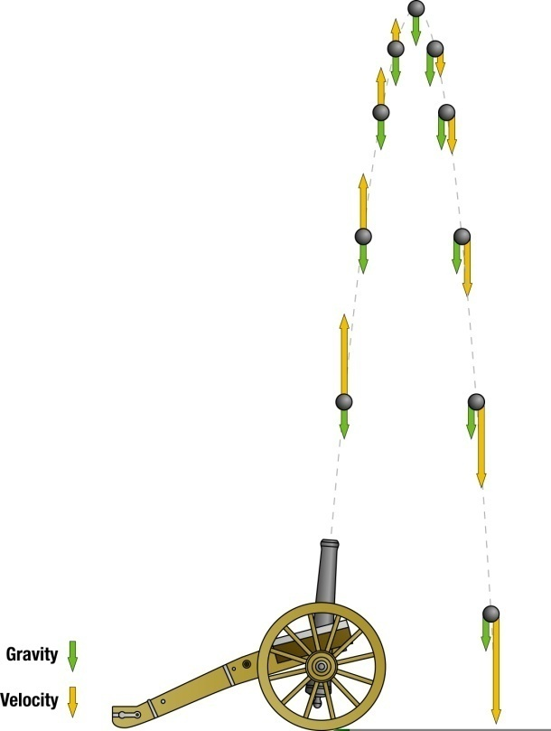
Decomposing “falling” motion into its components

Slide 7

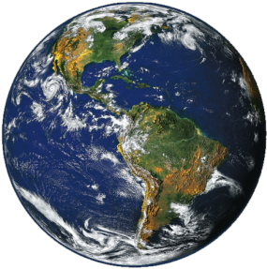
What direction is the moon falling?

Slide 8
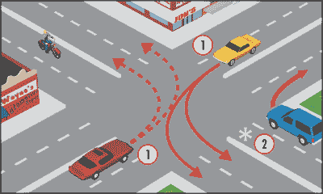
You turn left in a car at a constant speed. The horizontal force on you
Pushes you to the right
Pushes you to the left
Pushes you straight ahead
With what kind of force?
How about contact force?
This is really just many electromagnetic forces?

Slide 9
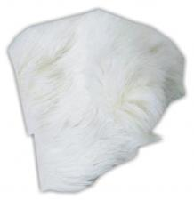
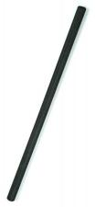
Static electricity discharge conclusion
+
Human hands
Rabbit Fur
Glass
Nylon
Wool
Fur
Silk
Paper
Steel
Wood
Amber
Hard rubber
Nickel, Copper
Brass, Silver ,Gold, Platinum
Polyester ,Styrofoam
Saran Wrap .Scotch Tape
Vinyl
Silicon
Teflon
Materials with weakly bound electrons tend to lose them
tendency to charge positively (lose electrons)
Materials with sparsely filled outer shells tend to gain them
tendency to charge negatively (gain electrons)
-
Notes:
Human hands (usually too moist, though) Very positive
Rabbit Fur
Glass
Human hair
Nylon
Wool
Fur
Lead
Silk
Aluminum
Paper
Cotton
Steel Neutral
Wood
Amber
Hard rubber
Nickel, Copper
Brass, Silver
Gold, Platinum
Polyester
Styrene (Styrofoam)
Saran Wrap
Polyurethane
Polyethylene (like Scotch Tape)
Polypropylene
Vinyl (PVC)
Silicon
Teflon Very negative

Slide 10
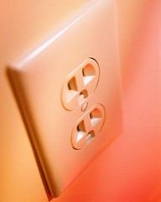
Electric current: Charges in motion
Resistance to flow causes heat or energy loss
DC is one way, AC alternates

Slide 11
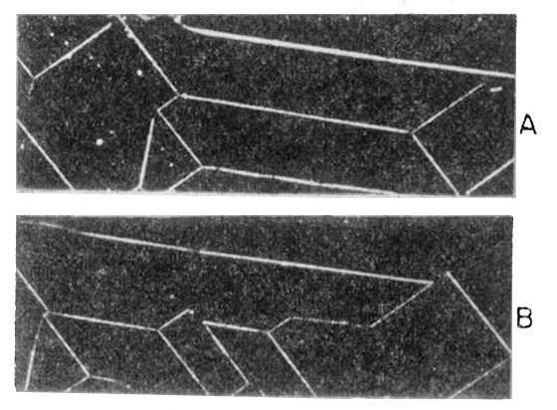
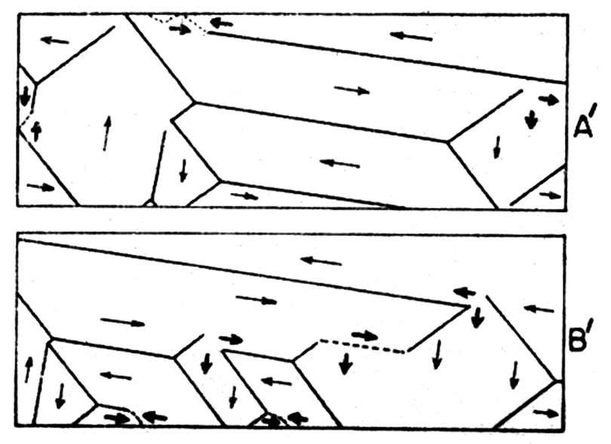
Permanent Magnets
Magnetism arises when the atoms (which act as tiny permanent magnets) align themselves in tiny domains.
Only a few metals can stick to magnets!

Slide 12
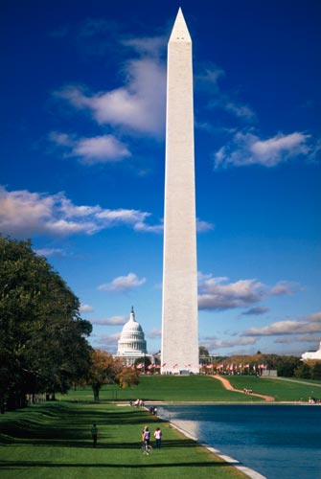


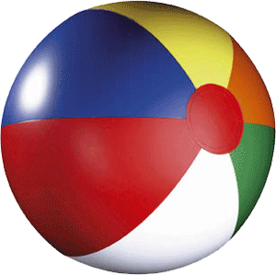

Pressure
Block inside monument
Force
______
Pressure =
Area

Slide 13
The pressure of a fluid increases with depth. How much it increases depends on the fluid density.
We live at the bottom of a fluid
  At sea level, air pressure is about 15 psi
Deep end of the swimming pool
  Water pressure increases about 1 atmosphere every 11 meters.
300 lbs.

Slide 14
Archimedes Principle
It is less dense than the surrounding fluid.
It weighs less than an equal volume of fluid.
The buoyant force is equal to its weight when it is only partially submerged.
It displaces a weight of fluid equal to its weight when it is only partially submerged.

Slide 15
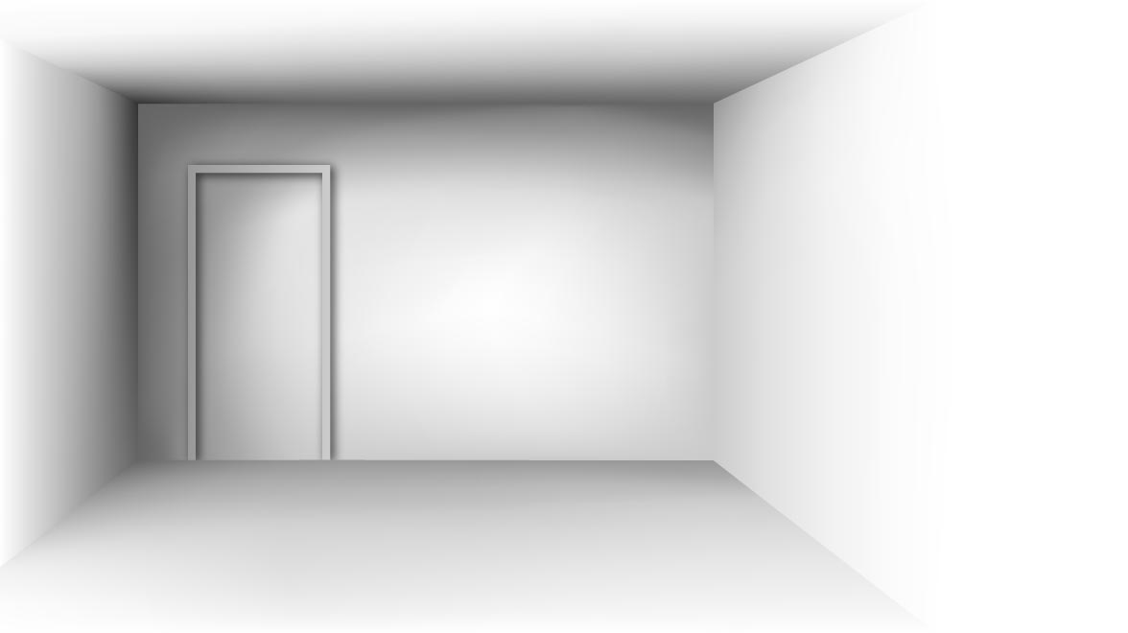
All Motion is relative:
There are two types of reference frames
Inertial reference frames do not accelerate
Non-inertial reference frames accelerate.
Could you tell the difference between two inertial frames?
Could you tell the difference between an inertial frame and a non-inertial frame?

Slide 16
Special Relativity Postulates
The laws of nature are the same for all observers who are in uniform motion.
The speed of light in empty space is the same for all observers regardless of their motion or the motion of the source of light.
"Everything should be made as simple as possible, but not simpler.“ ~Albert Einstein

Slide 17
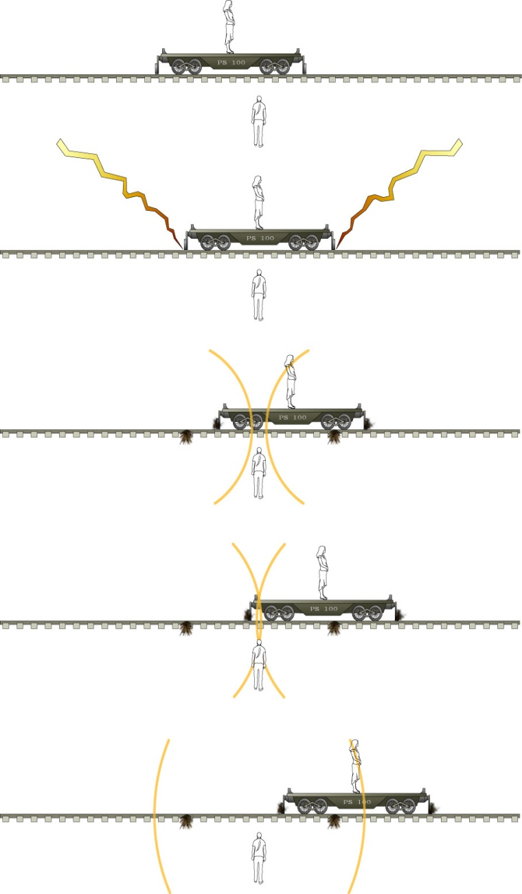
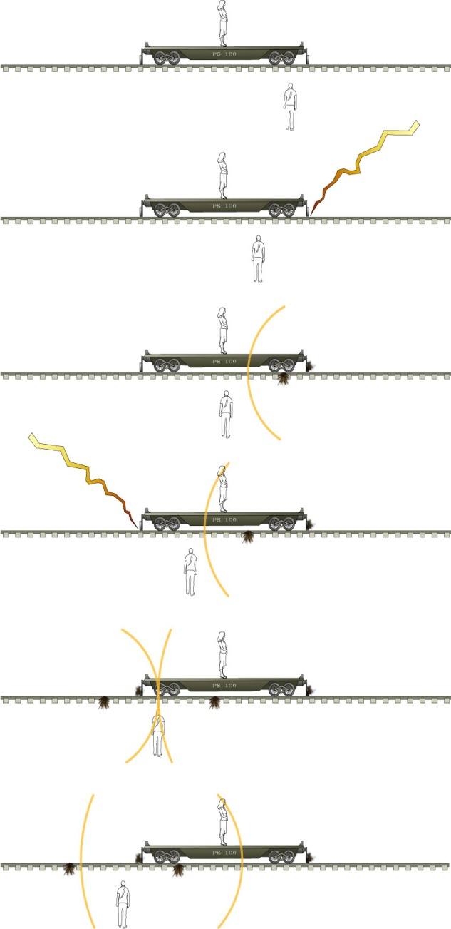
Simultaneity and Length Contraction
Length measurements of moving objects require simultaneous measurement of positions

Slide 18
Conservation Laws
What does it mean to conserve something?
A conserved quantity:
_______ can neither be created or destroyed, but can be changed from one form to another or transferred from one object to another.

Slide 19
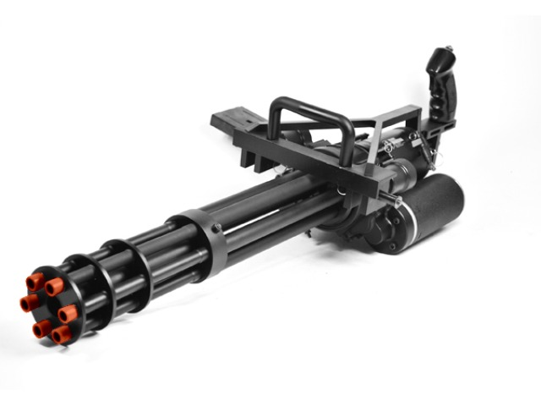
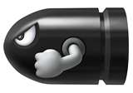
Conservative with Momentum:
Momentum transfer
mv = mv
velocity of bullets
velocity of gun
v
v
m
m
http://www.youtube.com/watch?v=4CfREbZ1V5o

Slide 20
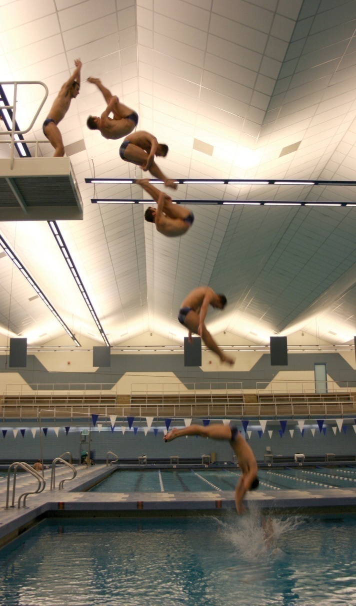
Conservation of angular momentum
Angular momentum is mass x speed x radius
Examples:
  Diver
  Ice skater
  Riding a bike
Iw = Iw
Equal masses but different shapes
50*2 = 4*25
It speeds up!

Slide 21
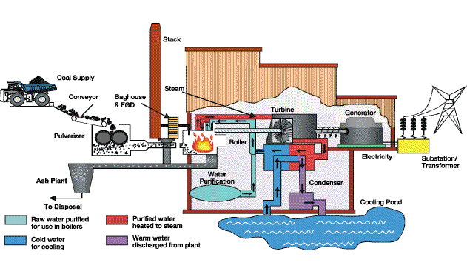
Sometimes it is hard to describe all of the motion in a system, and we want something simpler
We must turn to energy and measure the system in larger divisions

Slide 22
Examples: Forms of energy
Kinetic Energy?
Gravitational Potential Energy?
Electrical Potential Energy?
Internal Energy
  Thermal (internal kinetic)?
  Elastic potential (internal electrical)?
  Chemical Potential (internal electrical)?
Radiant Energy?

Slide 23
Energy Transfer and Transformation
Radiation: energy is transmitted by visible light, infrared radiation, ultraviolet radiation, X-rays, or radio waves. (sun, space heater)
Conduction (Heat Flow ): a process in which internal energy is transferred because of a difference in temperature. (electric stove, soldering iron)
Convection: internal energy is transferred because matter moves from one place to another. (hot air furnace)
Work: energy is transferred or transformed by forces acting on an object. (friction, muscles, electric motor)
Combustion: chemical potential energy is transformed into another form (gasoline engine, dynamite, light stick)

Slide 24
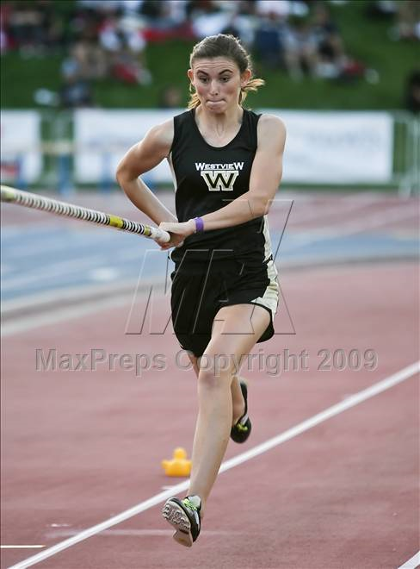
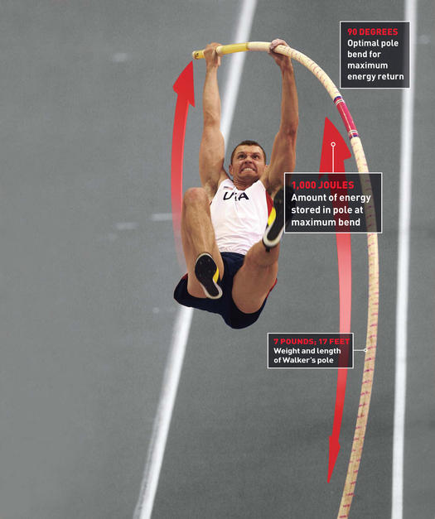
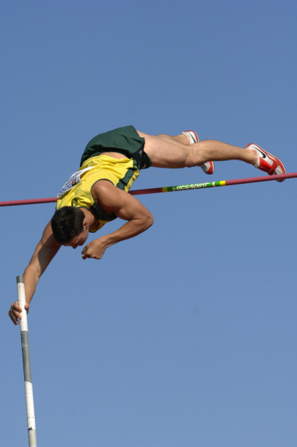
Kinetic
Elastic
Potential
WR 6.15m
Sergei Bubka

Slide 25

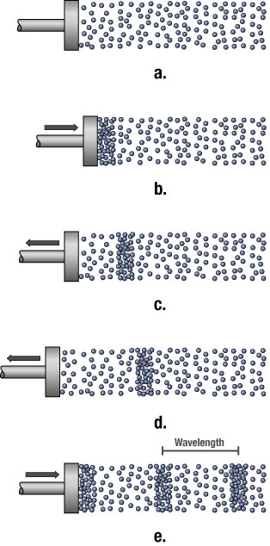



Types of Waves
Surface
Compression
Transverse

Slide 26
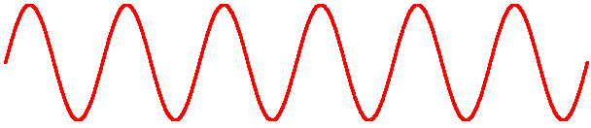
Wave Properties
Wavelength is the distance between two similar parts of the wave
Amplitude is the amount of displacement from the rest position
Frequency is the number of wave crests which pass a point per second.
Speed = frequency × wavelength
Transverse Wave
Compression Wave
Notes:
Radio: 10 feet (FM) to close to a mile (AM)
Light: 10⁻⁶ m (1/1000 mm)

Slide 27
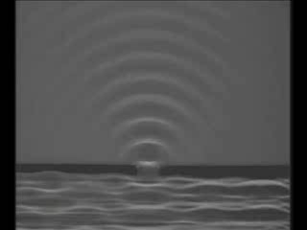
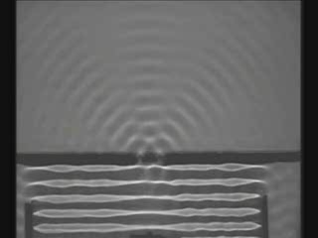
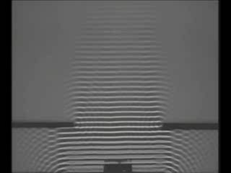
Wave behavior: Diffraction and Interference
The wave fans out when it encounters an obstacle or opening.
The amount of diffraction depends on relationship between wavelength and size of opening:
  most when wavelength is similar to opening
  small when wavelength is much smaller than opening.
When two or more waves meet.
  constructive interference: two crests add together
  destructive interference: crest and trough cancel

Slide 28
Standing waves
Points of the medium that are permanently at rest are called Nodes
Points of the medium that have maximum oscillation are called Anti-Nodes
Only certain frequencies produce standing waves in a given system. These are called resonance frequencies.
The energy of a wave is associated with its frequency.
We can create one dimensional standing waves using a rope:
antinodes
No good. No standing wave will form.
nodes

Slide 29

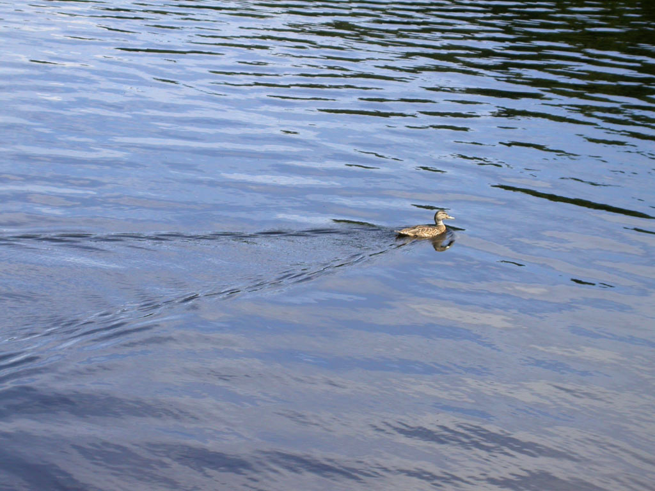
The Doppler Effect
When the source and the observer are in motion relative to one another, the observed frequency can change.
Bonus: If a source is moving faster than the speed of the wave, shock waves form.
Notes:
show video clip #21 with Doppler shift of a train horn
Emphasize: higher frequency if moving towards you, lower frequency if moving away.
Other demonstration--swinging a speaker.

Slide 30
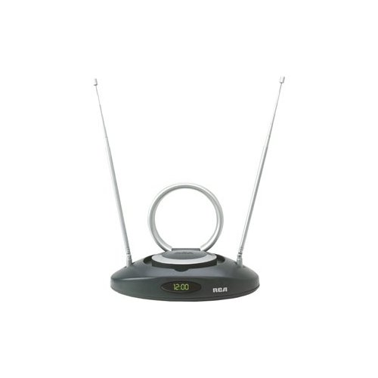
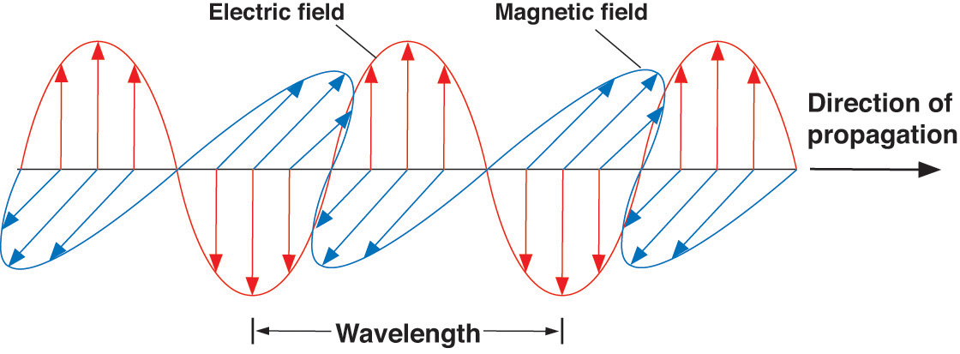
Accelerating Electrons
Electromagnetic radiation is given off whenever electrons accelerate.
It, in turn, causes other electrons to accelerate. (TV, microwave oven)

Slide 31
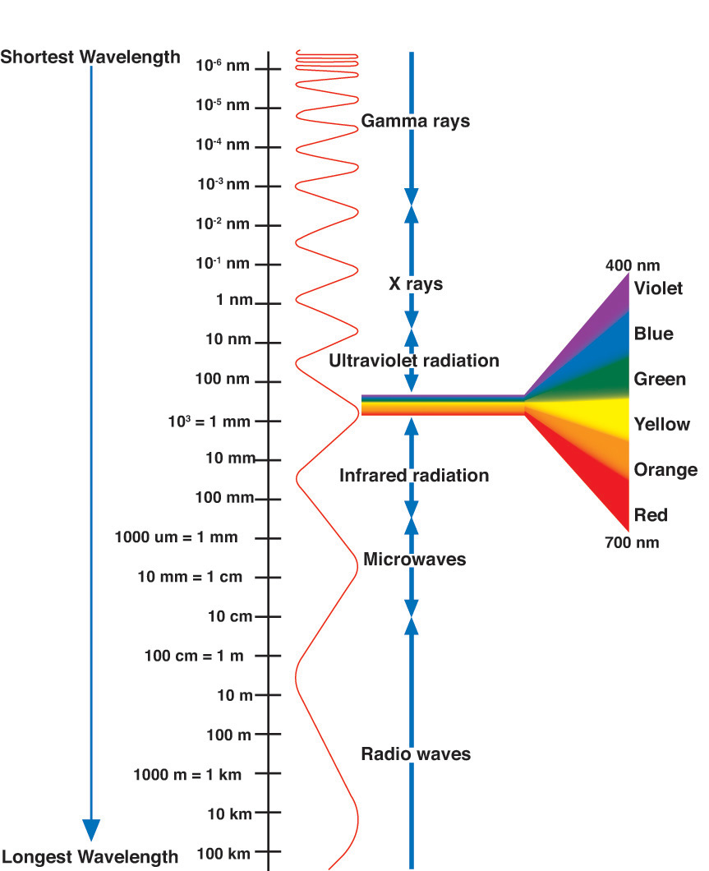
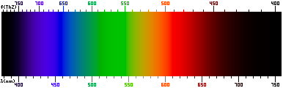
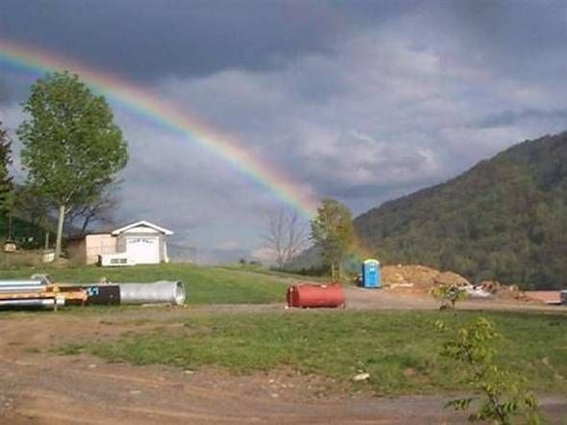
The electromagnetic spectrum
The pot at the end of the rainbow…
Notes:
Finally,
someone has managed to photograph
the pot at the end of the rainbow!!!
Wouldn't you know it!!!!!

Slide 32
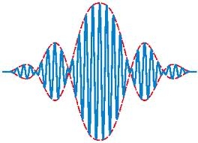
Wave Particle Duality
Light is both a wave and a particle.
  It behaves like a wave when unobserved
    It travels through both slits like a wave
  It is detected like a particle
    It hits the screen as individual dots

Slide 33
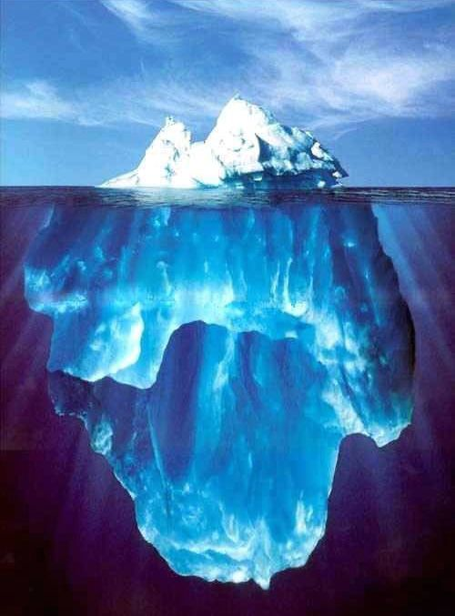
Matter Properties: Density
steel
Styrofoam
Objects normally contract when cooled. What happens to the density? Why?
Water is an exception. It expands as it changes to a solid, so ice is less dense than liquid water
  This is good; Otherwise ice would sink and the planet would freeze over.

Slide 34
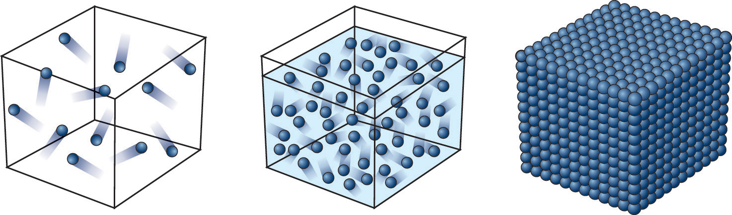
Molecular Model: States
Solid: The molecules are frozen in place but still vibrate.
Liquid: The molecules move past each other but still have a weak attraction.
Gas: The molecules only interact when they collide.
Plasma: The molecules collide with enough energy to break into charged pieces.

Slide 35
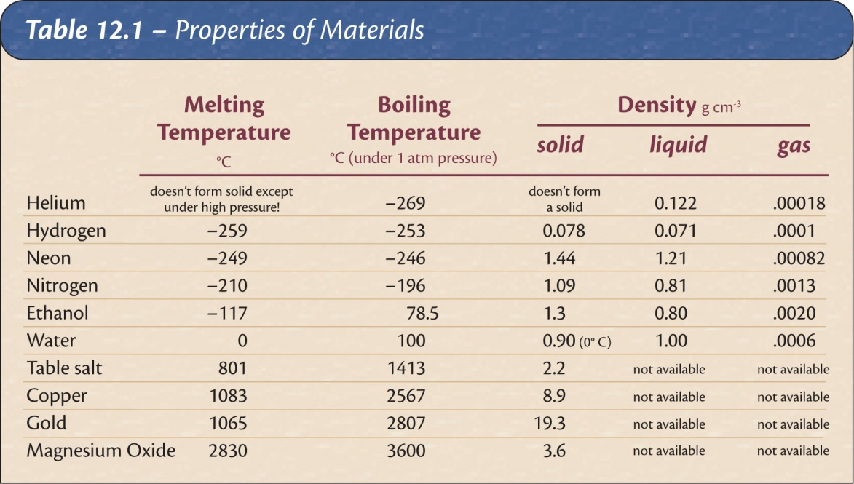
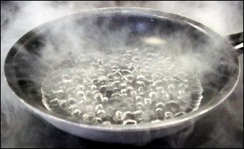
Physical States of Matter
State is a function of temperature and pressure.
Different materials change state at different temperatures.
Balloon in liquid Nitrogen: air phase change

Slide 36
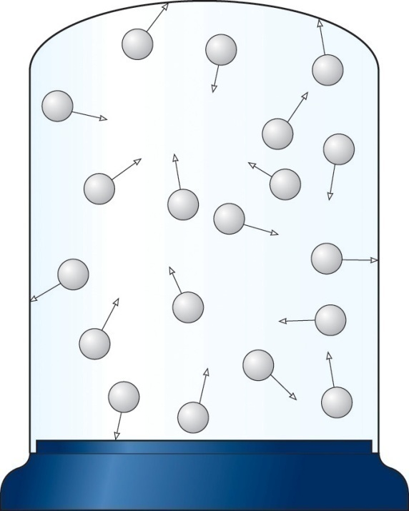
Properties Explained
Temperature is a measure of the average kinetic energy of the molecules.
Evaporation is when the fast molecules escape a gas even when the average temperature is below boiling.
Pressure is caused by molecular collisions with the walls of the container. Like throwing a huge number of balls against a wall.
Notes:
Because the oven doesn't go to 700 degrees.

Slide 37
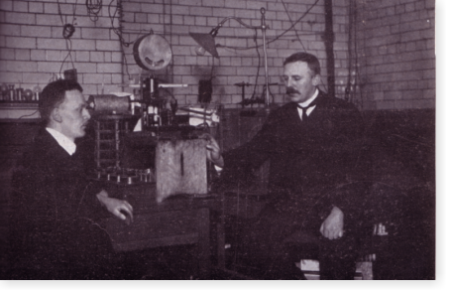
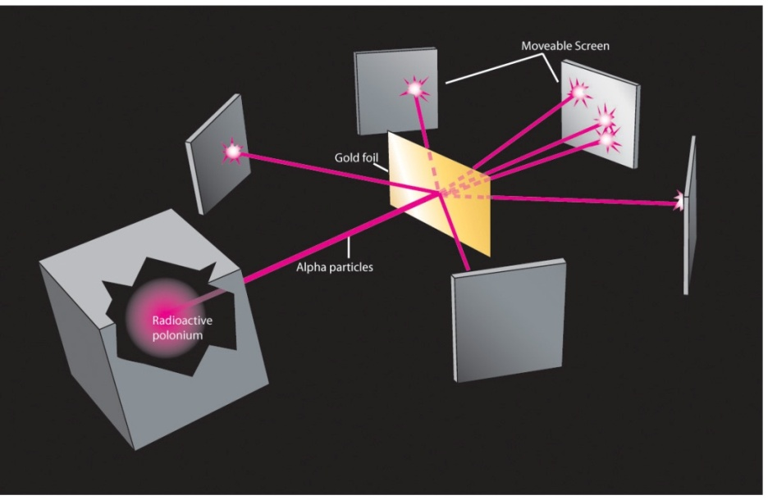
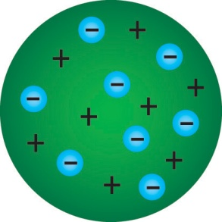
Plum Pudding model
Rutherford, Geiger, and Marsden
A colleague of J. J. Thompson, Ernest Rutherford, set about to find out how dense the positive pudding was by firing newly discovered alpha particles at a thin gold foil.
The idea was to measure how much they deflected as they passed through.
Expectation
Result

Slide 38
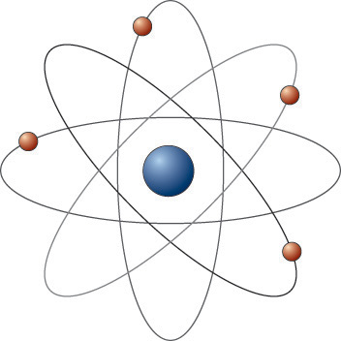
Rutherford proposed replacing it with the “solar system” model. Problems at the start!
  The positive portion is concentrated into a tiny nucleus at the atomic center
  The negative electrons orbit about the nucleus in well-defined paths. The orbital radii define the atomic diameter instead of the positive pudding.
Accelerating (orbiting) electrons should continually radiate, loose energy, and spiral into the nucleus
However if electrons are stationary they would fall into the nucleus too.
There was no fix for this. The model had insurmountable flaws and soon died.

Slide 39
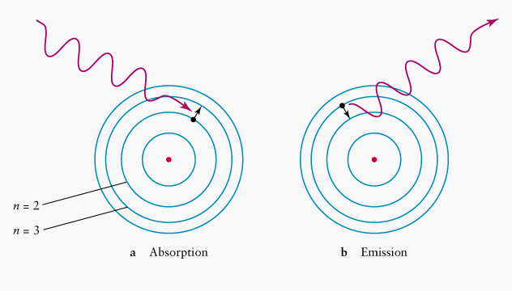
Absorption vs. Emission spectra
Remember each wavelength of light corresponds to photons of a certain energy (We can not emit or absorb partial photons.)
Therefore transitions between orbits correspond to specific wavelengths of light. Light has wavelengths of 400nm to 700nm. Which end of this range would red be?
Absorption
Emission

Slide 40
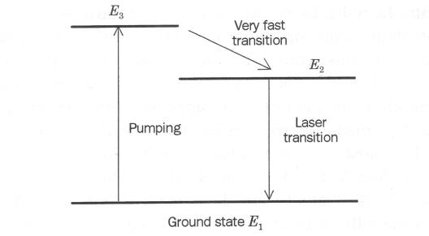
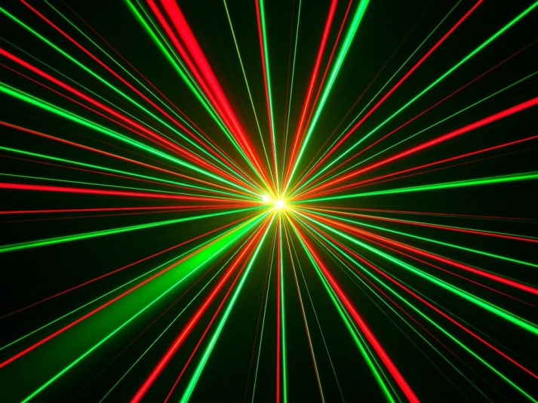
An “Energy Level Diagrams”
A
B
A-B transition emits light
Rydberg Formula
f = C[ (1/n₁)² – (1/n₂)² ]
Hydrogen

Slide 41
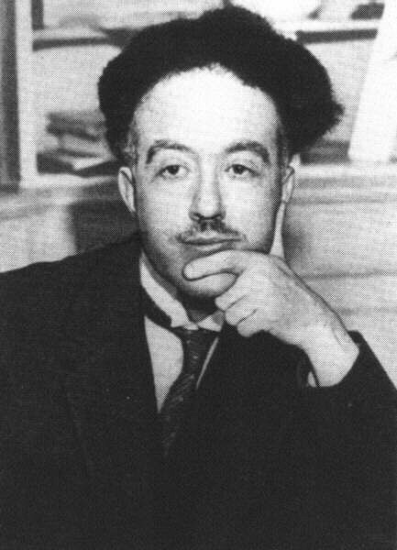
The de Broglie Hypothesis
In 1923 a graduate student named Louis de Broglie proposed a radical idea about matter: In addition to light, matter should also exhibit a wave-particle duality.
A particle of mass should have a wavelength defined by:
wavelength = h / (mass × speed)
where h = Plank’s constant = 6 x 10⁻³⁴

Slide 42
Why don’t we observe the wave nature of matter?
To observe wave effects, your “slits” need to be similar to the wavelength
wavelength = h / (mass×speed)
h = 6 x 10⁻³⁴
Example: It would take 10²⁷ years for a student to “diffract” through a doorway.
For all material objects except the very least massive (such as electrons and protons), the wavelength is so immeasurably small that it can be completely ignored.

Slide 43
The results depend on how and what we measure.
Don’t measure which hole the electron goes through → wave-like behavior.
Do measure which hole the electron goes through → particle-like behavior.
How the electron behaves depends on whether it is observed.

Slide 44

The Uncertainty Principle and waves
To find the trajectory of a particle we must know its position and velocity at the same time.
How do you locate the position of a wave/particle electron?
A well-defined momentum has a well-defined wavelength according to De Broglie.
  wavelength = h / momentum
Pure sine wave →
unclear position but clear wavelength (momentum).
Sharp pulse →
clear position but unclear wavelength (momentum).

Slide 45






Standing wave modes in two dimensions
Notes:
http://rt210.sl.psu.edu/phys_anim/waves/indexer_waves.html

Slide 46


Orbitals are three dimensional standing probability waves (found by solving the Shrödinger Wave equation )
1s orbital
An f orbital
d orbitals

Slide 47


The Pauli Exclusion Principle
No more than two electrons can occupy the same orbital (in a given shell).
If two electrons are in the same orbital, they must have different spins.

Slide 48

The second law of Thermodynamics
Changes occurring in natural systems always proceed in such a way that the total amount of “disorder” in the universe either is unchanged or increased. If total “disorder” is increased, the process is irreversible.

Slide 49
So what does it mean to increase entropy?
Increasing disorder (entropy)
  An increase in random motion.
  A greater physical mixing of types.
  A reduction of temperature differences.
  Conversion of energy to a lower order
Distinct Temperature Regions
Heat Flow
Heat Death

Slide 50

Chemical Bonds
The constituent atoms in molecules are held together by “bonds”. A bond is usually a pair of electrons.
  Strong Bonds: Metallic, Ionic, Covalent
  Weak Bonds: van der Waals, Hydrogen
The quantum model explains them all

Slide 51


Deducing molecular structure with a mass spectrometer
Mass Spectroscopy
Masses of molecular
fragments
C₉O₄H₈
Aspirin
Parent peak:
Mass of the molecule
180 amu

Slide 52

IR spectroscopy can be used to deduce chemical formulas and structures
IR Vibrational Spectroscopy
fingerprint region
C₉O₄H₈
Aspirin
C=O
Different molecular groups vibrate in different regions
Energy of vibration

Slide 53


Reactions Go at
Different Speeds
Cellulose + O₂ → CO₂ + H₂O
  Dead tree in forest
  Wood in fire
  Sawdust in explosion
Why?
2 C₇H₅N₃O₆ → 3 N₂ + 5 H₂O + 7 CO + 7 C

Slide 54
Reactions are more likely to occur if
There are more collisions between atoms and the collisions are more vigorous
Increase the concentration of atoms
  Increase the pressure
  Increase the temperature
2. The energy of the system will decrease
3. The entropy of the system will increase

Slide 55

Basic Categories
The elements divide nicely into two categories, metals and nonmetals.
Nonmetals
Nonmetals
Metals
Metals

Slide 56

Semiconductors have Energy Band Split in Two. There are no orbitals with the energies in the gap
METALS
High melting temperatures
Electrical conductivity
Malleability
Thermal conductivity
Opaque
Luster
SEMI-CONDUCTORS
Band Gap
BAND
BAND
BAND
Band filled – no electrical conductivity possible
at low temperatures

Slide 57


Metals vs Non-Metals
Metals
  Large atoms
  Few valence electrons
  Low ionization energies
Non-metals
  Small atoms
  Many valence electrons
  High ionization energies
Why do metals and non-metals react?
Principles of reactivity:
materials react to lower energy and increase entropy of universe

Slide 58
Chemistry Categories
Organic
Hydrocarbons – Chains(petroleum products) and Rings(benzene)
Steroids – Interlocking Carbon Rings(vitamin D, bile salts, cholesterol)
Carbohydrates – Saccharides(glucose, sucrose, lactose, starch, cellulose, glycogen)
Proteins – Amino acids assembled into polypeptides into rich structures
Nucleic Acids – Long Polymers involved in heredity and creation of proteins made from nucleotides.
Lipids – Hydrophobic molecules with H:O ratio greater than 2:1. Combination of Glycerol and Fatty Acids.
Inorganic
Salts
Minerals
Examples:
Iron Oxide FeO
Aluminum Oxide AlO
Carbon Monoxide CO
Carbon Dioxide CO₂
Carbonates CO₃
Carbides C
Cyanides CN
Silicates SiO₄

Slide 59



What causes plaque in the arteries?
Differences in the Tails
Saturated fatty acids
No kinks
Unsaturated fatty acids
One kink (mono)
More than 1 kink (poly)
each C has 2 H atoms
C▬ C ▬ C ▬ C
(carbon-carbon single bonds)
Some C have only 1 H atom
C▬ C = C ▬ C
(carbon-carbon double bonds)
Kinks occur at double bonds.
(True of Unsaturated Fatty Acids that are found in Nature.)

Slide 60






Formation of Silicate Ions in minerals
Mica
Asbestos
Quartz

Slide 61

Considering Carbon Dating
Carbon-14 does not decay into Carbon-12
Carbon-14 decays into Nitrogen-14 and an electron
However! The ratio of C-14 to C-12 approaches that of the atmosphere
Can Carbon-14 can decay into Carbon-12?
C-14
e
+
e
p
p

Slide 62

Fusion
Combining two small nuclei to make a larger one gives off energy.
Abundant fuel (in sea water) and large energy gain make this a very exciting possibility.
The catch: Because nuclei are positively charged, you need either extremely hot reactants or large confining forces.
  What forces do you have available for confinement?

Slide 63

Fission
Breaking one extremely large nucleus into two smaller ones gives off energy.
Free neutrons from one fission can trigger another fission, creating a chain reaction.
This reaction is easy to control simply by changing the number of neutrons that are absorbed by inert atoms.
This reaction produces isotopes not normally found in nature.

Slide 64
Radioactive decay
Alpha decay – A nucleus emits 2 protons and 2 neutrons (a helium nucleus).
Beta decay – A proton changes into a neutron or vice versa
Gamma decay – Protons or neutrons shift energy levels and emit a high-energy photon.

Slide 65
Half Life
The half life is the time it takes half a sample of radioactive nuclei to decay
Importance examples
  ¹⁴C --> ¹⁴N + e + neutrino (half life of 5730 years)
  ⁴⁰K + e --> ⁴⁰Ar + neutrino (half life of 1.3 billion years)
Applicable only to matter which was once living and presumed to be in equilibrium with the atmosphere, taking in carbon dioxide from the air for photosynthesis.
Carbon-14 decays with a halflife of about 5730 years by the emission of an electron of energy 0.016 MeV. This changes the atomic number of the nucleus to 7, producing a nucleus of nitrogen-14. At equilibrium with the atmosphere, a gram of carbon shows an activity of about 15 decays per minute.

